Slide 1
Tech for the Environment: Teacher notes
Before delivering Tech for Environment please make sure you have:
Downloaded and read the Tech for the Environment plan.
Decided how you would like the students to present their group research.
If you are using tablets, you may find it easier to pre-load the Instant Wild App onto them OR you can use the desktop version.
Resources needed for Tech for Environment:
Access to the internet either through the tablets or laptops / desktops – individually or small groups for research.
Large paper and stationery for group presentations.
Printouts of Smart Home Connectivity worksheets.
Printouts of homework sheets.

Slide 2
Share homework
Tech We Can | Tech for Environment

Slide 3
The Environment
TECH FOR
To understand how technology is used for the environment and broaden my knowledge of careers available in this field
© Tech She Can 2022

Slide 4
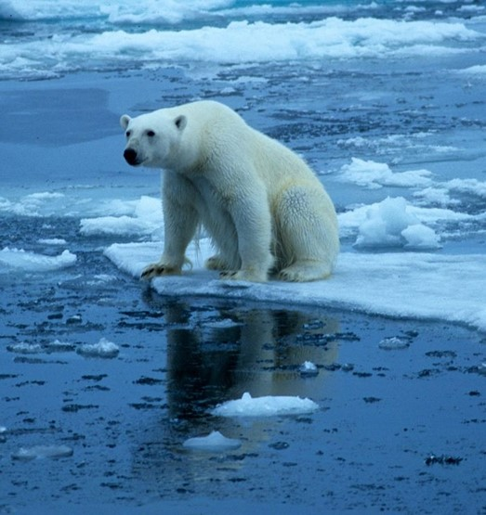
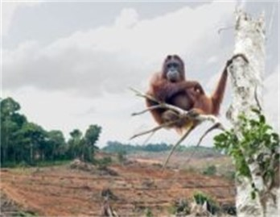
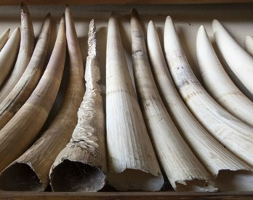
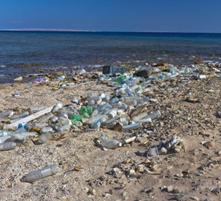
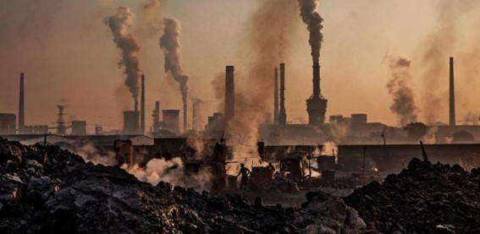
What issues are animals and the environment facing in the world today?

Slide 5
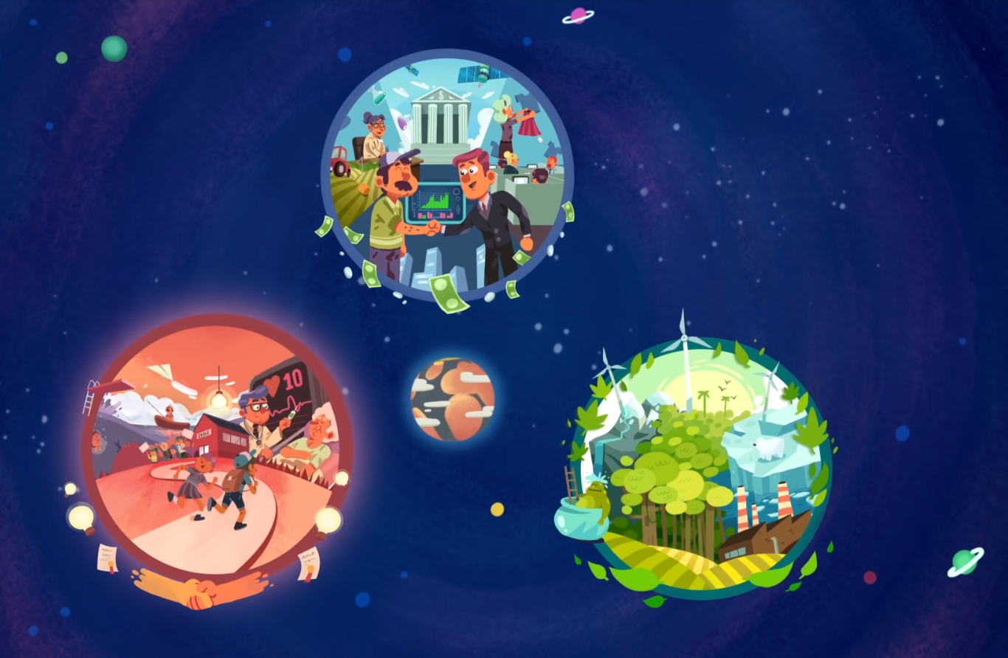
What does sustainability mean?
VIDEO SCREENSHOT
Watch video
Tech We Can | Tech for Environment

Slide 6
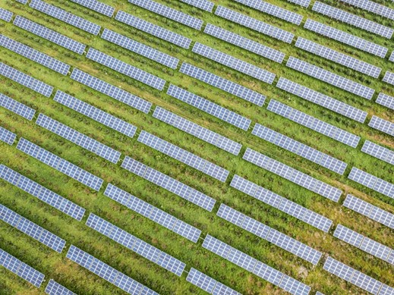
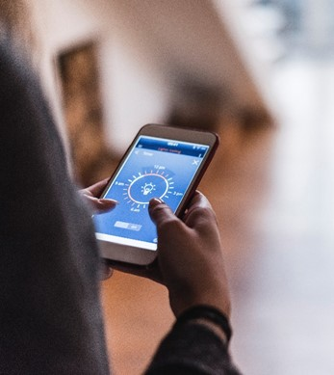
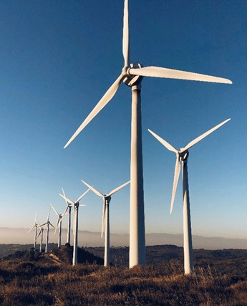
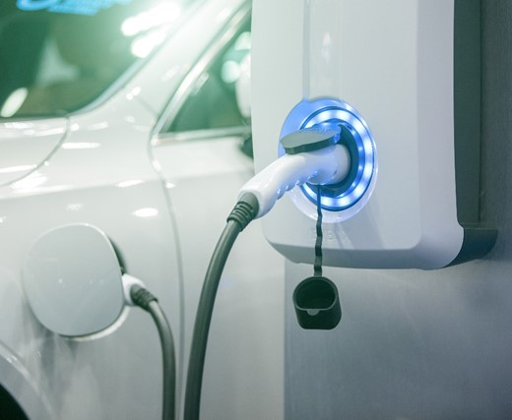
How is tech used for the environment?
Do you know of ways in which technology is used to preserve and protect the environment?

Slide 7
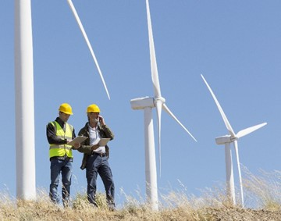
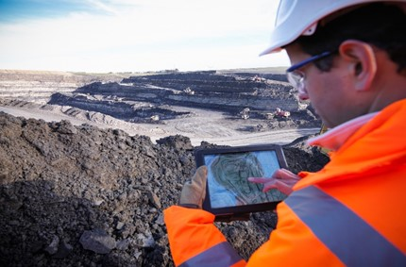
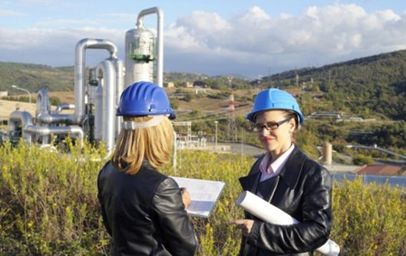
Careers in Tech for the Environment
Energy Engineer
Ecologist
Environmental Engineer
As an energy engineer, you'll need to design, develop and build renewable energy technologies.
Ecologists are specialist scientists who survey ecosystems and assess the diversity, quantity and behaviour of the different animals and plants within them. They develop and use a variety of technology to help them with their roles.
Environmental Engineers use the principles of engineering, soil science, biology, and chemistry to develop solutions to environmental problems. They work to improve recycling, waste disposal, public health, and water and air pollution control.

Slide 8
Meet today’s role model
Frankie
Sustainability Consultant
Watch video
Tech We Can | Tech for Environment

Slide 9
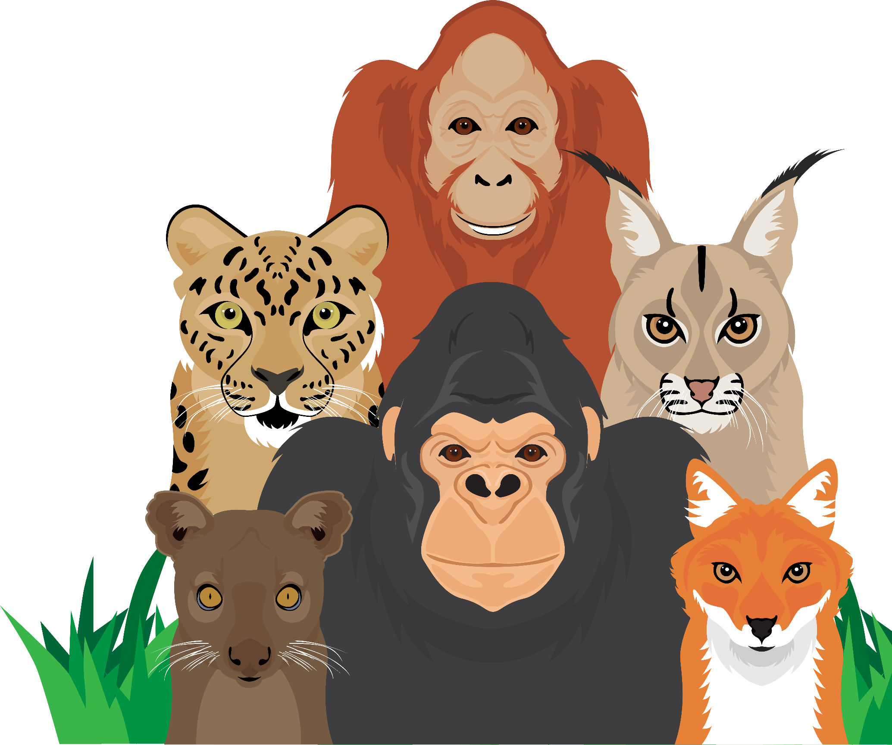
Endangered animals
What does the word ‘endangered’ mean?
Why do we need to protect endangered animals?
How do humans affect animals’ habitats?

Slide 10
Your task
There are many ways technology is helping to monitor and protect animals. In your groups, find the answer to one of these questions and prepare a presentation to share with your classmates.
Why do scientists study penguin poo from space?
How are text messages helping to save elephants?
How are drones used to help monitor endangered animals?
What are smart collars and how are they used to protect and monitor endangered / vulnerable animals?
What are SMART hooks and how are they helping to protect sharks?
What is Project AWARE and how is it helping protect the ocean environment and sea life?

Slide 11
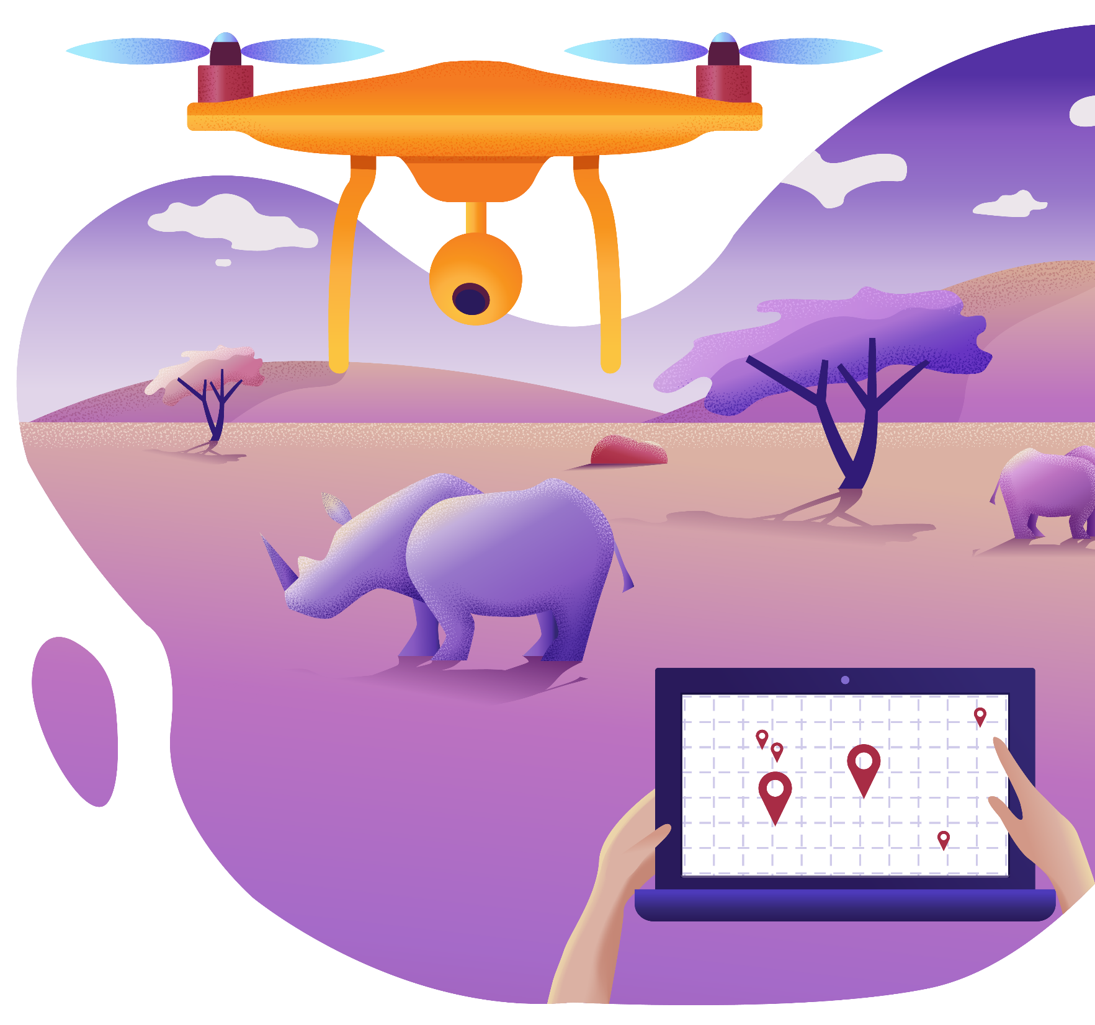
Time to share your research
Would any of you be interested in working with technology like this?
Would any of you like to design technology to help monitor and protect animals?

Slide 12
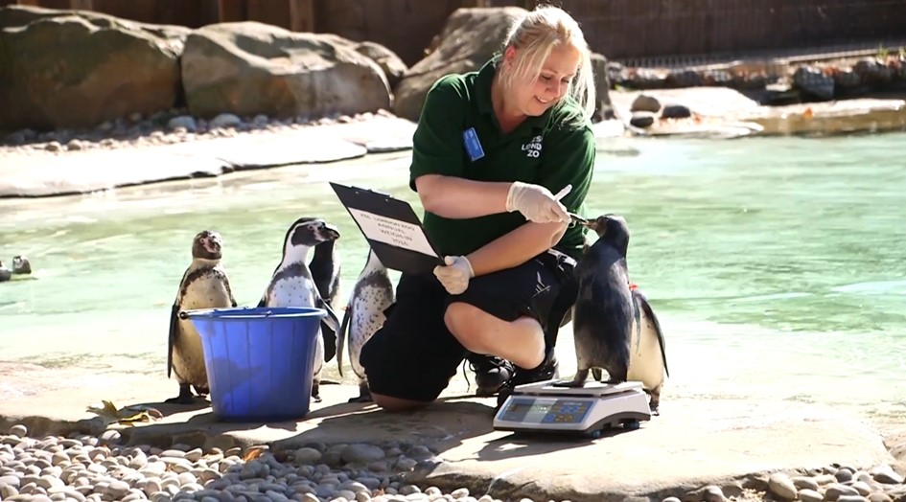
How is technology changing the world of work?
How is technology transforming the care of wildlife?
How does a Zoo Veterinarian use technology?
Do any of you want a career as a vet? If so, you will more than likely have a job using a variety of technology. Would any of you like to design technology to be used in animal healthcare?
Watch video
Tech We Can | Tech for Environment

Slide 13
Instant Wild App
Open the Instant Wild App OR Desktop Version https://instantwild.zsl.org/intro
Click on ‘Start tagging’
Click on ‘Continue as guest’
Complete the tutorial if you would like to or begin tagging some animals by clicking on the images and trying to identify the species captured by the camera
You can look at the live images which can be a little trickier or click on ‘Most Liked’/‘Most Talked About’ for some slightly easier pictures to tag.
How do apps like this help animal conservation?
Would any of you like a career designing and creating apps like this?

Slide 14
How can Smart Home technology help the environment?
What does living in a ‘smart home’ mean?
Do you know the name of any smart home devices?
Do you have any in your own homes?
Watch video
Tech We Can | Tech for Environment

Slide 15
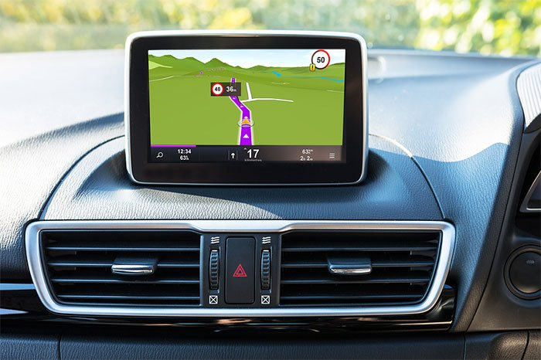
Your task
Smart home: A home equipped with lighting, heating, and electronic devices that can be controlled remotely by a smartphone or computer
Having a smart home could actually benefit the environment, if the products are used in a certain way.
Complete the ‘Smart Home Connectivity Worksheet’ by thinking of ways in which you could connect devices in the home to help save energy / have a positive impact on the environment.
Draw a line between the two products and use an ‘IF THIS THEN THAT’ statement to explain how the two devices could be connected.
IF I programme my car sat nav to home THEN the heating comes on to time itself with my arrival.
(This avoids heating being left on to ensure the house is warm when I get home therefore saving energy).

Slide 16
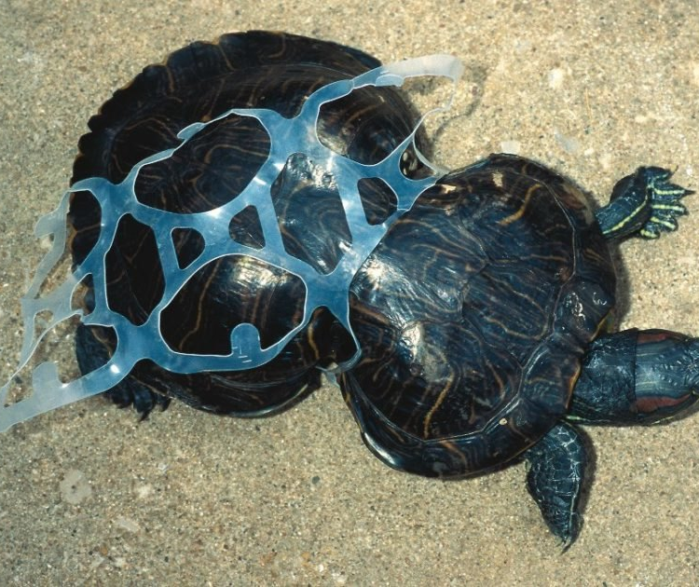
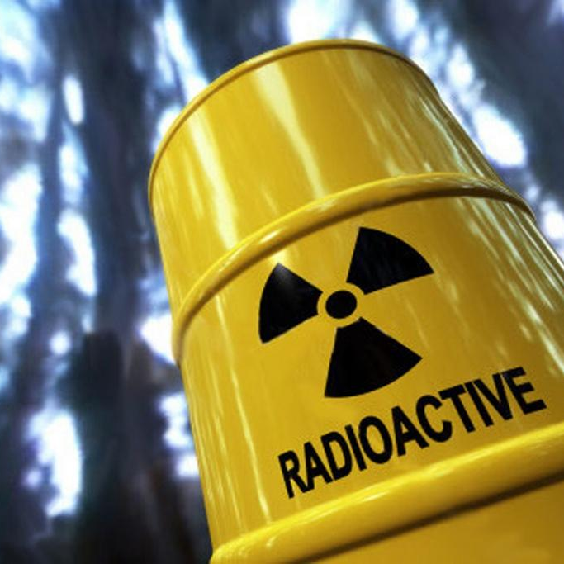
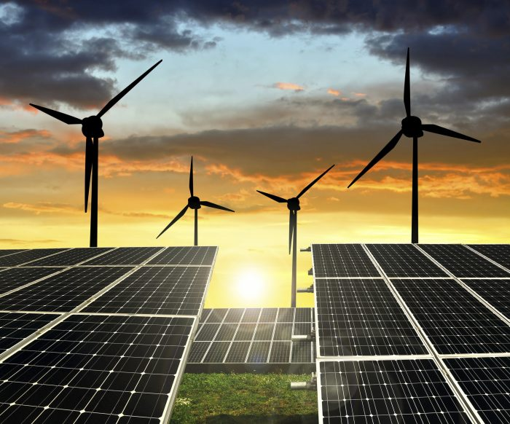
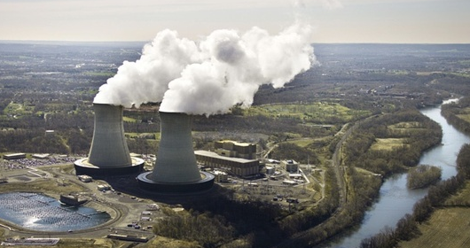
Class discussion
Creation of plastic products
Recycling
Advancements in technology have both positively and negatively affected the environment. It is important that we continue to develop, invent and create technology to have a positive environmental impact.
We can try to design and create technology to fix some of the damage caused and create a sustainable future for our planet.
Nuclear waste
Renewable energy
Large scale production of products in factories

Slide 17
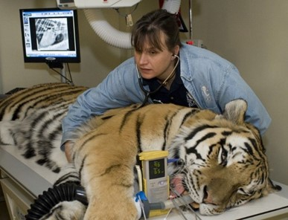
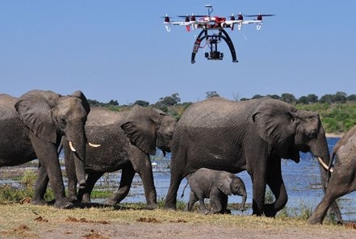
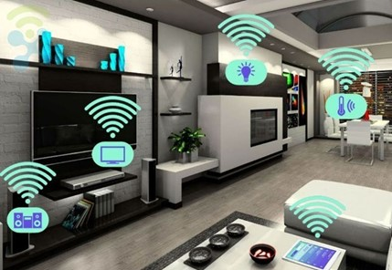
Class discussion
Can you see yourself working in any Tech for the Environment careers?
Did anything particularly interest you today?

Slide 18
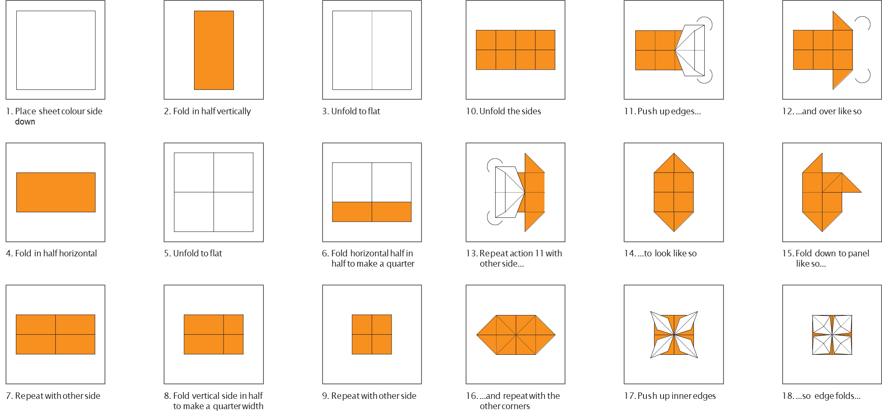
Homework
With the support of an adult at home, follow the written instructions to create a paper origami drone.
On the drone, research and record at least 2 ways drones are being used to help the environment.
If you would prefer to, then you could research how drones are used to help the environment and record your research in a different way.

