Slide 1
Computer systems and system software
Computer systems
Notes:
Resources are updated regularly — the latest version is available at: ncce.io/tcc.
This resource is licensed under the Open Government Licence, version 3. For more information on this licence, see ncce.io/ogl.

Slide 2
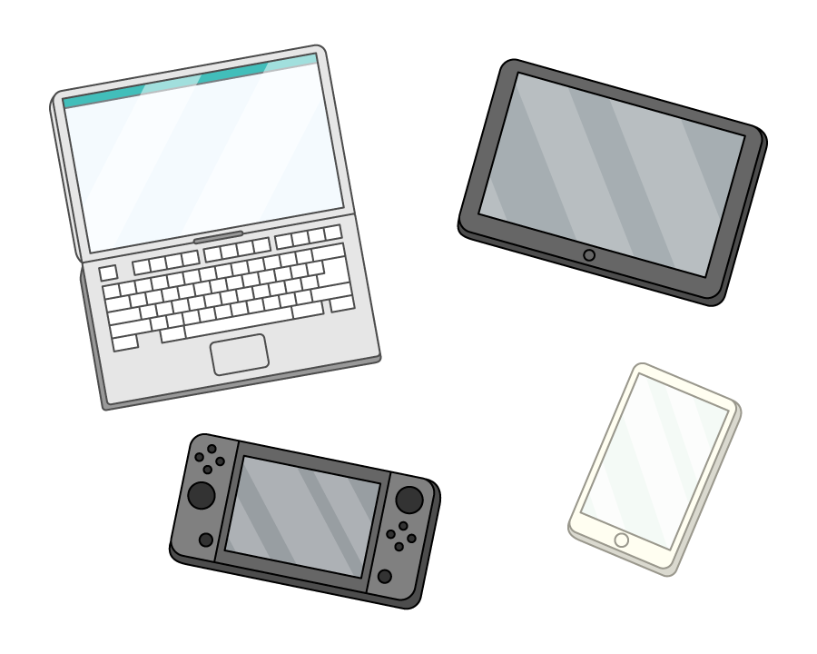
What makes a computer?
Starter activity
What characteristics does a device need to have to be considered a computer?
Discuss with the person next to you.

Slide 3
What makes a computer?
Starter activity
Which of these devices are computers? Do they have the characteristics you discussed?
Mobile phone
Video game console
A tablet
Calculator
Smart watch
Laser pointer
Coffee machine

Slide 4
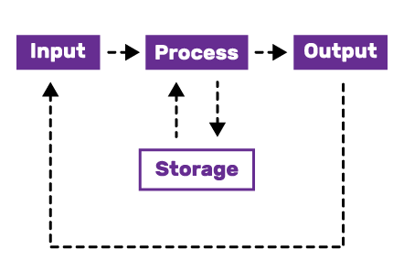
What is a computer?
Starter activity
A programmable device that takes in data, processes it into useful information, and then outputs the information so it can be used.
This is often described in the computing cycle you can see on the right.

Slide 5
Lesson 1: Computer systems and system software
Objectives
In this lesson, you will:
Define an embedded system
Compare embedded and general purpose computer systems
Describe the role of system software as part of a computer system

Slide 6
Embedded Systems
Introduction to Embedded Systems (youtube.com)

Slide 7
Spot the embedded systems
Activity 1
Both a mobile phone and a coffee maker are computers, but they are very different devices.
Computer systems can be categorised as either:
General purpose
Embedded systems
How would you categorise the mobile phone and coffee maker?

Slide 8
Spot the embedded systems
Activity 1
Mobile phone: General purpose
Coffee maker: Embedded system

Slide 9
Spot the embedded systems
Activity 1
General purpose computers are devices that have a variety of uses, the user chooses the task for the computer to complete.
Embedded systems are more specialised, they can only do a limited number of things, but they do them very well.

Slide 10
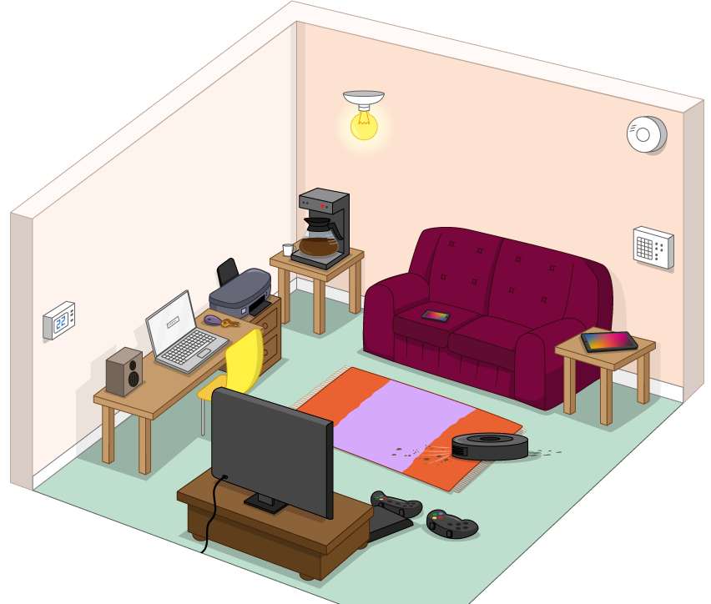
Spot the embedded systems
Activity 1
Inside this room there are lots of computers. Some of them are general purpose and others are embedded systems.
On your own, sort them into two lists.
Embedded
General purpose

Slide 11
Spot the embedded systems
Activity 1
General purpose:
Used for many different types of tasks
Lots of resources — memory, storage, CPU cores
Most tasks require a user
Embedded systems:
?
?
?

Slide 12
Spot the embedded systems
Activity 1
Embedded systems
Coffee machine
Vacuum robot
Thermostat
Security system
Bluetooth speaker
…?

Slide 13
Spot the embedded systems
Activity 1
General purpose:
Used for many different types of tasks
Lots of resources — memory, storage, CPU cores
Most uses require a user
Embedded systems:
Specialised to a specific task/set of tasks
Limited resources
Often function without a user

Slide 14
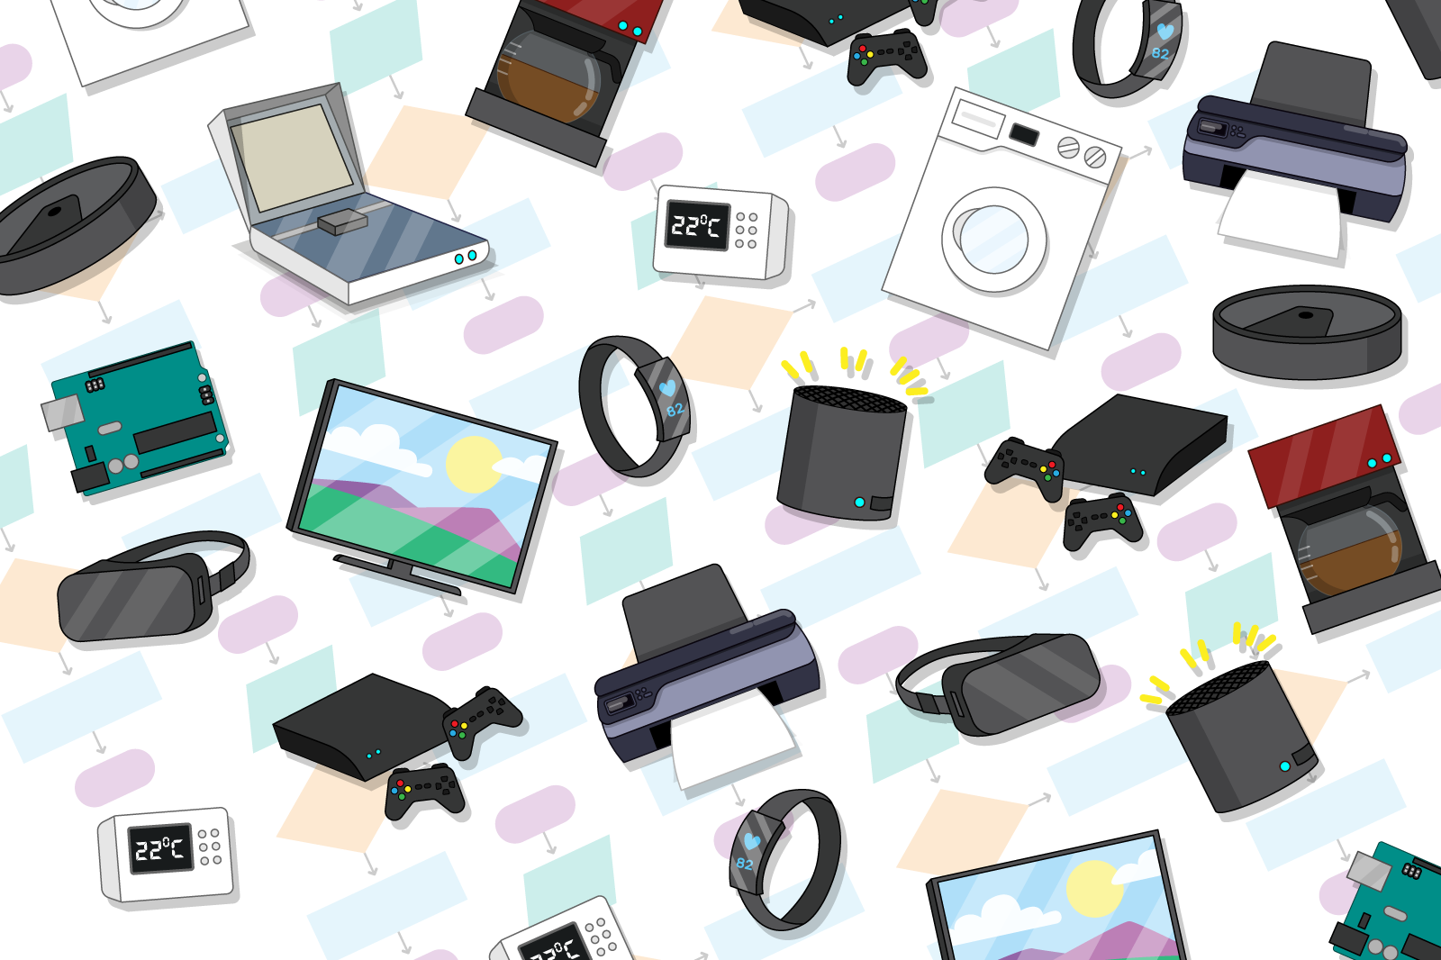
Embedded systems in the classroom
Activity 2
What computers and devices can you spot in the classroom?
Can you find any embedded systems?

Slide 15
TASK
Create a Powerpoint Presentation that contains the following:
5 types of embedded system
Each one must have an image and a description of their use

