Slide 1
WJEC LEVEL 1/2 VOCATIONAL AWARD ICT (TECHNICAL AWARD)
Unit 1: ICT in Society
Topic: IT12: Artificial intelligence
Name:
Assessment criteria:
Criteria | Emerging | Developing | Secured | Mastered
Understand how AI (Artificial Intelligence) technology improves efficiency/productivity for businesses and/or individual users.
Interim feedback:
Final feedback:
©SIMPLY TEACH 2023 | www.mysimplyteach.co.uk | info@mysimplyteach.co.uk

Slide 2
WJEC LEVEL 1/2 VOCATIONAL AWARD ICT (TECHNICAL AWARD)
Task 1: Branches of AI
Activity
Identify these branches of AI based on the descriptions shown below.
A system that closely tries to mimic how the human brain works.
A system that to automatically learn and improve from experience without being explicitly programmed.
Made up of interconnected units that processes information by responding to external inputs, relaying information between each unit.
©SIMPLY TEACH 2023 | www.mysimplyteach.co.uk | info@mysimplyteach.co.uk

Slide 3
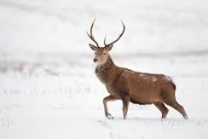
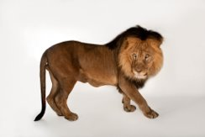
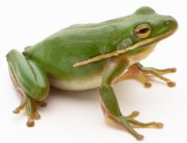
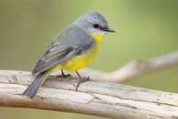
WJEC LEVEL 1/2 VOCATIONAL AWARD ICT (TECHNICAL AWARD)
Task 2: Machine learning
Activity:
A computer has been provided with some training data so it can learn how to identify mammals. Using the images below. Identify whether each image meets the criteria of a mammal.
Two eyes | Y
Nose
Four legs
Fur
Tail
Ears
Two eyes
Nose
Four legs
Fur
Tail
Ears
Two eyes
Nose
Four legs
Fur
Tail
Ears
Two eyes
Nose
Four legs
Fur
Tail
Ears
©SIMPLY TEACH 2023 | www.mysimplyteach.co.uk | info@mysimplyteach.co.uk

Slide 4
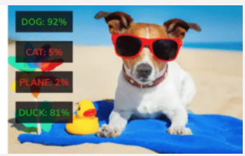
WJEC LEVEL 1/2 VOCATIONAL AWARD ICT (TECHNICAL AWARD)
Task 3: Image recognition
Activity A:
AI uses classification and tagging for image recognition.
Matchup each description to the correct key term (Yellow cards)
Then match up the examples to the correct key term (Orange cards)
Classification
Tagging
Detection
Segmentation
Identify objects found in the image by labelling them.
Helps to determine what the object found in the image is most likely to be.
This gives use the specific information (at pixel level)
Outputs the rectangle, or bounding box, on the image where the objects are.
We know in which box in the image duck and the dog are.
There are both a dog and a duck.
More detailed information based on their pixels.
We are pretty sure there are only a dog and no cat.
©SIMPLY TEACH 2023 | www.mysimplyteach.co.uk | info@mysimplyteach.co.uk

Slide 5
WJEC LEVEL 1/2 VOCATIONAL AWARD ICT (TECHNICAL AWARD)
Task 4: How is AI being used?
Activity
In the boxes provided below, identify how AI is being used. One has been done as an example.
Healthcare
Autonomous vehicles
Car manufacturing
Video games
AI is used for diagnosing diseases, predicting patient outcomes, and assisting in medical image analysis. It can help in early detection of diseases, drug discovery, and personalised medicine.
©SIMPLY TEACH 2023 | www.mysimplyteach.co.uk | info@mysimplyteach.co.uk
Notes:
Other answers can be accepted.

Slide 6
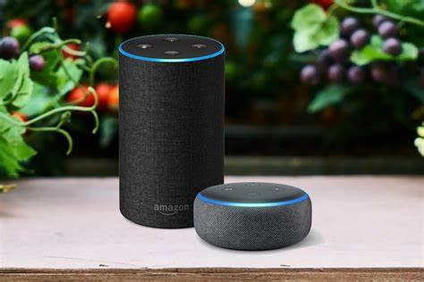
WJEC LEVEL 1/2 VOCATIONAL AWARD ICT (TECHNICAL AWARD)
Task 5: AI Accuracy
Activity A
Speech recognition technology is believed to have 95% accuracy.
Why might 95% accuracy not be considered enough?
Activity B
What consequences are the police faced with if they use facial recognition technology to catch criminals?
Activity C
How would a mobile phones facial recognition technology react to a 3D print of someone’s else face? Would it work?
©SIMPLY TEACH 2023 | www.mysimplyteach.co.uk | info@mysimplyteach.co.uk

Slide 7
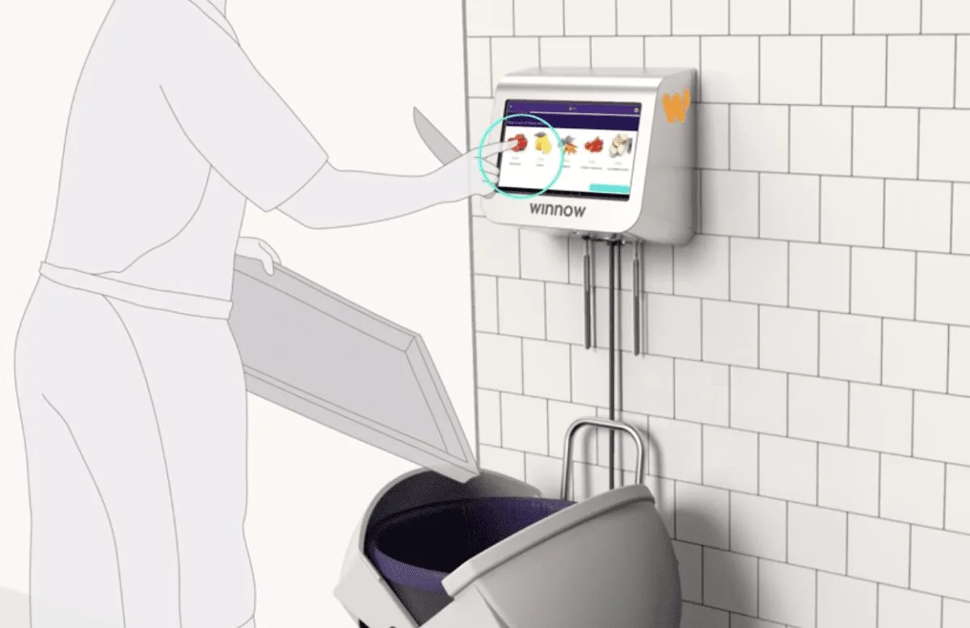
WJEC LEVEL 1/2 VOCATIONAL AWARD ICT (TECHNICAL AWARD)
Task 6: Smart bins
Activity A
How does an AI-powered bin work?
The world’s first AI-powered bin has been launched as part on an effort to cut down on food waste in commercial kitchens.
Activity B
How much food is being wasted on average in the UK each year?
​
​
Activity C
What impact could the use of AI-powered bins have on a restaurant?
©SIMPLY TEACH 2023 | www.mysimplyteach.co.uk | info@mysimplyteach.co.uk

Slide 8
WJEC LEVEL 1/2 VOCATIONAL AWARD ICT (TECHNICAL AWARD)
Task 7: Google maps
Activity A
What must the AI algorithm consider when calculating a route?
Activity B
Finding specific houses and buildings can be difficult. What does the AI algorithm do to tackle this problem?
​
​
©SIMPLY TEACH 2023 | www.mysimplyteach.co.uk | info@mysimplyteach.co.uk

Slide 9
WJEC LEVEL 1/2 VOCATIONAL AWARD ICT (TECHNICAL AWARD)
Task 8: Pros and cons
Activity
In the table below and using the hints provided, identify three advantages and three disadvantages of using Artificial Intelligence.
Hints:
Automation
Recommendations
Chatbots
Advantages | Disadvantages
Hints:
Jobs
Ethics
Reliability
©SIMPLY TEACH 2023 | www.mysimplyteach.co.uk | info@mysimplyteach.co.uk

Slide 10
WJEC LEVEL 1/2 VOCATIONAL AWARD ICT (TECHNICAL AWARD)
Task 9: Exam focus
Command word alert!
Give/import/list/name: Provide/name/select/recognise brief facts or examples (from a given source or
from recall)
Exam-style question
List the three branches of Artificial Intelligence (AI). (3 marks)
Key points | Response
Guidance Look back at the previous tasks.
©SIMPLY TEACH 2023 | www.mysimplyteach.co.uk | info@mysimplyteach.co.uk

