Slide 1
WJEC LEVEL 1/2 VOCATIONAL AWARD ICT (TECHNICAL AWARD)
Unit 1: ICT in society
Topic: IT24 - Networks
Name:
RAG:
Assessment criteria:
Criteria | Emerging | Developing | Secured | Mastered
Types of networks (LAN and WAN)
Interim feedback:
Final feedback:
©SIMPLY TEACH 2023 | www.mysimplyteach.co.uk | info@mysimplyteach.co.uk

Slide 2
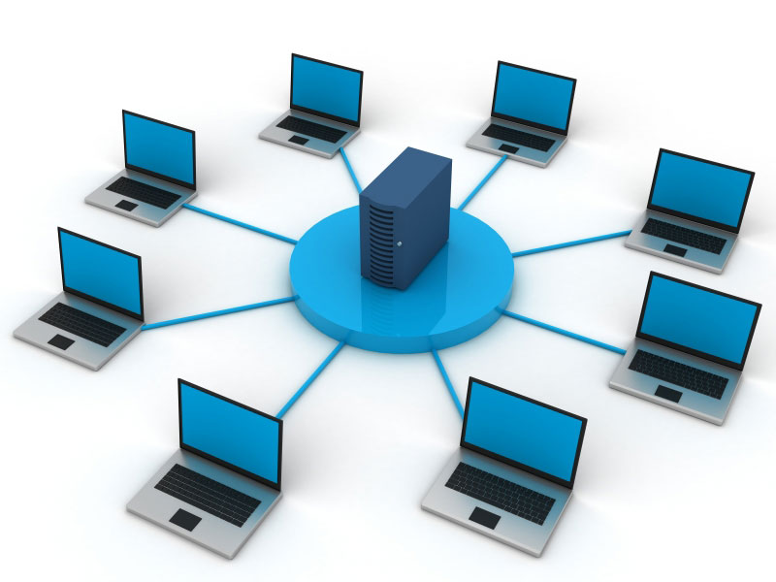
WJEC LEVEL 1/2 VOCATIONAL AWARD ICT (TECHNICAL AWARD)
Task 1: Networks
Activity A
Use the internet find an image of a computer network and add a screenshot in the box below.
Activity B
What is the difference between a networked computer and stand-alone computer?
Activity C
List two benefits to using a networked computer.
Hints:
Resources
Centralisation
Storage
Remote access
Communication
Security
©SIMPLY TEACH 2023 | www.mysimplyteach.co.uk | info@mysimplyteach.co.uk

Slide 3
WJEC LEVEL 1/2 VOCATIONAL AWARD ICT (TECHNICAL AWARD)
Task 2: LAN
Activity A
What does LAN stand for?
Games console
Local Area Network
Tablet device
Router
Smartphone
Activity B
What does a LAN cover?
A LAN covers a small geographical area.
Laptop
Activity C
Darren has a home network which is connected to the following devices:
Laptop
Smartphone
Tablet device
Games console
Complete the diagram above to show each of the devices listed are connected to Darren’s home network.
©SIMPLY TEACH 2023 | www.mysimplyteach.co.uk | info@mysimplyteach.co.uk

Slide 4
WJEC LEVEL 1/2 VOCATIONAL AWARD ICT (TECHNICAL AWARD)
Task 2: LAN
A school also uses a LAN because it’s based over one site and therefore covers a small geographical area.
Activity D
The following network includes the following pieces of hardware:
1 printer
1 photocopier
4 laptops
Add these devices to partially complete LAN diagram. Label each device and ensure they’re connected to the switch.
Laptop
Laptop
Server
Switch
Laptop
Photocopier
Printer
Laptop
©SIMPLY TEACH 2023 | www.mysimplyteach.co.uk | info@mysimplyteach.co.uk

Slide 5
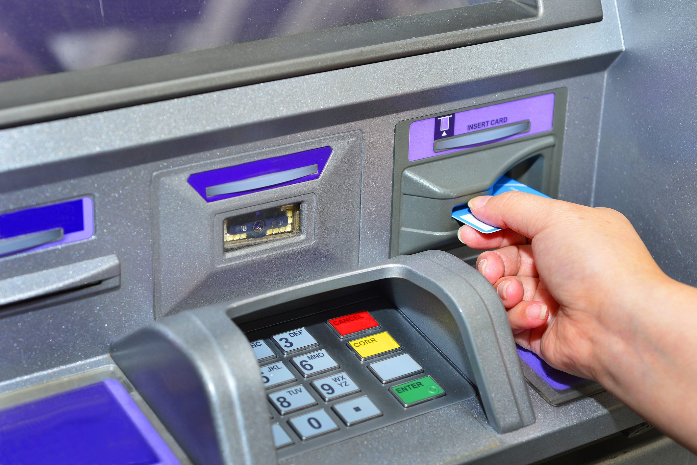
WJEC LEVEL 1/2 VOCATIONAL AWARD ICT (TECHNICAL AWARD)
Task 3: WAN
Activity A
What does WAN stand for?
Wide Area Network
Activity B
What does a WAN cover?
A WAN covers a larger geographical area.
Activity C
In the table below, tick (✓) one box per row to identify whether a WAN or LAN is most likely to used.
Activity D
Banks will use Wide Area Networks (WAN) to allow customers to use ATM’s (shown above)
Why is a WAN suitable for this purpose?
 | LAN | WAN
A school | ✓
The internet |  | ✓
A nationwide organisation |  | ✓
A home network | ✓
Customers can withdraw cash from any cashpoint as long as they have their card. If the bank used a LAN then the customer could only withdraw cash from ATM’s that are connected to the local branches network.
©SIMPLY TEACH 2023 | www.mysimplyteach.co.uk | info@mysimplyteach.co.uk

Slide 6
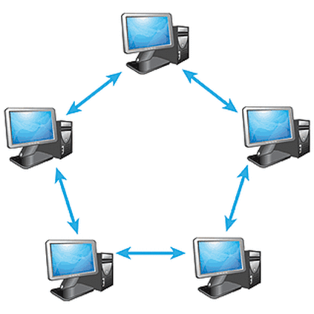
WJEC LEVEL 1/2 VOCATIONAL AWARD ICT (TECHNICAL AWARD)
Task 4: Peer-to-Peer network
Activity B
What is a peer to peer network?
Activity A
Use the internet find an image of a peer-to-peer computer network and add a screenshot in the box below.
Activity C
Which type of network would use a peer-to-peer network?
Activity D
In the table below, tick (✓) one box per row to identify whether a peer-to-peer network would be used in each of these scenarios.
 | Yes | No
A school
The internet
A nationwide organisation
A home network
©SIMPLY TEACH 2023 | www.mysimplyteach.co.uk | info@mysimplyteach.co.uk

Slide 7
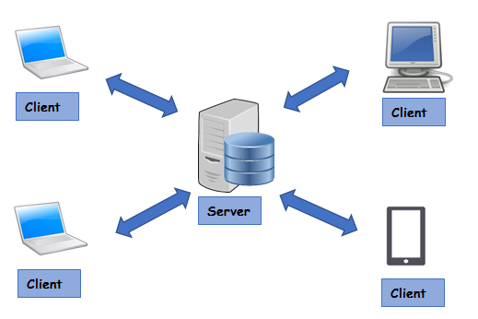
WJEC LEVEL 1/2 VOCATIONAL AWARD ICT (TECHNICAL AWARD)
Task 5: Client-server network
Activity B
What is a client-server network?
Activity A
Use the internet find an image of a client-server network and add a screenshot in the box below.
Activity C
Which type of network would use a client-server network?
Activity D
In the table below, tick (✓) one box per row to identify whether a client-server network would be used in each of these scenarios.
 | Yes | No
A school
The internet
A nationwide organisation
A home network
©SIMPLY TEACH 2023 | www.mysimplyteach.co.uk | info@mysimplyteach.co.uk

Slide 8
WJEC LEVEL 1/2 VOCATIONAL AWARD ICT (TECHNICAL AWARD)
Task 6: Factors that affect network performance
Activity A
Name as many factors that you can think of, which can affect the performance of a network.
Can you name all seven!!?
1
2
3
4
5
6
7
©SIMPLY TEACH 2023 | www.mysimplyteach.co.uk | info@mysimplyteach.co.uk
Notes:
They don’t have to be in this order.

Slide 9
WJEC LEVEL 1/2 VOCATIONAL AWARD ICT (TECHNICAL AWARD)
Task 7: Checkpoint
RAG:
Activity A
List two types of network. (2 marks)
Feedback:
Activity B
List two network models. (2 marks)
Activity C
List three factors that can affect the performance of a network. (3 marks)
©SIMPLY TEACH 2023 | www.mysimplyteach.co.uk | info@mysimplyteach.co.uk
Notes:
Activity C – Other answers accepted

Slide 10
WJEC LEVEL 1/2 VOCATIONAL AWARD ICT (TECHNICAL AWARD)
Task 8: LAN and WAN – Advantages and disadvantages
Activity A
In each table below, identify three advantages and three disadvantages to using a LAN and WAN.
LAN
Advantages | Disadvantages
WAN
Advantages | Disadvantages
©SIMPLY TEACH 2023 | www.mysimplyteach.co.uk | info@mysimplyteach.co.uk
Notes:
Other answers can be accepted.

Slide 11
WJEC LEVEL 1/2 VOCATIONAL AWARD ICT (TECHNICAL AWARD)
Task 9: Peer-to-Peer and Client-server – Advantages and disadvantages
Activity A
In each table below, identify three advantages and three disadvantages to using a Peer-to-peer and Client-server network.
Peer-to-Peer
Advantages | Disadvantages
Client-Server
Advantages | Disadvantages
©SIMPLY TEACH 2023 | www.mysimplyteach.co.uk | info@mysimplyteach.co.uk
Notes:
Other answers can be accepted.

Slide 12
WJEC LEVEL 1/2 VOCATIONAL AWARD ICT (TECHNICAL AWARD)
Task 10 – LAN and WAN: Similarities and differences
Activity
In the table below identify three similarities and three differences between a LAN and a WAN.
Similarities | Differences
©SIMPLY TEACH 2023 | www.mysimplyteach.co.uk | info@mysimplyteach.co.uk
Notes:
Other answers can be accepted.

Slide 13
WJEC LEVEL 1/2 VOCATIONAL AWARD ICT (TECHNICAL AWARD)
Task 11: Factors that affect network performance
Activity
For each scenario, state one reason why the performance of their network may have been affected in the reason column.
No. | Scenario | Reason
1 | Five people are sharing one internet connection. They are connected to the network via laptops, tablets and smartphones.
2 | Erin is trying to use her smartphone at home and she checks out her Wi-Fi signal and it’s low.
3 | Freddie has placed his router behind his TV at home.
4 | Freddie ran a speed test and was receiving download speeds of 17MB per second whereas his friend Max is receiving 52MB per second.
5 | Jimmy is having problems streaming 4K Ultra High Definition (HD) videos. They keep buffering.
6 | Jess is working in café and has connected to a VPN while using their public Wi-Fi.
©SIMPLY TEACH 2023 | www.mysimplyteach.co.uk | info@mysimplyteach.co.uk

Slide 14
WJEC LEVEL 1/2 VOCATIONAL AWARD ICT (TECHNICAL AWARD)
Task 12: Exam focus
Exam-style question
Answer the following question:
DC Logistics are a local business with a small office that contains six computers, a service and a printer which are all connected to a LAN (Local area network)
Identify three advantages to connecting these computers together into a Local Area Network (LAN) (3 marks)
Command word alert!
Identify: Recognise, distinguish and establish what something is
Key points | Response
Guidance What impact does the use of a LAN have on? Accessing files Accessing resources (i.e. printer) Software installation/updates Security installation/updates Communication between colleagues Use of an internet connection The role of the server in handling accounts.
©SIMPLY TEACH 2023 | www.mysimplyteach.co.uk | info@mysimplyteach.co.uk

