Slide 1
Lesson 1:
Get in gear
Year 8 – Computing systems
Notes:
Last updated: 25/03/2021
This resource is licensed under the Open Government Licence, version 3. For more information on this licence, see ncce.io/ogl.

Slide 2
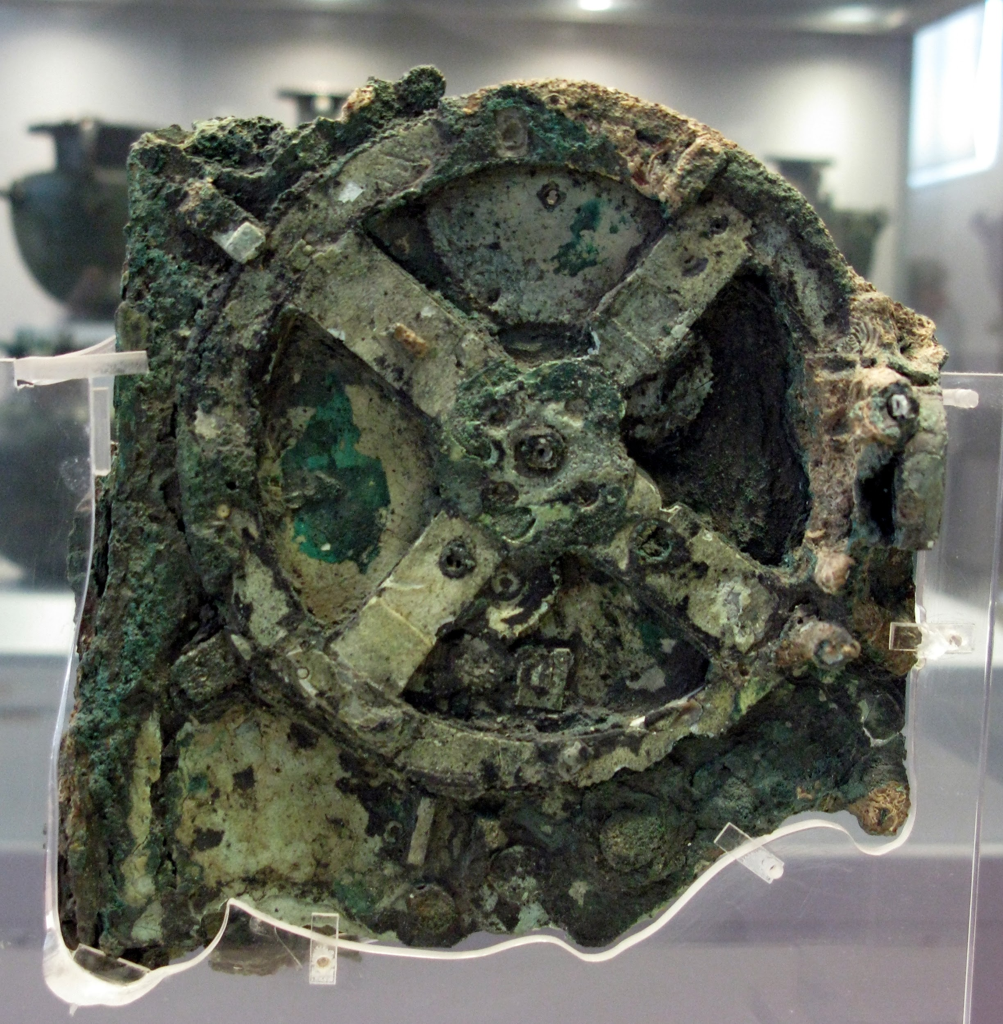
Starter activity
The Antikythera mechanism
It was retrieved in 1900 from a Roman shipwreck off the coast of Antikythera island.
It was constructed some time in the 1st or 2nd century BC.
Notes:
Image sources:
https://commons.wikimedia.org/wiki/Category:Antikythera_Mechanism#/media/File:The_Antikythera_Mechanism_(3471171927).jpg
https://commons.wikimedia.org/wiki/Category:Antikythera_Mechanism#/media/File:0143_-_Archaeological_Museum,_Athens_-_Antikythera_mechanism_-_Photo_by_Giovanni_Dall'Orto,_Nov_11_2009.jpg

Slide 3
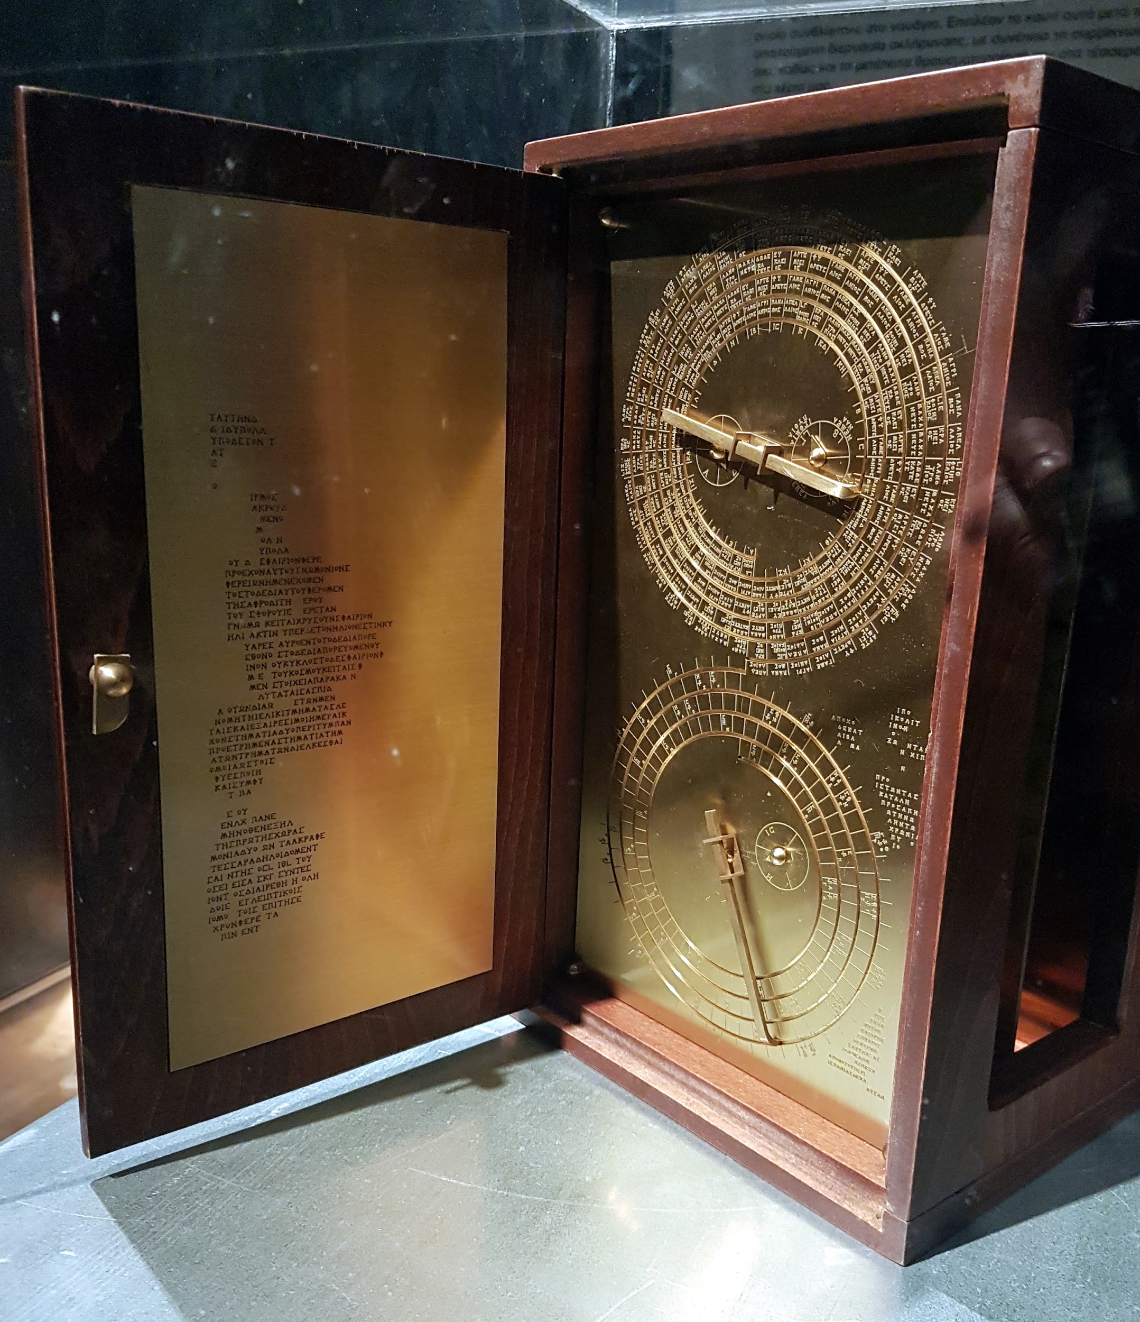
Starter activity
The Antikythera mechanism
We now know that it was a complex geared mechanism that could predict solar eclipses, as well as the position of the moon and known planets.
There are dozens of documentaries about the Antikythera mechanism, describing the fascinating attempts to understand its function.
Notes:
Image sources:
https://upload.wikimedia.org/wikipedia/commons/8/8b/Antikythera_mechanism_frontview%2C_1st-2nd_century_BC%2C_Greece_%28model%29.jpg
https://commons.wikimedia.org/wiki/Category:Antikythera_Mechanism#/media/File:Antkythera.jpg

Slide 4
Starter activity
The Antikythera mechanism
We now know that it was a complex geared mechanism that could predict solar eclipses, as well as the position of the moon and known planets.
Think, write, pair, share .
Would you call the Antikythera mechanism a computer?
How is it similar or different to modern computers?
Notes:
Image sources:
https://upload.wikimedia.org/wikipedia/commons/8/8b/Antikythera_mechanism_frontview%2C_1st-2nd_century_BC%2C_Greece_%28model%29.jpg
https://commons.wikimedia.org/wiki/Category:Antikythera_Mechanism#/media/File:Antkythera.jpg

Slide 5
Objectives
Year 8 – Computing systems
In this unit, you will:
Investigate different layers of computing systems:
From programs and the operating system
To the physical components that function together as a system to execute these programs
To the fundamental binary building blocks that these components consist of

Slide 6
Objectives
Lesson 1: Get in gear
In this lesson, you will:
Learn what the purpose of a computing system really is
Explore what programs are, and look at specific examples of programs that we often use

Slide 7
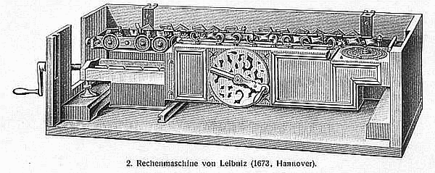
Activity 1
The Pascaline and the stepped reckoner
Pascal (1642) and Leibniz (1672) designed calculating machines.
Leibniz’s machine was the first to add, subtract, multiply, and divide.
Question .
How are these machines similar or different to modern computers?
Notes:
Image sources:
https://en.wikipedia.org/wiki/Pascal's_calculator#/media/File:Pascaline_-_top_view_and_mechanism.jpg
https://en.wikipedia.org/wiki/Pascal's_calculator#/media/File:Pascaline-CnAM_823-1-IMG_1506-black.jpg
https://commons.wikimedia.org/wiki/Category:Leibniz_calculator#/media/File:Leibniz_Stepped_Reckoner_drawing.png

Slide 8
Activity 1
Automate the process
“If we wanted to produce a more admirable machine it could be so arranged that it would not be necessary for the human hand
to move the machine from operation to operation: Things could be arranged in the beginning so that everything should be done by the machine itself.”
Question .
What is Leibniz suggesting here?
The “more admirable machine” would follow a program .
Extract from Leibniz’s description of the Machina arithmetica
Notes:
Image sources:
https://en.wikipedia.org/wiki/Pascal's_calculator#/media/File:Pascaline_-_top_view_and_mechanism.jpg
https://en.wikipedia.org/wiki/Pascal's_calculator#/media/File:Pascaline-CnAM_823-1-IMG_1506-black.jpg
https://commons.wikimedia.org/wiki/Category:Leibniz_calculator#/media/File:Leibniz_Stepped_Reckoner_drawing.png

Slide 9
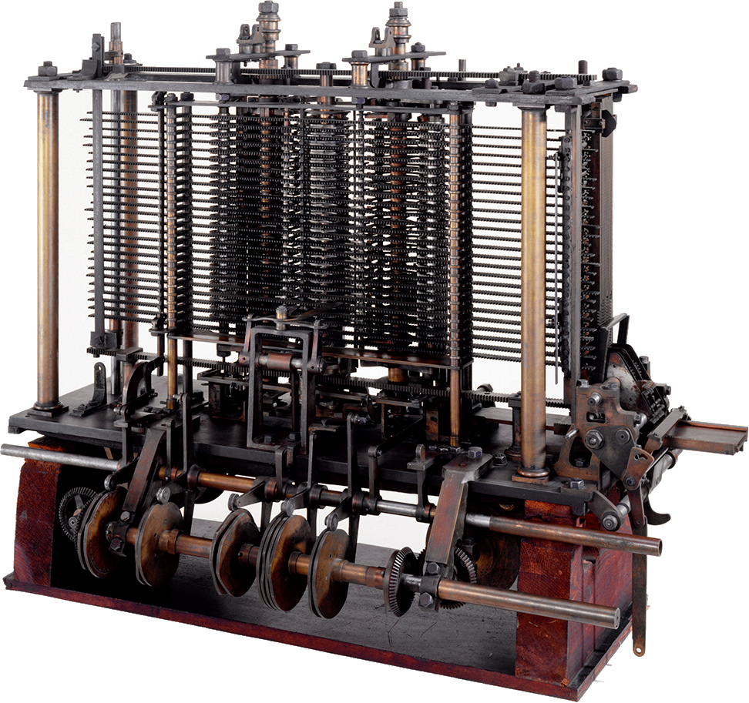
Activity 1
Babbage’s Analytical Engine
Babbage (1837) conceived of a programmable machine that would perform calculations, as specified
by instructions on punched cards.
Question .
How is this machine similar or different to modern computers?
Notes:
Image sources:
https://commons.wikimedia.org/wiki/Category:Analytical_Engine#/media/File:Babbages_Analytical_Engine,_1834-1871._(9660574685).jpg
https://commons.wikimedia.org/wiki/Category:Analytical_Engine#/media/File:Babbage_Analytical_Engine_Plan_1840_CHM.agr.jpg
https://en.wikipedia.org/wiki/Analytical_Engine#/media/File:PunchedCardsAnalyticalEngine.jpg

Slide 10
Activity 1
Automate the process
Calculating machines | Modern computers
〃 | Receive input , process it, produce output
Purpose-built: designed to automate a specific process | General-purpose: designed to automate any process, as specified by a program
The data and operations to be performed are either specified manually by the user, or hardwired into the machine. | The data and instructions to be performed can be stored in memory .

Slide 11
Activity 1
Automate the process
Calculating machines | Modern computers
〃 | Receive input , process it, produce output
Purpose-built: designed to automate a specific process | General-purpose: designed to automate any process, as specified by a program
The data and operations to be performed are either specified manually by the user, or hardwired into the machine. | The data and instructions to be performed can be stored in memory .
This will be our definition of a computer.

Slide 12
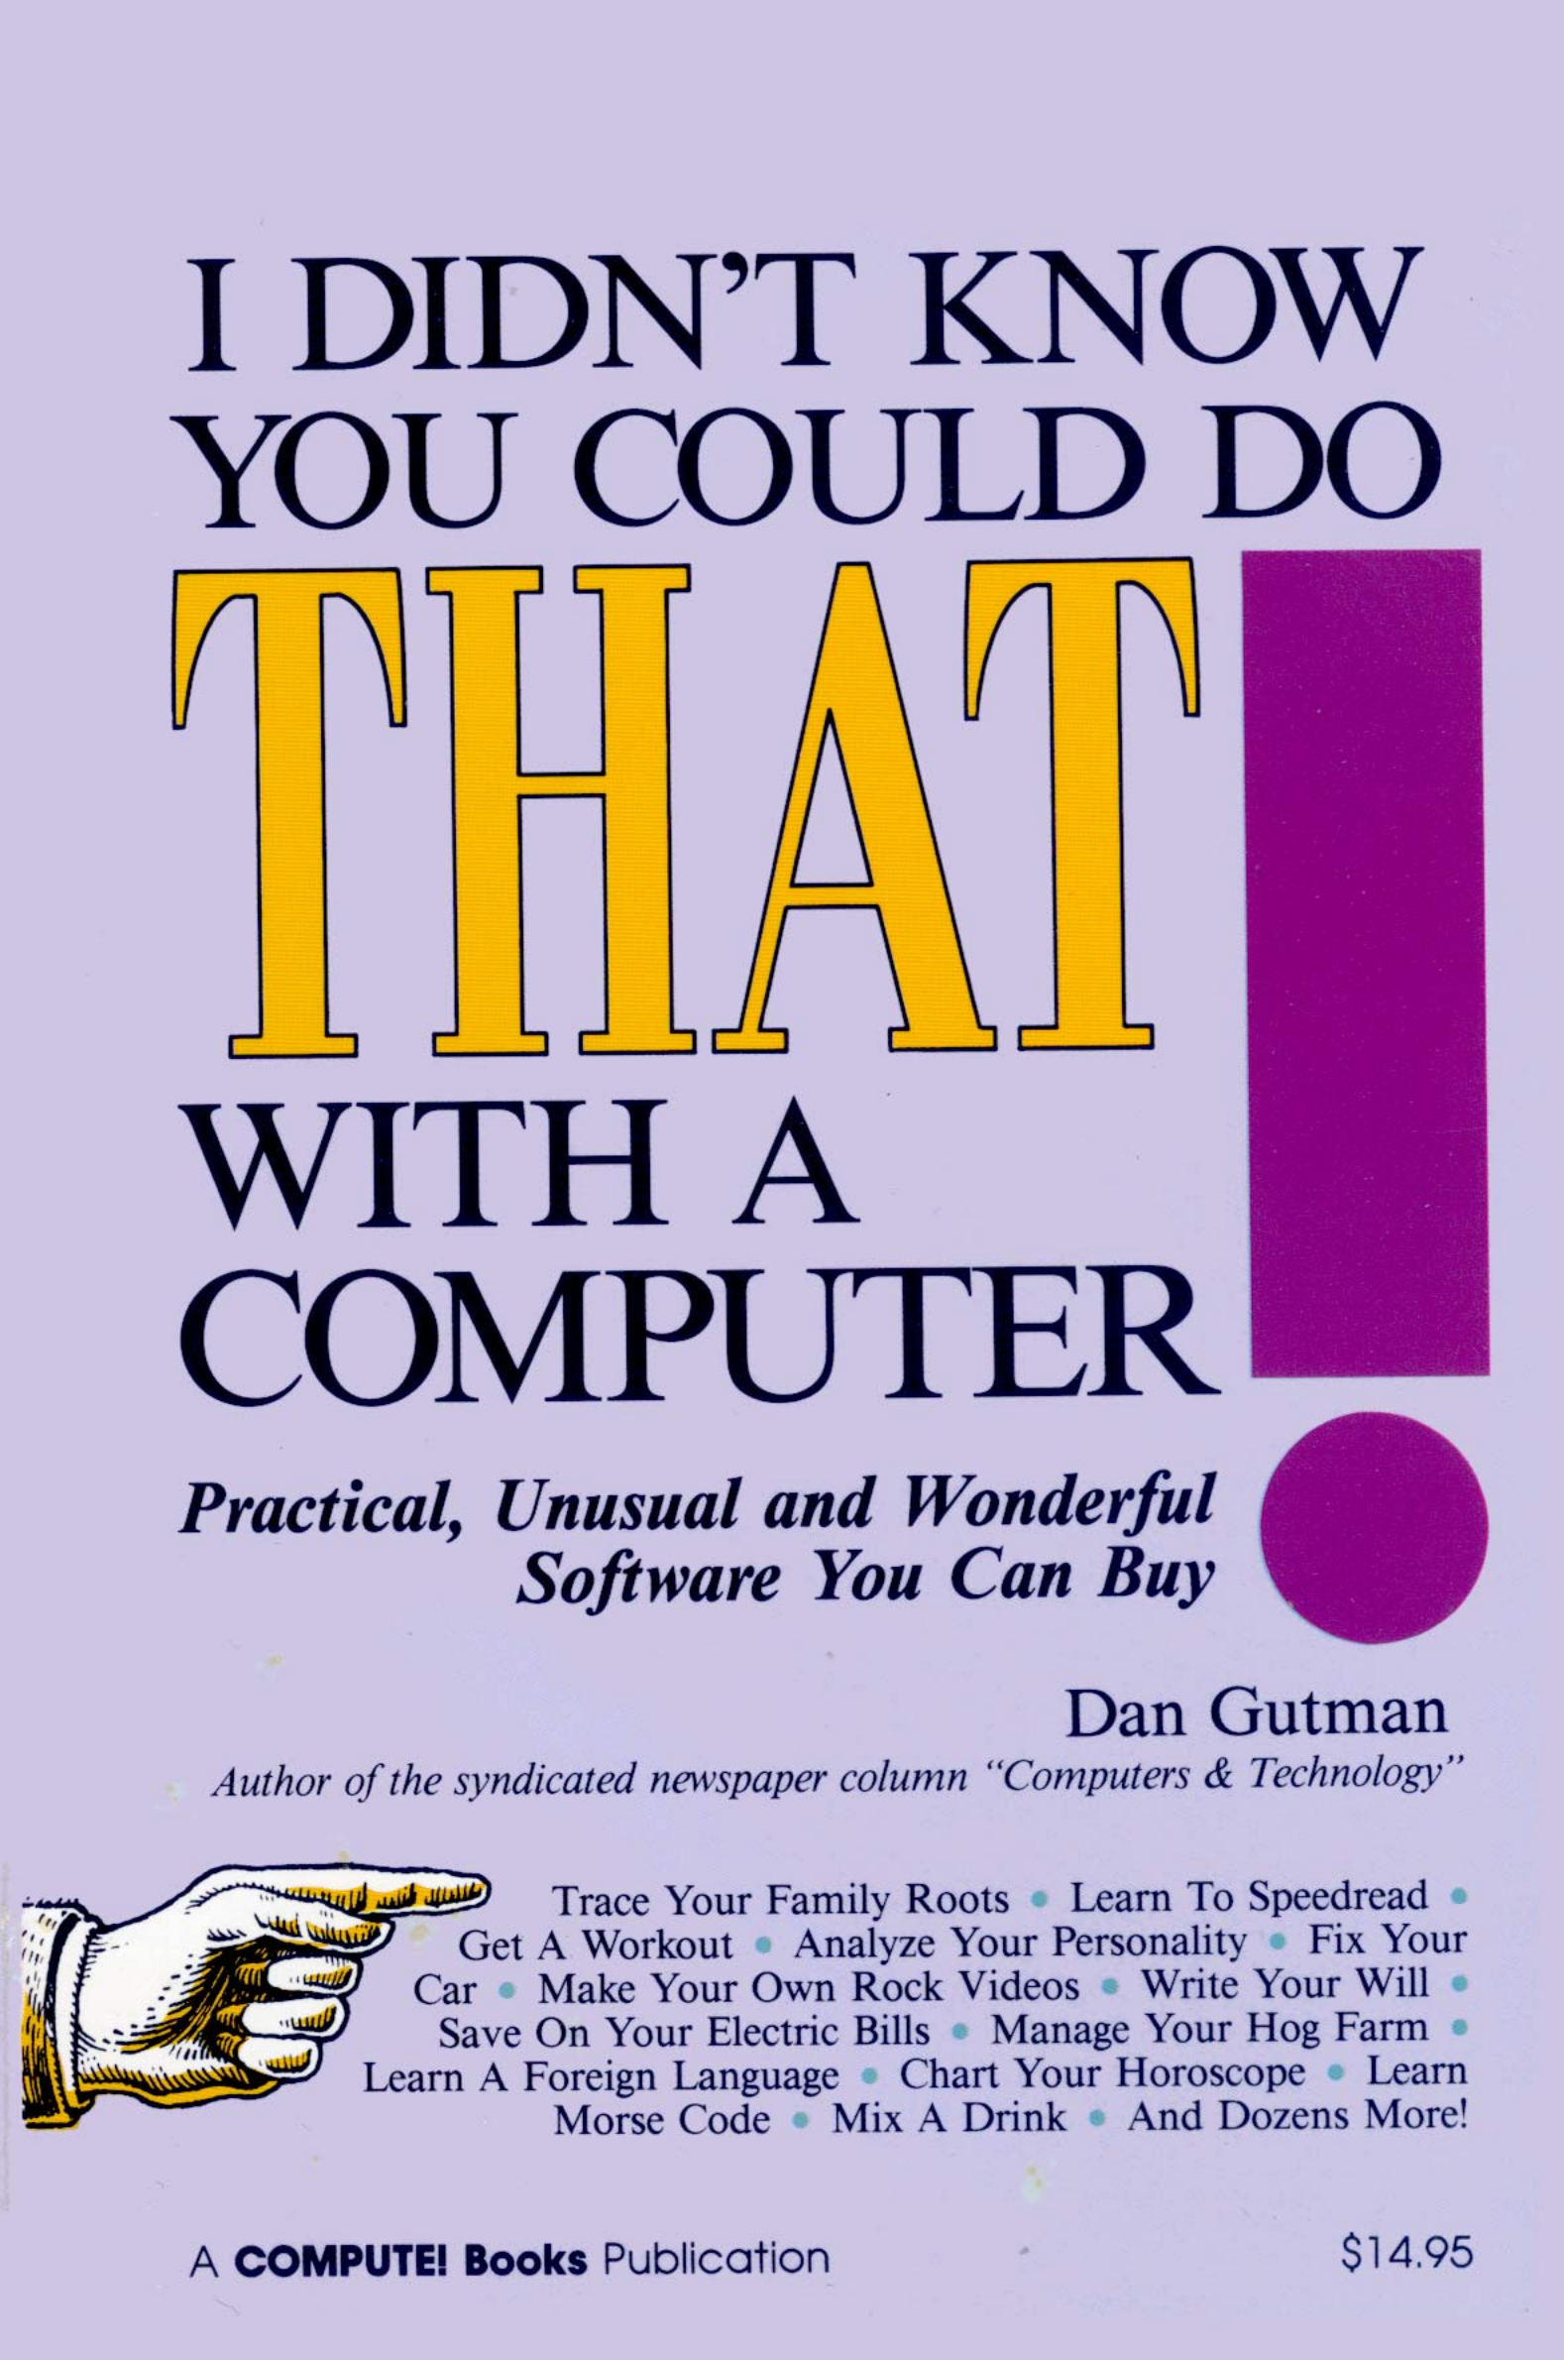
Activity 2
What makes a computer different...
❠
...than an appliance such as a dishwasher?
The computer is the only appliance that can do more than one thing. Toasters toast. Refrigerators cool. Lamps illuminate.
One appliance, one task.
But the computer can do hundreds of tasks. The computer doesn’t have a specific, well-designed purpose.
I didn’t know you could do that with a computer! – Dan Gutman (1986)

Slide 13
Activity 2
What makes a computer different...
...than an appliance such as a dishwasher?
The computer is the only appliance that can do more than one thing. Toasters toast. Refrigerators cool. Lamps illuminate.
One appliance, one task.
But the computer can do hundreds of tasks. The computer doesn’t have a specific, well-designed purpose.
Question .
What are your thoughts on this claim? Do you think that’s true?

Slide 14
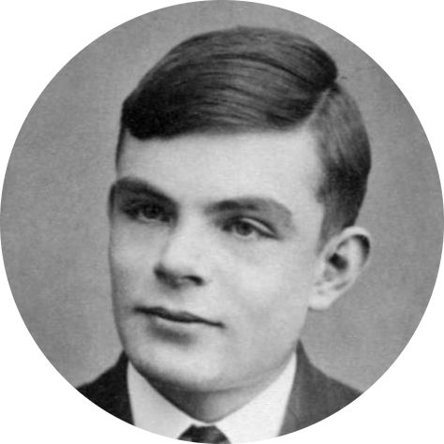
Activity 2
What makes a computer different?
The purpose of a general-purpose computer is to execute programs that operate on data.
Through each program, the computer transforms itself into a machine that performs a specific task.
This is essentially how Alan Turing described it.
Notes:
Image source: https://commons.wikimedia.org/wiki/File:Alan_Turing_Aged_16.jpg

Slide 15
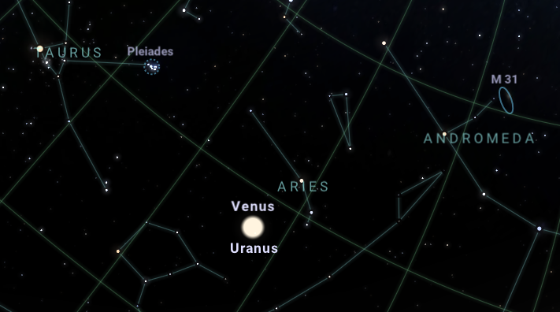
Activity 2
What makes a computer different?
The purpose of a general-purpose computer is to execute programs that operate on data.
Through each program, the computer transforms itself into a machine that performs a specific task.
Screenshot of Stellarium
Notes:
Image source: https://commons.wikimedia.org/wiki/Category:Antikythera_Mechanism#/media/File:The_Antikythera_Mechanism_(3471171927).jpg

Slide 16
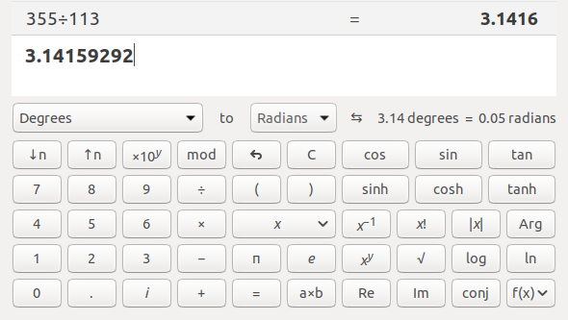
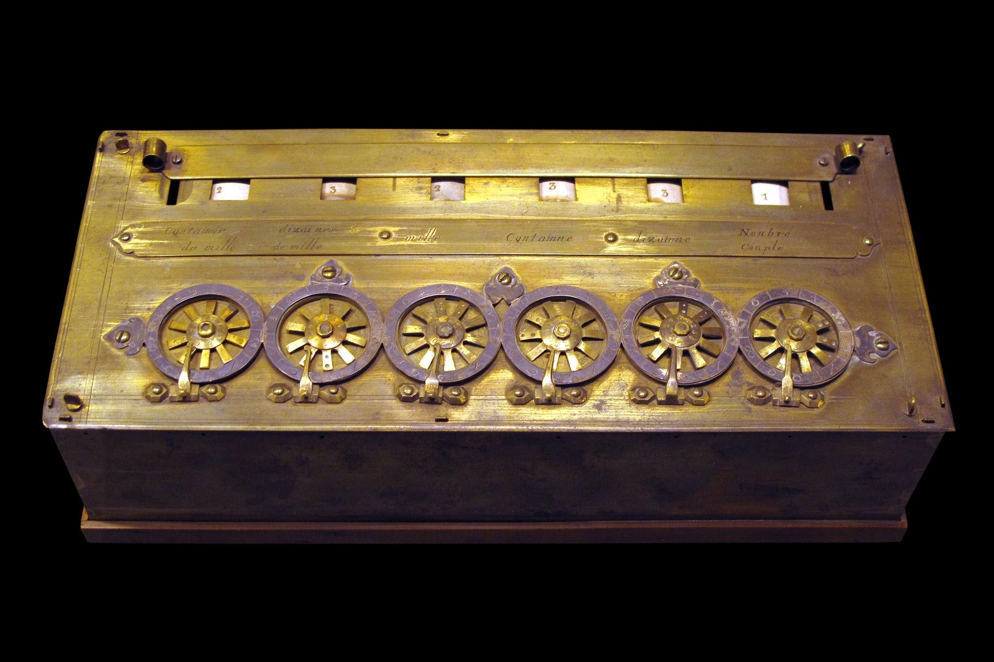
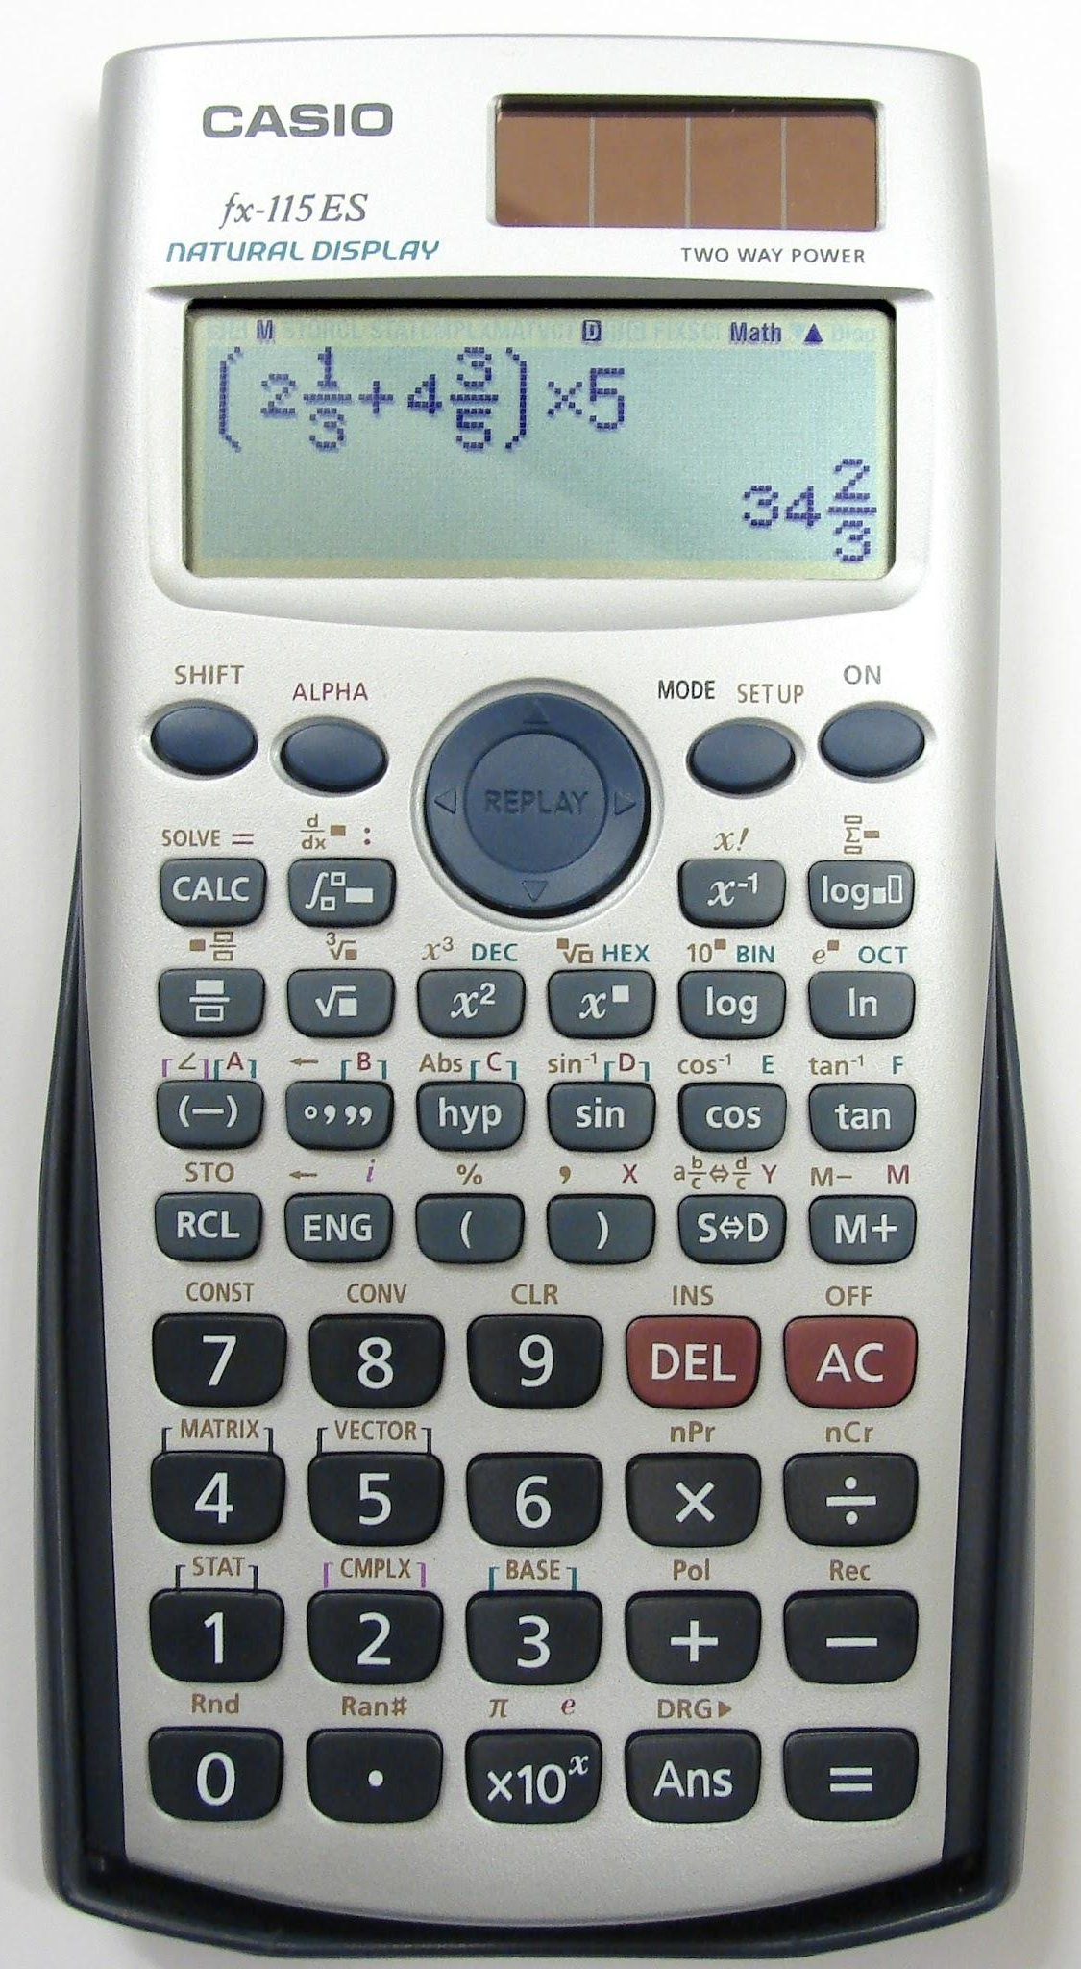
Activity 2
What makes a computer different?
The purpose of a general-purpose computer is to execute programs that operate on data.
Through each program, the computer transforms itself into a machine that performs a specific task.
Notes:
Image sources:
https://commons.wikimedia.org/wiki/File:Pascaline-CnAM_823-1-IMG_1506-black.jpg
https://commons.wikimedia.org/wiki/File:Casio-fx115ES-5564.jpg

Slide 17
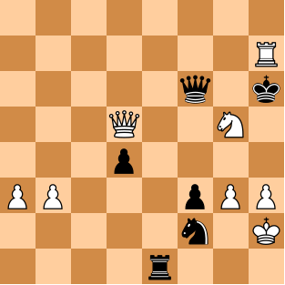
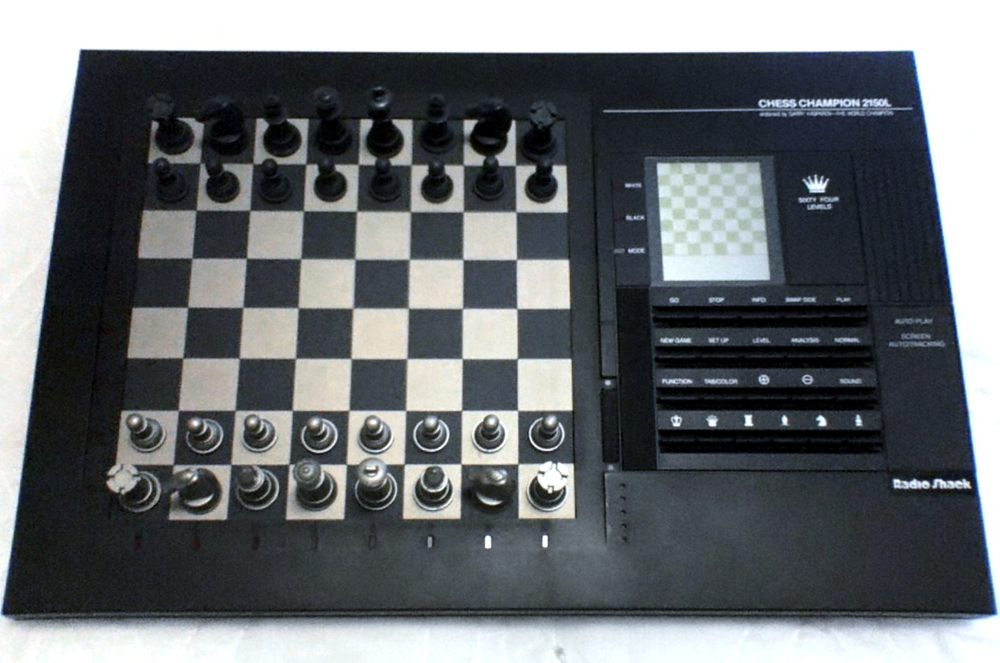
Activity 2
What makes a computer different?
The purpose of a general-purpose computer is to execute programs that operate on data.
Through each program, the computer transforms itself into a machine that performs a specific task.
Notes:
Image source: https://commons.wikimedia.org/wiki/File:RS_Chess_Computer.JPG

Slide 18
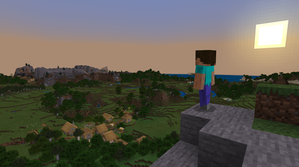
Activity 2
And beyond
The purpose of a general-purpose computer is to execute programs that operate on data.
Through each program, the computer transforms itself into a machine that performs a specific task.
▹
This includes ‘machines’ that we wouldn’t be able to construct physically.
▹
This includes ‘machines’ that we haven’t conceived of yet.
Notes:
Image source: https://upload.wikimedia.org/wikipedia/en/1/17/Minecraft_explore_landscape.png

Slide 19
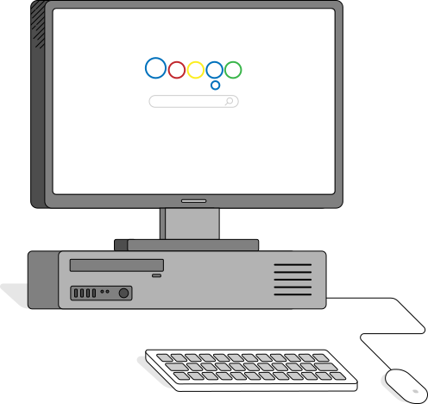
Activity 3
Your software
You use programs for every task that you perform on your computer.
The word software simply means programs.
The word computer applies to all kinds of general-purpose computing devices.

Slide 20
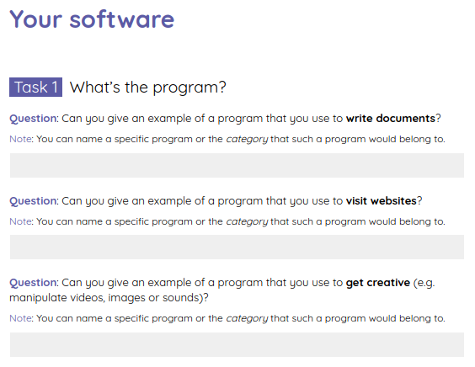
Activity 3
Your software
Use the worksheet to write down some of the programs you know.
The word software simply means programs.
The word computer applies to all kinds of general-purpose computing devices.

Slide 21
Activity 3
Your software – Answers
Programs to write documents with:
word processors
Programs to visit websites with:
browsers
Programs to manipulate media with:
video editing, image editing, sound editing programs
Subtle point: Sometimes you visit websites to perform these tasks, which might mean that parts of the program are executed on remote computers.

Slide 22
Activity 3
Your software – Answers
Question Are videos, images, and sounds programs?
Answer No, they are data.
Programs are required to read that data and play back the videos, or display the images, or reproduce the sounds.
When asked if something is a program, you could ask yourself:
Does it perform a task?
Does it process data?

Slide 23
Activity 3
Your software – Answers
Question Are operating systems programs?
Answer Yes. The tasks they perform are to supervise and manage many aspects of the system’s operation.
You will learn more about this in future lessons

Slide 24
Activity 4
Executing a program
Execute the instructions on the intelligent piece of paper, to play noughts and crosses against a human opponent.
This will give you an insight into what it means to execute a program and carry out instructions mechanically.

Slide 25
Activity 4
Executing a program
Work in pairs.
Draw the noughts & crosses 3⨉3 grid.
X goes first and is the mechanical player: follow the instructions blindly.
O goes second and is the human player: play as you like and make sure X follows the instructions.
Switch roles after each game.

Slide 26
Plenary
Concept map
This incomplete concept map contains some of the lesson ideas.
Fill in the missing labels, which specify the relationships between them.
computing system
program
comprise(s)
execute(s)
instructions
data
operate(s) on

Slide 27
Plenary
Concept map
This incomplete concept map contains some of the lesson ideas.
Fill in the missing labels, which specify the relationships between them.
computing system
executes
program
comprises
instructions
data
operate on

Slide 28
Summary
In this lesson, you...
Next lesson, you will...
Learnt that the purpose of a general-purpose computing system is to execute programs
Explored what programs are, and looked at specific examples of programs that we often use
Describe the hardware components used in computing systems and how they work together in order to execute programs
Highlight how all computing systems, regardless of form, are similar in structure (‘architecture’)

