Slide 1
Lesson 2: Networking hardware
Save a copy
Year 7 – Networks: from semaphores to the Internet
Notes:
Last updated: 01-07-20
This resource is available online at ncce.io/net1-2-s. Resources are updated regularly — please check that you are using the latest version.
This resource is licensed under the Open Government Licence, version 3. For more information on this licence, see ncce.io/ogl.

Slide 2
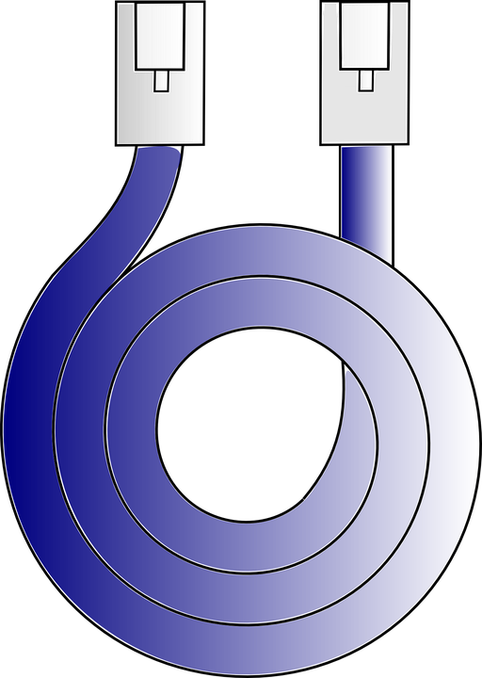
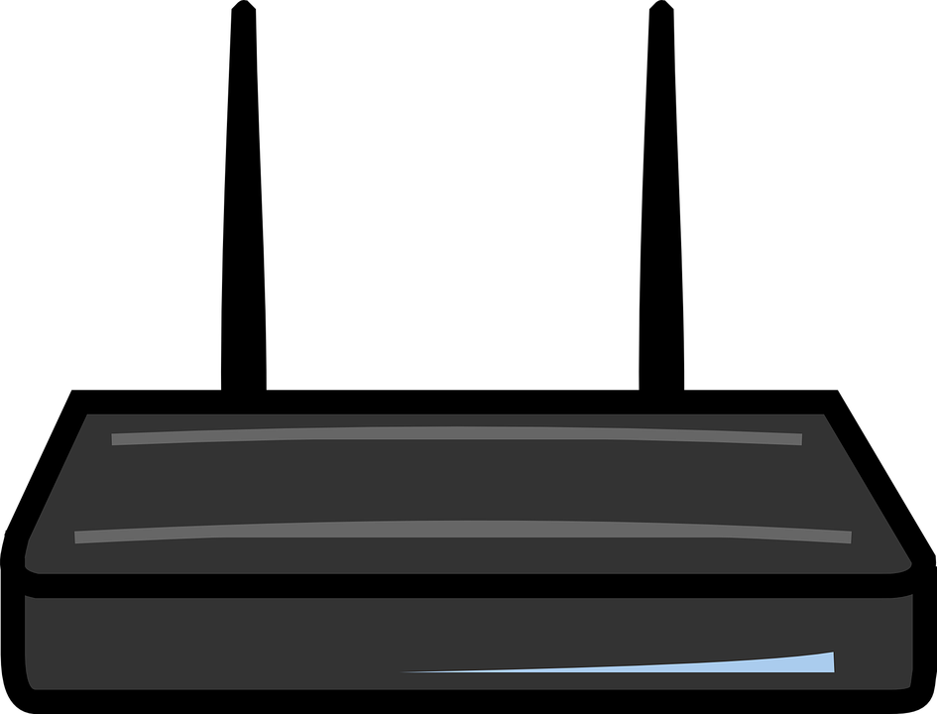
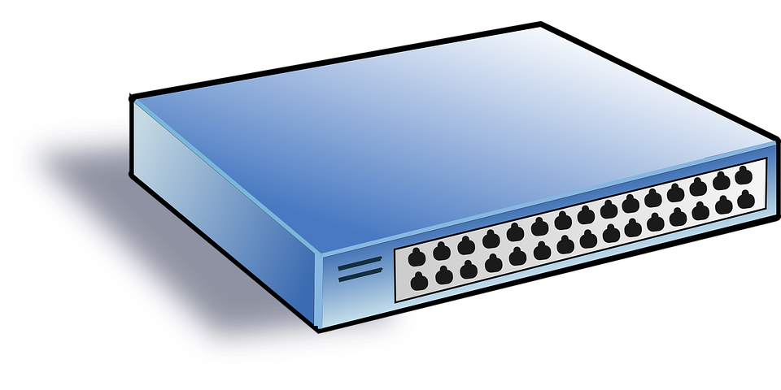
What am I?
Starter activity
Network cable
Hub
Router
Server
Can you match the images of hardware components used in computer networks with the correct terms?
Think, write, pair, share
Notes:
The ‘Network hardware’ worksheet includes the ‘What am I?’ activity. You can find the solution in the answers sheet.
Image sources:
Ethernet cable Image: https://pixabay.com/vectors/cable-network-data-transfer-38382/
Hub Image: https://pixabay.com/vectors/switch-hub-network-net-lan-35568/
Router Image: https://pixabay.com/vectors/router-switch-wireless-computer-154290/
Server Image: https://pixabay.com/vectors/computer-case-desktop-network-156129/

Slide 3
Lesson 2: Networking hardware
Objectives
In this lesson, you will:
List examples of the hardware necessary for connecting devices to networks

Slide 4
Network hardware
There are a number of pieces of hardware that are needed in order to create a network. You will become familiar with the following:
Network cable
Hub
Server
Router
Activity 1

Slide 5
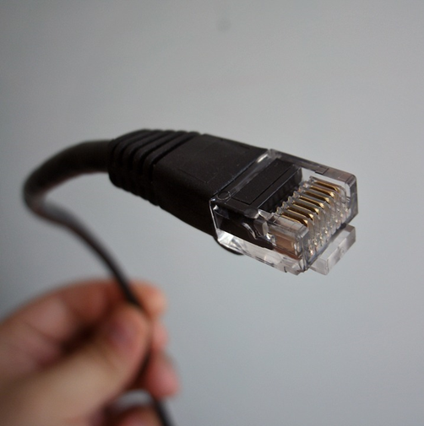
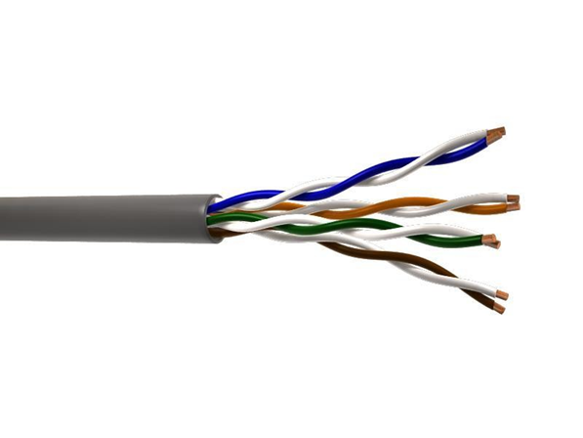
Network cables
Activity 1
To connect together different devices, you need cables.
They have plastic plugs that connect into sockets on devices.
The cable is made up of a number of copper wires.
Data can be sent in both directions across a cable.
Can you spot any network cables in the classroom?
Notes:
To connect together different devices, you need cables. The cables carry the electronic signals sent between machines communicating with one another. The most common type are called ‘Ethernet cables’.
They have plastic plugs that click into sockets on the network devices.
The cable is made up of a number of copper wires. Some send data in one direction, some send data in the other direction.
Image sources:
Ethernet cable Image: https://pixabay.com/photos/ethernet-network-cable-networking-1685294/
Twisted pair cable Image: https://commons.wikimedia.org/wiki/File:Unshielded-twisted-pair1.jpg

Slide 6
Build a network: scenario 1
Activity 2
A small company has 4 people working for it with 4 computers.
All computers now need to be networked together using cables so that they can communicate and access each other’s files.
In pairs, use the computer icons and lines (representing cables) to illustrate the network.
Remember: all computers must be connected together
Notes:
A ‘Build a network’ worksheet has been provided for this task. Learners have a slide for each of the scenarios discussed in this lesson. Learners can simply drag the icons on the slide to build the network — the line represents the cable. The learners can duplicate the line using copy and paste, and then position and rotate it as required. You may have to demonstrate this to the learners, depending on their skills.
Alternatively, this would make a great unplugged activity. Learners could use sticky notes to represent the devices (e.g. a personal computer), and string to represent the cables.
Computer icon image: http://www.freestockphotos.biz/stockphoto/15372

Slide 7
Hub
Activity 3
A hub connects a number of computers together.
Ports allow cables to be plugged in from each connected computer.
A message sent from computer A to computer B travels via the hub.
Hub
Notes:
A hub connects a number of computers together within the same room or building. The hub has ports that allow cables to be plugged into it from each connected computer. When a hub receives a message from a computer, it passes the message on to all of the computers connected to it.
Hub image source: https://pixabay.com/vectors/switch-hub-network-net-lan-35568/

Slide 8
Build a network: scenario 2
Activity 3
The company wishes to install a hub to reduce the overall number of cables used to network the 4 computers.
Use the computer icons in the worksheet provided.
Work in pairs.
?
Notes:
There is a slide in the ‘Build a network’ worksheet for each of the scenarios discussed in this lesson. Learners should use slide 3 for this scenario.
Computer icon image source: http://www.freestockphotos.biz/stockphoto/15372

Slide 9
Server
Activity 4
Some networks will have a server.
A server is a powerful computer which provides services.
There are many different types of server, for example, a file server which stores files (i.e. text, images, sound, or video) that can be accessed by all devices on the network.
File server
Notes:
Some networks will have a server. A server is a powerful computer which provides services to other devices in a network, such as central storage of shared files. This would be defined as a ‘file server’. Users on the network can save files to the file server, and open files from the file server. This is a great way of sharing files across many computers and allowing users to work on files collaboratively.
Server image source: https://www.needpix.com/photo/97937/computer-database-network-server-free-vector-graphics

Slide 10
Build a network: scenario 3
Activity 4
The company wishes to install a file server so that all 4 computers can store their files in a central location.
Use the icons provided in the worksheet.
Work in pairs.
?
Hub
Notes:
Learners should use slide 4 of the ‘Build a network’ worksheet.
Image sources:
Computer icon image: http://www.freestockphotos.biz/stockphoto/15372
Hub image: https://pixabay.com/vectors/switch-hub-network-net-lan-35568/

Slide 11
Fill in the blanks
Fill in the six missing words describing a network cable, hub, and server.
Activity 5
Notes:
The ‘Network hardware’ worksheet includes the ‘fill in the blanks’ activity. You can find the solution for this activity in the ‘Network hardware’ answer sheet.

Slide 12
Router
Activity 6
When a network needs to be connected to another network over a large area, a router is needed.
A router forwards messages from one network to another. It acts as a gateway.
A common job of a router is to join a home network to the internet via an internet service provider (ISP).
Router
Can you give any examples of internet service providers?
Notes:
A router is used to send messages between different networks that are not local (e.g. not in the same building). It connects the two separate networks together so that they can communicate with one another. For example, if a company had an office in London and an office in Newcastle and it needed to share files between the two networks, it would use a router to link the two networks and allow the files to be forwarded. A common use of a router is to connect a home or business network to the internet.
The router will typically have different ports. One port will be used to connect to the internet, and others will be used to connect to each of the devices within the network it resides on. The connection to the internet is provided by an ISP (internet service provider). Examples of ISPs include Virgin, Sky, and TalkTalk, among others.
Router image source: https://commons.wikimedia.org/wiki/File:Osa_device-wireless-router.svg

Slide 13
Build a network : scenario 4
Activity 6
The company wants to connect its network to the internet so that the 4 users can carry out internet research on their computers via the web.
Use the icons provided in the worksheet.
Work in pairs.
File server
Hub
?
?
Note: a figure of a cloud is often used to represent the internet on network diagrams
Notes:
Learners should use slide 5 in the ‘Build a network’ worksheet.
Image sources:
Computer icon image: http://www.freestockphotos.biz/stockphoto/15372
Hub image: https://pixabay.com/vectors/switch-hub-network-net-lan-35568/
Server image: https://www.needpix.com/photo/97937/computer-database-network-server-free-vector-graphics

Slide 14
True or false?
Plenary
A router acts as a gateway.
A hub connects a number of computers together in a network.
A server is a powerful computer that provides a service to a network.
You need a hub to connect a network to the internet.
Network cables are often made up of multiple copper wires.
There is only one type of server.
OR

Slide 15
Next lesson
Summary
In this lesson, you…
Learnt about key pieces of hardware used in computer networks.
Next lesson, you will…
Learn about the term ‘bandwidth’, and the difference between wired and wireless connections.

