Slide 1

WELCOME TO OUR
COMPUTING DEPARTMENT AT JTFS
Username: JTFS-Visitor01, 02, 03,
Password: FreeSchool24$

Slide 2
Computer Science
H446
Taster Group 1
9:25 – 10:10

Slide 3










12
Networks task
Expected time to complete: 50 mins
Types of networks
Use the following symbols:
TASK
Carry out some research on computer networks, in particular LANs, WiFi, Network topologies and connectivity devices to help you with this task, if needed.
Use the symbols on the right (feel free to revise them) to create an appropriate network over the floorplan on Slide 4.
Make sure your network meets all the following requirements:
  Each member of the main office needs a desktop PC
  Angela, Pam, Dwight and Oscar also use an office issued smart phone
  The following rooms new access to WiFi:
    Meeting room (top right)
    Reception
    Conference Room
    Main office
Desktop PC
Tablet
Phone
Router
WAP
Switch
Firewall
Server
Photocopier
Indicates a wireless enabled device

Slide 4
Use a circle with a transparent fill (so you can see the network underneath) with a width and height of 12.5cm to provide the WiFi coverage needed to cover the rooms above:
  The circles need to have a WAP at the centre
  The 12.5cm diameter circles represent the maximum range of each WAP
  They WAP icons must be attached to a wall
  You must use the minimum number of WAP possible to provide the coverage needed
All desktop PCs use wired connections in a star network configuration
  The top left server room, conference room and main office need to be on one subnet with its own switch
  All other rooms are on a separate subnet and will require its own hardware for this
  The two subnets need to be appropriately connected together
The top left room needs to have a server placed in it and connected appropriately to the local subnet
The server room needs hardware to appropriately connected the LAN to “The Internet”
Reception needs a photocopier and it needs connecting to the local subnet
A firewall should be placed somewhere appropriate
For additional help and support in structuring your answer you might like to watch some of the videos from the following Craig ‘n’ Dave playlists:
OCR: SLR 11 – Networks
https://student.craigndave.org/videos/slr-11-networks

Slide 5
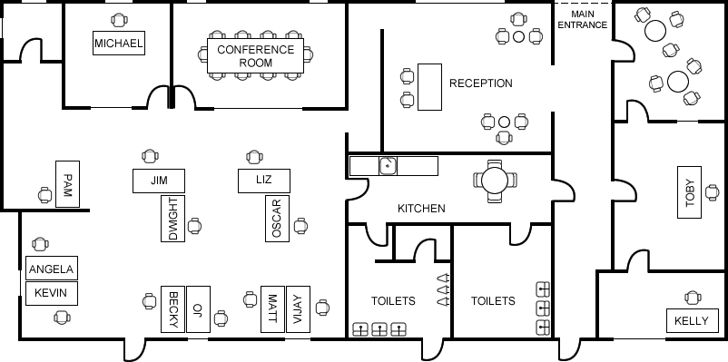
12
Networks task
Types of networks

