Slide 1
Lesson 1 : Spreadsheet warm-up
Notes:
Last updated: 29/09/2021
Resources are updated regularly — the latest version is available at: ncce.io/tcc.
This resource is licensed under the Open Government Licence, version 3. For more information on this licence, see ncce.io/ogl.

Slide 2
Lesson 1: Spreadsheet warm-up
Objectives
In this lesson, you will:
Create a spreadsheet model for a given scenario
Demonstrate how to utilise formulae to calculate income
Apply cell formatting

Slide 3
Starter
Starter
How much do you remember about spreadsheets?
The Starter activity is a labelling exercise to help you remember common spreadsheet terminology. There is also a fault-finding task.
Open and complete the Starter activity: A0 Resource – Lesson 1 starter
Answers here: A0 Solutions – Lesson 1 starter

Slide 4
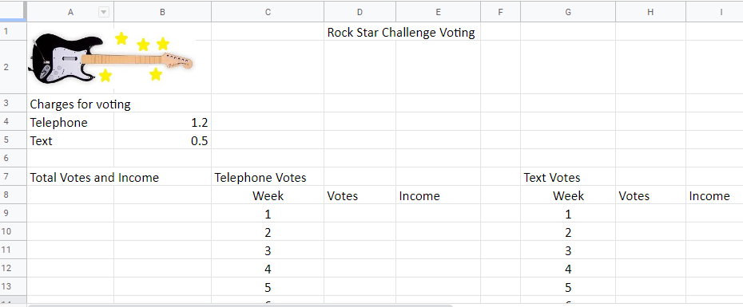
Open the spreadsheet
Activity 1
Open the spreadsheet A1 Resource – RSC voting

Slide 5
Enter data
Activity 1
Enter the data from A1 Worksheet – Voting data

Slide 6
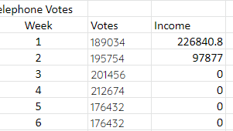
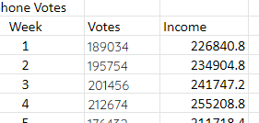
Enter formula
Activity 1
In cell E9 enter a formula to calculate income from telephone votes, then use the fill handle to populate the cells below
Change the formula to ABSOLUTE: cell E9 should look like this:
=D9*$B$4
What’s gone wrong?
The formula has been changed RELATIVE to each row so it quickly goes ‘wrong’
See A1 Worksheet – Voting data

Slide 7
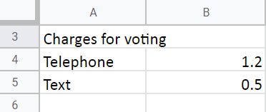
Note
Activity 1
The cost of a telephone vote can be broken down like this:
RSC is charged to set up this kind of call – they pass this on to the user
BT charge a setup fee too
Then there is the amount which goes to RSC
All this gives a total of £1.20 for a telephone vote

Slide 8
Enter formula
Activity 1
Enter a formula in cell E19 to calculate the total income from telephone calls

Slide 9
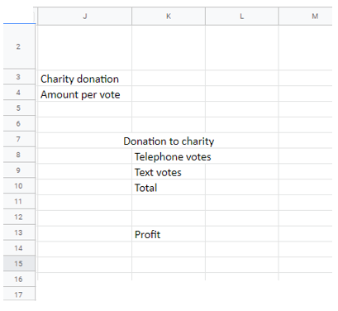
Charity donation
Activity 2
Just like I’m A Celebrity, RSC wants to make a donation to a charity for every vote cast.
Cell K4 – enter an amount to donate
Cell L8 – enter a formula to calculate the amount to be donated from telephone votes
Cell L9 – enter a formula to calculate the amount to be donated from text votes
Cell L10 – calculate the total donated to charity
Cell L13 – calculate the profit: add together income from telephone and text votes then subtract the donation
See A2 Worksheet – Charity donation and profit

Slide 10
Formatting
Activity 2
Formatting makes data more readable. Cells containing money should be formatted as currency. Some headings which cover multiple columns could be merged and it might help to add a background fill colour to headings. Example below:

Slide 11
Scenarios
Activity 3
By changing the values in B4, B5, and K4 you can affect the amount of income from votes and how much will be donated to charity.
Spend a short time changing these values to see what happens.
What value does K4 have to be so that RSC donates £500,000 to charity?
What values would B4 and B5 have to be so that the total income was £1 million?

Slide 12
Plenary
Plenary
Question
What is the difference between a RELATIVE formula and an ABSOLUTE formula? Can you give an example?
Answer
A RELATIVE formula looks similar on each row in a column, but each time the row will change. Example: =A1+B1, =A2+B2, etc.
An ABSOLUTE formula always refers to the same cell, for example if a cell holds the VAT rate or interest rate. Example: =A1*$J$1, A2*$J1$1, etc.

Slide 13
Summary
Next lesson
In this lesson, you...
Created a spreadsheet model for a given scenario
Demonstrated how to use formulae to calculate income
Applied cell formatting
Next lesson, you will...
Use common formulae to model seat sales and income from an event
Use formatting to make the spreadsheet readable and to highlight different areas, e.g. seats available, income
Use data validation when entering data in order to reduce user error

