Slide 1
WJEC LEVEL 1/2 VOCATIONAL AWARD ICT (TECHNICAL AWARD)
IT12:
Artificial intelligence
1.1.3 Services provided by IT
©SIMPLY TEACH 2023 | www.mysimplyteach.co.uk | info@mysimplyteach.co.uk

Slide 2
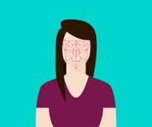
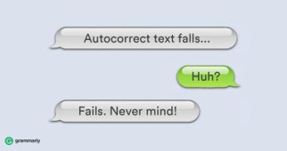
WJEC LEVEL 1/2 VOCATIONAL AWARD ICT (TECHNICAL AWARD)
Starter:
Activity
What do all of these have in common?
©SIMPLY TEACH 2023 | www.mysimplyteach.co.uk | info@mysimplyteach.co.uk
Notes:
This can be made into a printable starter activity.

Slide 3
WJEC LEVEL 1/2 VOCATIONAL AWARD ICT (TECHNICAL AWARD)
Specification point(s):
Learners should be aware of how each service improves efficiency/productivity for businesses and/or individual users.
Lesson objectives:
To understand what is meant by artificial intelligence and machine learning.
To know how artificial intelligence can be applied to the technologies we use in our everyday lives.
To know the benefits and drawbacks to using AI technologies.
©SIMPLY TEACH 2023 | www.mysimplyteach.co.uk | info@mysimplyteach.co.uk

Slide 4
WJEC LEVEL 1/2 VOCATIONAL AWARD ICT (TECHNICAL AWARD)
New information:
What is Artificial Intelligence?
A machine/algorithm that can interpret data, potentially learn from the data and use that knowledge to adapt and achieve specific goals. ​
Branches of AI
Artificial intelligence is made up of three branches.
Neural networks
It’s a computing system made up of interconnected units that processes information by responding to external inputs, relaying information between each unit.
Machine learning
Systems that automatically learn and improve from experience without being explicitly programmed.
Deep learning
A system that closely tries to mimic how the human brain works.
Examples of AI
Siri
Amazon Alexa
Google Home
Netflix and other entertainment services
Facial recognition
GPS
Chatbots
Search engines
…and many more!
©SIMPLY TEACH 2023 | www.mysimplyteach.co.uk | info@mysimplyteach.co.uk

Slide 5
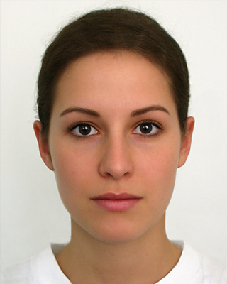
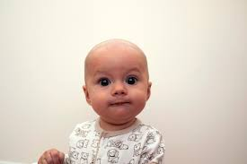
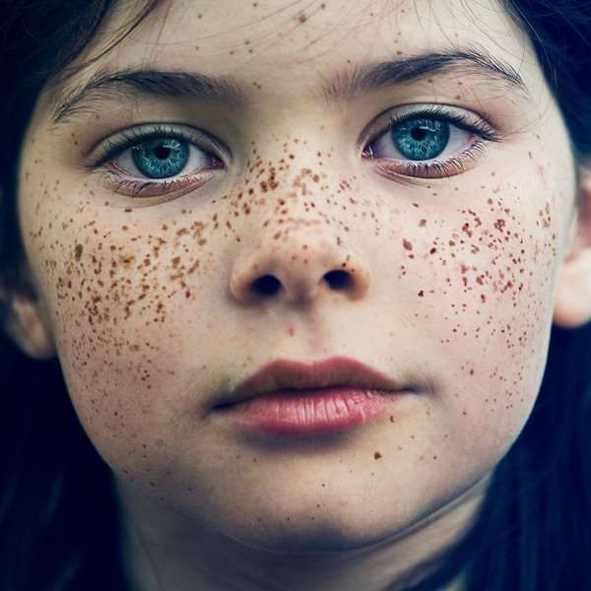
WJEC LEVEL 1/2 VOCATIONAL AWARD ICT (TECHNICAL AWARD)
Worked example:
Activity
If you look at all these photos, what common features can you identify?
Common features
©SIMPLY TEACH 2023 | www.mysimplyteach.co.uk | info@mysimplyteach.co.uk

Slide 6
WJEC LEVEL 1/2 VOCATIONAL AWARD ICT (TECHNICAL AWARD)
Worked example:
Activity
If you look at all these photos, what common features can you identify?
Common features
Eyes
Mouth
Skin
Nose
Ears
These common features could be referred to as rules. They’re typical features of the human face.
However, there is a problem with this. These common features could also be shared with animals such as dogs and cats.
©SIMPLY TEACH 2023 | www.mysimplyteach.co.uk | info@mysimplyteach.co.uk

Slide 7
WJEC LEVEL 1/2 VOCATIONAL AWARD ICT (TECHNICAL AWARD)
Worked example:
Activity
Let’s try and refine it further. Are there any features that will help us to differentiate between a dog and a human.
Common features – How are they different?
Eyes
Mouth
Skin
Nose
Ears
©SIMPLY TEACH 2023 | www.mysimplyteach.co.uk | info@mysimplyteach.co.uk

Slide 8
WJEC LEVEL 1/2 VOCATIONAL AWARD ICT (TECHNICAL AWARD)
Worked example:
Activity
Let’s try and refine it further. Are there any features that will help us to differentiate between a dog and a human.
Common features – How are they different?
Eyes – Colour is different, but both have two eyes
Mouth – Dogs have smaller mouth, no lips and bigger tongue.
Skin – Dogs have fur to protect their skin.
Nose – Dogs have a different shaped nose.
Ears – Both have two ears, dogs are near the top of their head.
This will help to refine the rules slightly but more would need to be done to refine this algorithm so it can only detect human faces. It has to learn as it goes along – It’s called Machine Learning.
©SIMPLY TEACH 2023 | www.mysimplyteach.co.uk | info@mysimplyteach.co.uk

Slide 9
WJEC LEVEL 1/2 VOCATIONAL AWARD ICT (TECHNICAL AWARD)
Main task:
Complete the workbook provided for this lesson IT12: Artificial intelligence
©SIMPLY TEACH 2023 | www.mysimplyteach.co.uk | info@mysimplyteach.co.uk

