Slide 1
TURN UP
Monday 13th March 2023
Line up in silence
Correct uniform on entry
Sit down quietly
Do the ‘Do It Now Task’
Sit down quietly
Log on
Go to: www.computingrt.com or TEAMS
WORK HARD
DO NOT move around the room
Complete your lesson goal
Listen and do not interrupt
BE NICE
Use good manners –
“Yes Miss / Here Miss”
“Please may I / Thank you Miss”​
Choose your language carefully
Help others

Slide 2
Lesson 3: Wired and wireless networks
Save a copy
Year 7 – Networks: from semaphores to the internet
Notes:
Last updated: 01-07-20
This resource is available online at ncce.io/net1-3-s. Resources are updated regularly — please check that you are using the latest version.
This resource is licensed under the Open Government Licence, version 3. For more information on this licence, see ncce.io/ogl.

Slide 3
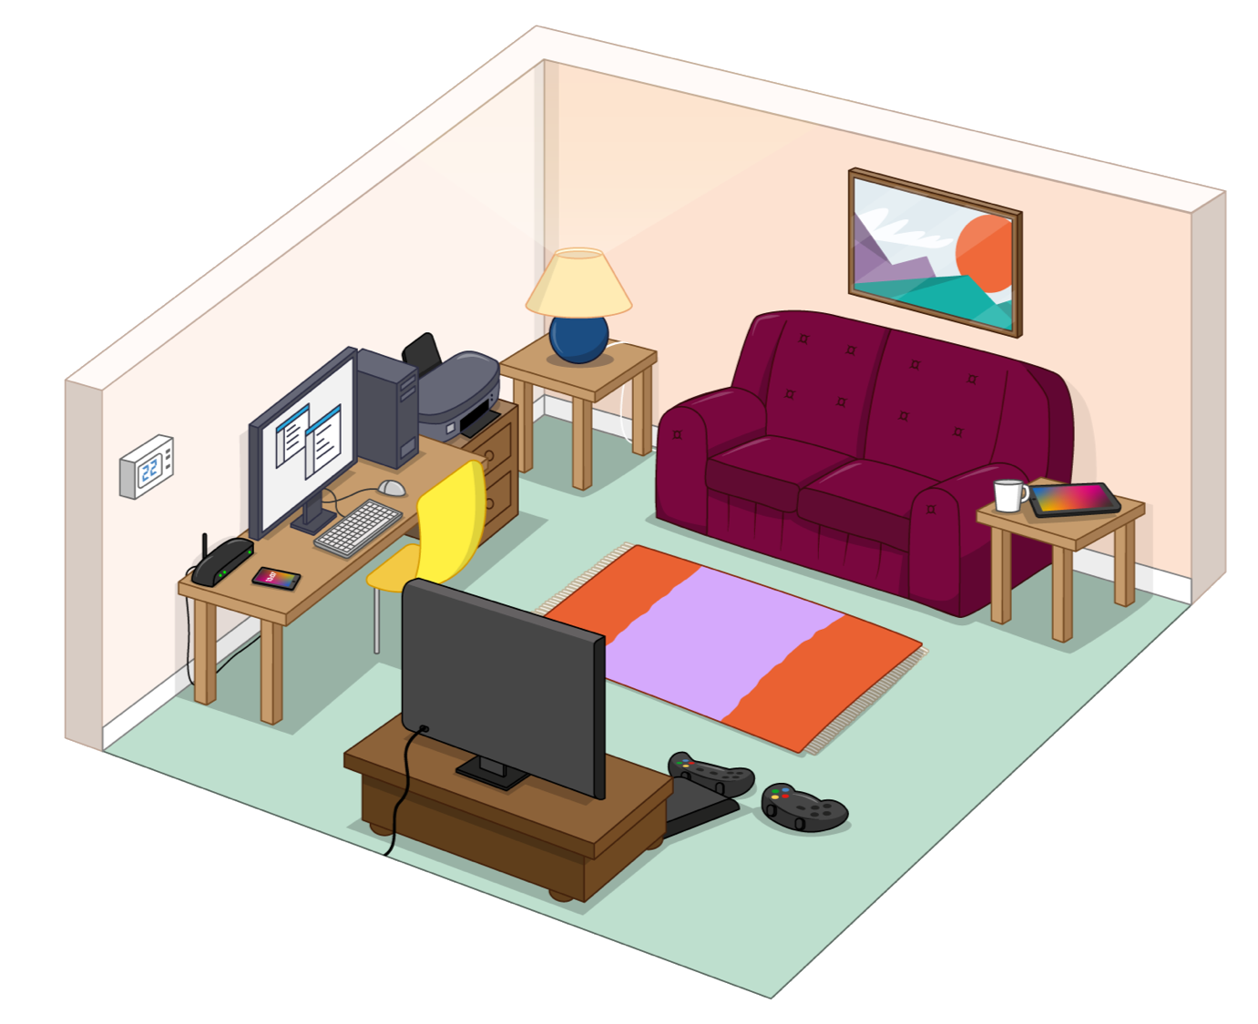
Wired or wireless?
Starter activity
Look at the image of the living room and the devices within it. Identify if the devices are connected to the network through wires or wirelessly.
Notes:
Learners should review the image. Within the image are seven devices (router, desktop PC, printer, TV, games console, tablet, and mobile phone). Learners should discuss with one another whether each device would connect to a network in the home through wires or wirelessly.
It is likely that learners will have different opinions on a few devices, such as the printer, games console, and TV. These devices could be set up either using wires or wirelessly in the learners’ homes. This will be discussed on the next slide.

Slide 4
Wired or wireless?
Starter activity
Answers:
Router – Wired
Desktop PC – Wired
Printer – Wired or wireless
TV – Wired or wireless
Games console – Wired or wireless
Tablet – Wireless
Smartphone – Wireless
Some devices can be either wired or wireless. Why might it be best for a games console to use a wired connection?
Notes:
A number of devices could be connected through wires or wirelessly. This may, in fact, be the case between different learners. Both will work in either setting. However, some devices might be better suited to a wired connection compared to a wireless connection. Ask the learners why it might be best for a games console to use a wired connection.
Learners may identify that a wired connection is better. They may use words like “stronger” or “quicker” or “faster”. Inform learners that you will address this in more detail later on in the lesson.

Slide 5
Lesson 3: Wired and wireless networks
Objectives
In this lesson, you will:
Compare wired to wireless connections and list examples of specific technologies currently used to implement such connections
Define ‘bandwidth’, using the appropriate units for measuring the rate at which data is transmitted, and discuss familiar examples where bandwidth is important

Slide 6
Wired and wireless data transmission
Activity 1
A computer network can be either wired or wireless.
Wired networks send data along cables.
Wireless networks send data through the air using radio waves.
Do you know any names of wireless technologies? (Think, pair, share)
Notes:
The most popular examples of wireless technologies are Bluetooth, WiFi, 3G, and 4G.
Other examples are: infrared, satellite, microwave, radio
Image sources:
Ethernet cable Image: https://pixabay.com/vectors/ethernet-internet-lan-network-1294340/
Wireless Image: https://pixabay.com/vectors/radiation-ionizing-wifi-wlan-297286/

Slide 7
Do you know any names of wireless
technologies?
Activity 1
Popular examples of wireless technologies are:
Bluetooth
WiFi
3G (third generation wireless mobile)
4G (fourth generation wireless mobile)
What is the difference between 3G and 4G?
Notes:
Popular examples of wireless technologies are Bluetooth, WiFi, 3G, and 4G. Bluetooth is a wireless technology for transferring data over short distances (e.g. Bluetooth headphones paired to a mobile phone to listen to music). WiFi allows computers, smartphones, or other networkable devices to connect to the internet or communicate with each other without wires. 3G and 4G are both wireless mobile phone technologies. There are many others, and learners may have suggested any number of wireless technologies. Other popular examples include infrared, satellite, microwave, and radio.
Learners are asked what the difference is between 3G and 4G. Learners just need to think about their answer at this stage. This question is revisited later on.
WiFi image source: https://pixabay.com/vectors/wlan-signal-black-wireless-network-303722/

Slide 8
Bandwidth
Activity 2
Bandwidth is the amount of data that can be moved from one point to another in a given time. Higher bandwidth = more data per second
The concept is similar to the volume of water flowing through a pipe. This depends on the size and thickness of the pipe.
More bandwidth DOES NOT increase the speed.
In the analogy of a pipe, the water doesn’t travel any faster as the pipe gets bigger, but you get more water because more can flow through at the given time.
Notes:
Bandwidth is the maximum rate that data can be transferred across a connection. A common misconception is that the more bandwidth you have, the faster the data travels. This is not the case. The data still travels at the same speed, but more data can travel through at any given time.
Computer icon image: http://www.freestockphotos.biz/stockphoto/15372

Slide 9
Bandwidth
Activity 2
A
B
C
Look at the three cables (A, B, and C). Which has the greatest bandwidth?
(Think, pair, share)
Notes:
Bandwidth is the maximum rate that data can be transferred across a connection. Ask the learners to ‘think, pair, share’: “Look at the 3 cables (A, B and C). Which has the greatest bandwidth?”.

Slide 10
Answer:
Activity 2
Look at the three cables (A, B, and C). Which has the greatest bandwidth?
Greatest bandwidth: A
A
B
C
Notes:
Learners will hopefully identify that A has the greatest bandwidth as it has the largest internal diameter which data can travel through.

Slide 11
Measuring bandwidth
Activity 3
Bandwidth is measured in bits per second
A bit is the smallest unit of data
Data transfer rates are now so good that bandwidth is usually measured in Megabits per second (Mbps)
1 Mb = 1 million bits
Which do you think has the highest and the lowest bandwidth? Broadband, 3G, or 4G?
(Think, pair, share)
Notes:
Ask the question: “Which do you think has the highest and the lowest bandwidth? Broadband, 3G, or 4G?”
Speed test icon source: https://upload.wikimedia.org/wikipedia/commons/thumb/4/4a/Speed_ballonicon2.svg/480px-Speed_ballonicon2.svg.png

Slide 12
Bandwidth compared
Activity 3
The typical download speeds are:
3G: 3 Mbps
4G: 20 Mbps
Broadband: 46 Mbps
Download: Your computer is receiving data (e.g. browsing a web page, watching online videos)
Upload: Your computer is sending data to the internet (e.g. putting a video on YouTube, posting a photo on Instagram)
Upload speeds are usually much slower than download speeds. Why? (Hands up)
Notes:
The answer is: 3G has the lowest bandwidth, and broadband has the highest bandwidth. Confirm that the learners understand the terms ‘download’ and ‘upload’, and then pose another question: “Upload speeds are usually much slower than download speeds. Why?”.
Mobile broadband typical speeds taken from: https://www.4g.co.uk/how-fast-is-4g/
Broadband speeds taken from: https://www.trustedreviews.com/news/uk-broadband-speed-average-2018-3470469

Slide 13
Answer:
Activity 3
Upload speeds are usually much slower than download speeds. Why?
Internet service providers (ISPs) configure our connection based on the most popular activities.
Most users spend much more time downloading than they do uploading.
For this reason, downloading gets allocated much more of the available bandwidth than uploading.

Slide 14
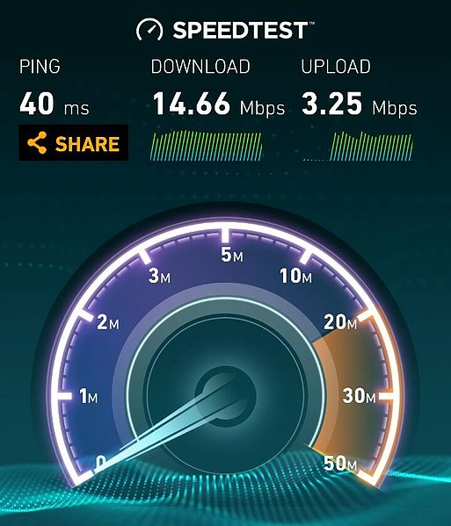
Performance test
Activity 4
Test the performance of your current connection.
Visit https://www.speedtest.net/
Look at your download speed
Look at your upload speed
Questions:
Are your speeds the same as your neighbours’? If not, why might that be?
If we were all watching YouTube at the same time, would this change the result?
Notes:
Note: This is a recommended activity, but if previous activities have overrun, then you could miss out this activity without affecting the learning objectives.
speedtest.net is a website that provides free analysis of internet performance. Learners can test their current connection and view their upload and download rate in Mbps.
When learners have run the test, ask them to pay particular attention to the upload and download speed. Ask them to think about their answers to the following questions:
Are your speeds the same as your neighbours? If not, why might that be?
If we were all watching YouTube at the same time, would this change the result?
Answers:
It is likely that learners have similar speeds, but they could vary. Some might be slower than others due to being further away from the hub connecting all of the machines to the router. An individual PC might have a damaged cable.
If all of the learners were watching videos on YouTube at the same time, all available bandwidth would be used and split across all of the learners’ PCs. As a result, download speeds would be much slower.
Speed test image source: https://commons.wikimedia.org/wiki/File:Jio4G_SpeedTest.jpg

Slide 15
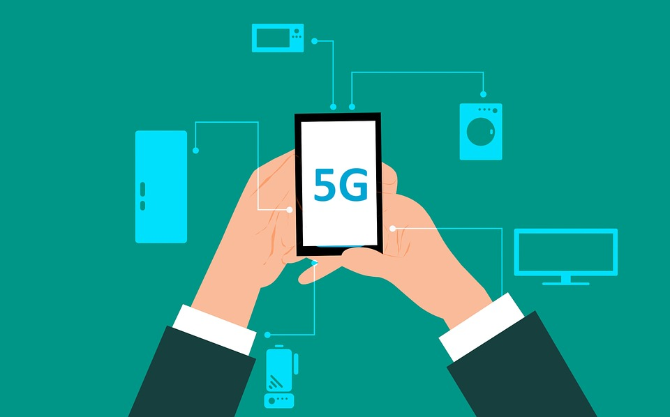
The future
Activity 4
5G is the next generation of mobile internet connectivity.
It is available now. EE was the first to release it in 6 cities in May 2019.
5G has the potential to reach speeds of 10 Gbps (1 Gb = 1000 Mb).
20 times faster than 4G.
It would take less than 1 second to download an HD film!
Notes:
Give learners an insight into our future. It is almost certain that bandwidth will continue to improve significantly. 5G has just been released and is growing in popularity. It has the capability to reach speeds of 10 Gbps.
5G image source: https://pixabay.com/illustrations/accessibility-browsing-5g-business-3570138/
5G speed data taken from: https://5g.co.uk/guides/how-fast-is-5g/

Slide 16
Activity 5
What does this mean and when might you see it? (Think, pair, share)
Notes:
Ask learners if they have seen this icon before and if so, when and why they think it occurred.

Slide 17
Answer: Buffering
Activity 5
Data is arriving at your device at a rate that is slower than it is being processed
Example: when you are watching a film on Netflix and it pauses, and you have to wait for a period of time before it starts again
Indicates that more bandwidth is required
Notes:
Think of your internet connection as a pipe, but instead of water, it’s carrying digital data. If you see the icon shown here, it means that your connection is too narrow and the data it carries is not coming through quickly enough to keep up with your activity. An example might be when you are watching a film on Netflix and it pauses, and you have to wait for a period of time before it starts again. If this occurs a lot, you might need to change your internet package to one with more bandwidth.

Slide 18
Bandwidth matters
Activity 6
Some online activities use more data than others.
Those using the most data require higher bandwidth in order to avoid delays, freezing screens, or buffering.
Can you identify which activities use more bandwidth? Complete the activity in your worksheet.
Notes:
Ask learners to refer to the worksheet. For this activity, they will be given a list of online activities. They need to categorise the activities between light, medium, and high internet use.
The answers are as follows:
Light internet use: reading online news, checking the weather
Medium internet use: checking social media, emailing regularly
High internet use: online gaming, a vlogger uploading videos to YouTube daily

Slide 19
Bandwidth matters – Answers
Activity 6
Light internet use: reading online news, checking the weather
Medium internet use: checking social media, emailing regularly
High internet use: online gaming, a vlogger uploading videos to YouTube daily

Slide 20
Wired versus wireless
Activity 7
We know that a network can be wired or wireless.
There are a number of advantages and disadvantages to both wired and wireless networks. Can you think of any?
Hands up
vs
Notes:
It is expected at this stage that learners would identify that portability is a key advantage of a wireless network. A key disadvantage of a wired network is the cables themselves, and the fact that they could be a trip hazard, or just unsightly.

Slide 21
Wired versus wireless
Activity 7
There are twelve statements.
You will be given two tables, one for wired networks and one for wireless networks.
Each table contains two columns, one for advantages, and one for disadvantages.
Your challenge:
Identify whether the statement relates to wired or wireless networks.
Next, identify whether it is an advantage or disadvantage.
Next, move the statement into the correct column.
Six statements have been completed for you. Six still need to be sorted.
Notes:
Ask learners to refer to the worksheet and complete the ‘Wired versus wireless’ activity, in which they need to identify a number of advantages and disadvantages to both wired and wireless networks. Twelve statements are provided and six of these have been completed already as examples. Learners need to copy and paste the remaining six statements into one of two tables (wired or wireless) and in each table, identify whether it is an advantage or a disadvantage.

Slide 22
Wired networks – Answers
Activity 7
Advantages | Disadvantages
Faster connection (little to no interference) | Cables can be a trip hazard and look unpleasant
Higher bandwidth | More expensive and time-consuming to add devices, as each device needs cables
Better security | Devices are in fixed positions (no portability)
Notes:
Wired networks
Advantages:
Faster connection (little to no interference)
Higher bandwidth — without interference, the connection speed is consistent. Also, the technology provides a greater bandwidth.
Better security — data sent across a wired network can only be accessed by devices attached to that network
Disadvantages:
Cables can be a trip hazard and look unpleasant — this becomes a greater problem the more devices you add
It is more expensive and time-consuming to add devices, as each device needs cables
Devices are in fixed positions (no portability) — this is a major disadvantage and gives users far less freedom to move around with their device; machines will be restricted to a fixed location

Slide 23
Wireless networks – Answers
Activity 7
Advantages | Disadvantages
No trailing wires/no trip hazard | Lower bandwidth
It is quick and cheap to connect new devices | Wireless connections can be weakened by walls and ceilings
Allows portability | Less secure
Notes:
Wireless networks
Advantages:
No trailing wires/no trip hazard — networks are unclustered and the connections are invisible, as they occur using radio waves
It is quick and cheap to connect new devices — devices simply have to search for the name of the wireless network and then connect to it (sometimes a password is required)
Allows portability — this is the main advantage; you can move freely with your devices (as long as you remain in range)
Disadvantages:
Lower bandwidth — wireless networks suffer from interference. This could be from neighbouring wireless signals, among others. This lowers the overall bandwidth.
Wireless connections can be weakened by walls and ceilings, causing dropped signals and lower speeds
Less secure — data sent across a wireless network can be intercepted more easily

Slide 24
Scenarios: wired or wireless?
Activity 8
You have six scenarios to read through.
Identify whether it would be best to use a wired network or a wireless network.
Notes:
Ask learners to complete the ‘Wired or wireless?’ activity in their worksheets. Six scenarios have been provided. Learners should read through each scenario carefully and identify whether they would be best served with a wired network or a wireless network.

Slide 25
Wired or wireless? – Answers
Activity 8
Wireless:
The restaurant
The cafe
The family
Wired:
The office
The vlogger
The primary school
Notes:
Wireless:
The restaurant: The tablets are portable. It would be very impractical to have wires connected from the screen in the kitchen to each tablet.
The cafe: The devices that customers bring to the cafe are portable. It is simpler to connect devices to a wireless network.
The family: Family members move around the house. They will be using portable devices.
Wired:
The office: Office workers have their own area in which they work on the computers. They do not need to have portable devices.
The vlogger: Uploading videos and online gaming are activities that require greater bandwidth.
The primary school: The computers are fixed to desks in two classrooms. It would be simple to wire these to hubs.

Slide 26
Exit ticket
Plenary
Define bandwidth
Notes:
Give learners the exit ticket at the end of the lesson. Learners are to spend the remaining minutes answering the question. Collect the tickets in at the end of the lesson and review the answers.
Ticket image source: https://pixabay.com/vectors/ticket-yellow-pass-admit-admission-303706/

Slide 27
Next lesson
Summary
In this lesson, you…
Learnt about the term ‘bandwidth’ and the difference between wired and wireless connections.
Next lesson, you will…
Learn about the internet and the ways in which data is transmitted between computers across a network.

Slide 28
TURN UP
Plenary
Line up in silence
Correct uniform on entry
Sit down quietly
Do the ‘Do It Now Task’
Log off
Headphones on monitors
Chairs under
Stand in Silence behind your chairs
WORK HARD
DO NOT move around the room
Complete your lesson goal
Listen and do not interrupt
BE NICE
Use good manners –
“Yes Miss / Here Miss”
“Please may I / Thank you Miss”​
Choose your language carefully
Help others

