Slide 1
Lesson 1: Computer networks
Year 7 – Networks: from semaphores to the Internet
Notes:
Last updated: 09-03-21
Resources are updated regularly — the latest version is available at: ncce.io/tcc.
This resource is licensed under the Open Government Licence, version 3. For more information on this licence, see ncce.io/ogl.

Slide 2
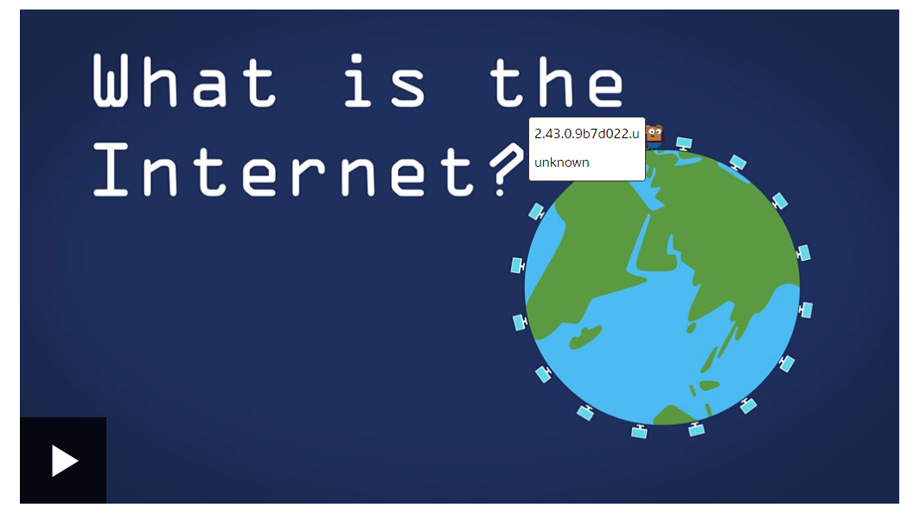
STARTER ACTIVITY – What is the Internet?
Watch the video as a class and then read through the webpage

Slide 3
How many devices are connected to the internet?
Group Starter Activity
Notes:
Pose the question to the learners and ask them to write their answers on a sticky note or piece of paper. This is a thought-provoking question, and you will not give the answer until the end of the lesson. The learners can revise their answers at any point in the lesson, but they should attempt to answer the question at the start.
Connections image source: https://pixabay.com/vectors/connection-communication-network-4348764/

Slide 4
Lesson 1: Computer networks and protocols
Objectives
In this lesson, you will:
Define what a computer network is and explain how data is transmitted between computers across networks
Define ‘protocol’ and provide examples of non-networking protocols

Slide 5
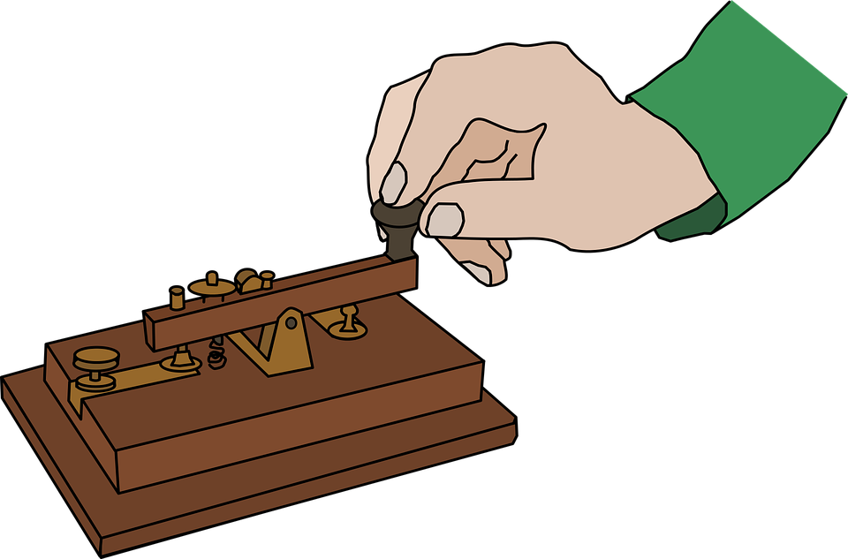
Historic communication methods
Activity 1
These are all forms of communication. Can you match the name with the image and the year in which they were first used?
Telegram
1876
Email
1961
1837
Carrier pigeon
1791
Telephone
1167
Semaphore
Notes:
This slide shows five communication methods, five images, and five years. Learners need to identify which method goes with which image and year. The activity is also provided in the worksheet for pupils to complete electronically, if required.
Image sources:
Pigeon image: https://pixabay.com/vectors/pigeon-animal-bird-wings-feathers-24418/
Telegram image: https://pixabay.com/vectors/code-communication-hand-history-1295854/
Email image: https://pixabay.com/illustrations/mail-message-email-send-message-1454731/
Telephone image: https://pixabay.com/illustrations/retro-telephone-dial-phone-vintage-4273184/
Semaphore image 1: https://en.wikipedia.org/wiki/Semaphore_telegraph#/media/File:Chappe_semaphore.jpg
Semaphore image 2: https://en.wikipedia.org/wiki/Semaphore_telegraph#/media/File:Chappe.svg

Slide 6
Answers
Activity 1
Carrier pigeon
Semaphore
Telegram
1167
1791
1837
Telephone
Email
1876
1961
Notes:
These are all forms of communication that involve passing a message on between multiple operators or devices until the message is received by the recipient. A computer network operates in the same way.
Interesting facts about each communication method that you could share:
Carrier pigeon: Carrier or homing pigeons are birds that have been trained to find their way back home over great distances. Carrier pigeons were used historically to send short messages on a small piece of paper attached to the leg of the bird. They were used in battle by armies to communicate. Some pigeons can fly at over 60 mph. By 1167, a regular carrier pigeon communication service had been created between Baghdad and Syria. Over 54,000 pigeons were used in WW1 and WW2 to relay secret messages.
Semaphore: The semaphore was first introduced in France in 1791, when France was on the brink of a revolution. The French government needed a way to send and receive messages quickly. Claude Chappe (along with his 4 brothers) created a system that was made of towers placed less than 20 miles apart. Each tower had two moving wooden arms and a crossbar. The position of these arms and the crossbar could be changed, and 196 different symbols were created based on these differing positions. A signal displayed by one tower would be observed by an operator using a telescope at the next tower, who would then make the same signal for the next tower — and so the message was sent from tower to tower. Operators needed to check their nearest towers very regularly and re-create the signal as quickly as possible. It was a very tiring job.
Telegrams: In 1837, two sets of inventors simultaneously developed an electrical telegraph: Wheatstone and Cooke in England, and Samuel Morse in the United States. Morse went on to develop an alphabet using dots and dashes that became known as ‘Morse code’. By 1861, this Morse telegraph system connected the West and East Coast of America.
Telephone: Alexander Graham Bell is commonly credited as the inventor of the telephone, though many individuals contributed to the devices that we use today. Alexander Graham Bell filed for the patent of the telephone system in 1876.
Email: 1961: The very first version of what we now know as email was created in 1965 at Massachusetts Institute of Technology (MIT). This allowed users to share files and messages on a central disk on a server, logging in from remote machines. In 2019, there are 293.6 billion emails sent every day. In 2023, more than 347.3 billion emails will be sent daily. At least half of all emails are spam. (Source: https://www.statista.com)
Image sources:
Pigeon image: https://pixabay.com/vectors/pigeon-animal-bird-wings-feathers-24418/
Message in a bottle image: https://pixabay.com/vectors/message-in-a-bottle-drift-bottle-154178/
Telegram image: https://pixabay.com/vectors/code-communication-hand-history-1295854/
Email image: https://pixabay.com/illustrations/mail-message-email-send-message-1454731/
Telephone image: https://pixabay.com/illustrations/retro-telephone-dial-phone-vintage-4273184/

Slide 7
What is a computer network?
Activity 2
A computer network is when two or more computers are connected together to allow them to communicate.
This brings many benefits, which will be covered later on.
THINK HOW BORING MOBILE PHONES WOULD BE IF WE COULDN’T CONNECT!
IS A MOBILE PHONE A COMPUTER?
Notes:
Give the learners the definition of a computer network.
Source of image of computer: https://cdn.pixabay.com/photo/2012/04/02/16/18/network-24862_960_720.png

Slide 8
Using computer networks
Activity 2
What common daily activities do you think use computer networks?
Group ideas…
Notes:
Ask the question to the learners. Ask them to think of the answers, then to pair with a neighbour and discuss their answers with each other.
Share image source: https://pixabay.com/vectors/classroom-comic-characters-1297775/

Slide 9
How many common daily activities do you think use computer networks?
Activity 2
Morning: music playing via a Bluetooth speaker, asking Alexa for the weather forecast, controlling your central heating via an app on your phone
Daytime: logging on to a PC for a Computing lesson, accessing files stored on the school network, printing to the library printer, researching a topic on the internet
Evening: Using social media, playing games online
Notes:
Go through the answers to the question. The daily activities shown are simply examples, and there are many ways in which computer networks may be used daily by the learners. Learners should be given the opportunity to amend their current answers.
Source of image of computer: https://cdn.pixabay.com/photo/2012/04/02/16/18/network-24862_960_720.png

Slide 10
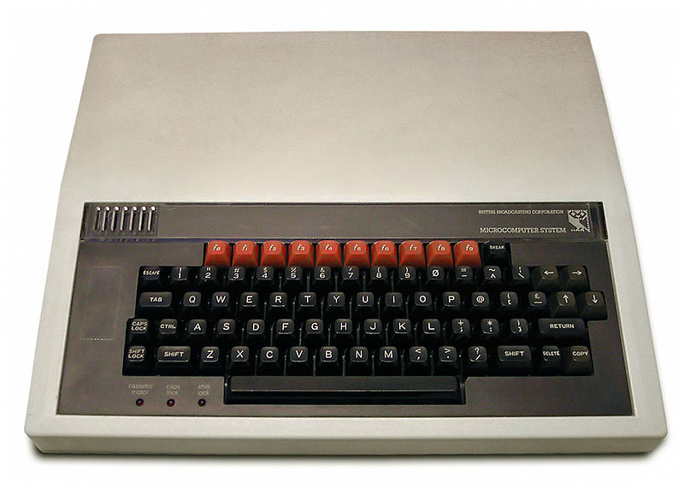
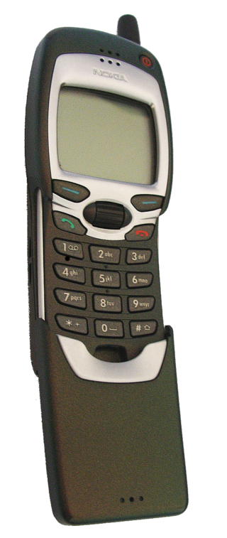
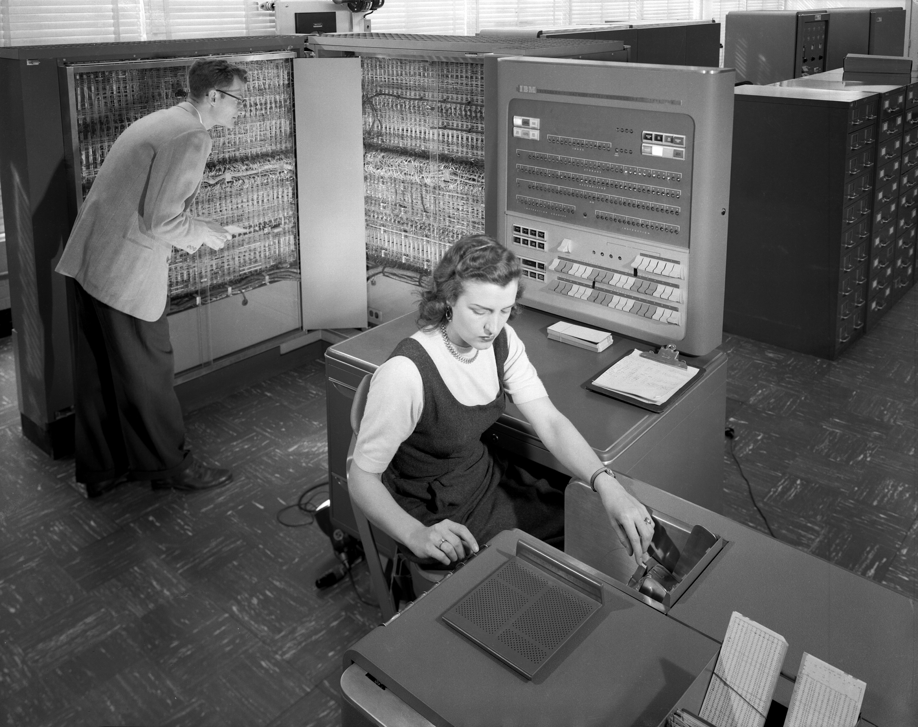
Key milestones of Computers becoming connected
Activity 3
Question revisited:
How many devices are now connected to the internet?
Guidance: There are just under 8 billion people on the planet.
The internet: The first internet was called the ARPANET. Only a few people had access to it initially.
World Wide Web: Tim Berners-Lee invented the WWW.
1969
1989
1950–1970
1974–1977
1999
Mainframe computers: Mainframe computers grew in popularity. These were large and expensive.
The first personal computers: IBM and Apple were a couple of the brands releasing PCs.
Mini computers: Nokia introduced a mobile phone that could connect to the internet.
Think, pair, share
Notes:
Computers have evolved greatly over the last 70 years. Discuss the timeline with your learners. This shows some key milestones in the growth of computer networking.
1950–1970: Mainframe computers grew in popularity. These were single computers supporting multiple users/terminals connecting to it at the same time. These machines were very large and expensive.
1969: The internet was brought online in 1969. It was initially called the ARPANET. It was a project run by the Advanced Research Projects Agency (ARPA) to connect four American universities together.
1989: A British scientist called Tim Berners-Lee invented the World Wide Web in 1989. The original purpose of the web was to allow automatic information sharing between scientists in different universities around the world.
1999: Nokia brought out a revolutionary new mobile phone called the 7110. This was the world’s first mobile phone that could access information from the internet. The mobile phone became a global communication device. Users could check weather reports as well as email. However, all information was text only.
Learners should now have a basic overview of how computer networks have evolved over time. Now, ask your learners the same question that was asked at the very start of the lesson, “How many devices are now connected to the internet?”. Ask them to review their answers, then to pair with a neighbour and discuss their answers with each other. If they are struggling to think of an answer, you could inform them that there are currently around 8 billion people on the planet. You could also mention that many devices now connected to the internet require no human-to-computer interaction; they are communicating with themselves independently. This is known as the Internet of Things (IoT) and includes devices such as smart meters sending gas and electric readings each day from our homes to our providers. If the learners’ answers differ from the start of the lesson, ask them to amend them. The answer will be revealed at the end of the lesson.
Image sources:
PC image: https://en.wikipedia.org/wiki/BBC_Micro#/media/File:BBC_Micro_Front_Restored.jpg
Word Wide Web image: https://commons.wikimedia.org/wiki/File:Emojione_1F310.svg
Nokia 7110 image: https://en.wikipedia.org/wiki/Nokia_7110#/media/File:Nokia_7110_open.png
Mainframe image: https://commons.wikimedia.org/wiki/File:IBM_Electronic_Data_Processing_Machine_-_GPN-2000-001881.jpg

Slide 11
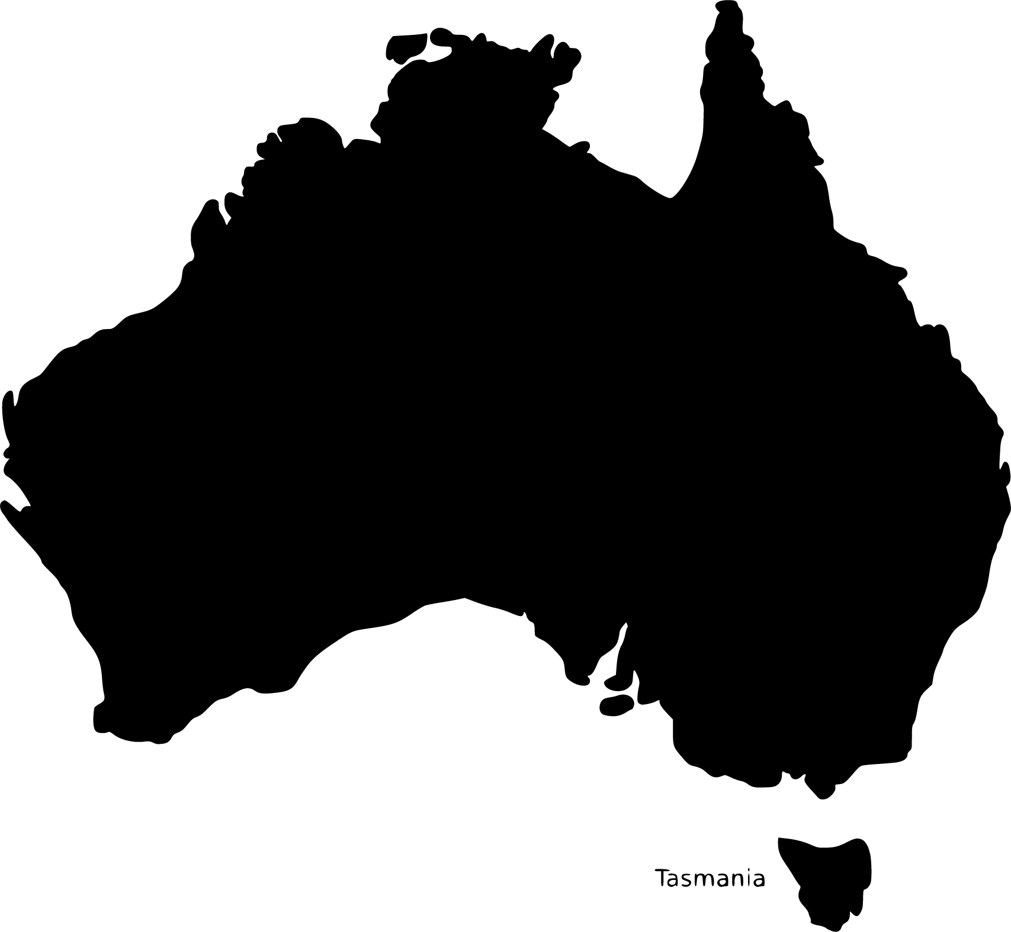
A message to Australia (part 1)
Activity 4
Imagine that you needed to send a message from the UK to Australia but no computer networks exist.
What methods would you use?
What information would you need?
Would anyone be involved in relaying the message?
Think, pair, share
Notes:
Ask the learners to discuss how they might send a message from their location to a person in Australia without the use of computer networks. Ask the learners to try to think of multiple methods, as well as the information that they would need in order to get the message to the intended recipient in Australia.
The simplest discussions might focus on an individual writing a message and then travelling from the UK to Australia to deliver it (via car, plane, or boat, etc.). More complex discussions might involve using more than one person in different countries on the way to Australia, who can each travel a short distance before passing it on to the next person in line. For this scenario, the recipient’s name and address would need to be included with the message. This would be one of the rules of the communication. Discussions may also include communication methods mentioned in activity 1, such as carrier pigeon.
Image sources:
Message image: https://pixabay.com/vectors/message-private-message-mail-email-369540/
UK image: https://svgsilh.com/image/36481.html
Australia image: https://svgsilh.com/image/157273.html
Computer icon: http://www.freestockphotos.biz/stockphoto/15372
Prohibited icon: https://pixabay.com/vectors/no-symbol-prohibition-sign-39767/

Slide 12
A message to Australia (part 2)
Activity 4
Imagine that you needed to send a message from the UK to Australia and computer networks do exist.
What methods would you use?
What information would you need?
Would anyone be involved in relaying the message?
Think, pair, share
Notes:
This is the same scenario as before, except that computer networks do exist. Ask the learners to try to think of multiple methods, as well as the information that they would need in order to get the message to the intended recipient in Australia.
Discussions will most likely be based around email, but could include instant message, or FaceTime and Skype. Most forms of computer-based communication would require the email address of the sender and the recipient. This would be one of the rules of the communication.
Image sources:
Message image: https://pixabay.com/vectors/message-private-message-mail-email-369540/
UK image: https://svgsilh.com/image/36481.html
Australia image: https://svgsilh.com/image/157273.html
Computer icon: http://www.freestockphotos.biz/stockphoto/15372

Slide 13
Message transmission: letters
Activity 4
An answer to the first scenario (no computer networks) might have been to write and post a letter.
How is a letter sent from the UK to Australia? What steps are involved between putting the letter in the postbox and it arriving at the destination?
(Hands up)
Notes:
Ask the learners to think about what happens when a letter is sent (which may have been a common answer when discussing sending a message between the UK and Australia with no computer networks). Hopefully, the learners will discuss the use of post office depots that are located at key intervals along the journey. The letter is passed to these depots until it reaches its final destination.
Image sources:
Message image: https://pixabay.com/vectors/message-private-message-mail-email-369540/
UK image: https://svgsilh.com/image/36481.html
Australia image: https://svgsilh.com/image/157273.html

Slide 14
Message transmission: email
Activity 4
Just as a letter does not go directly from the sender to the recipient, the email does not travel from a sender’s machine through a cable or “into the cloud” directly to the recipient’s machine.
The message is passed on to many mail servers along the way, who help get the message to its destination.
Notes:
Hopefully, a common answer to the second scenario, where computer networks existed, was “email”. A common misconception is that a message is transmitted directly from one machine to another across a network or the internet. Learners may believe that when an email is sent, it simply ‘enters the cloud’ and then appears at the recipient’s machine, or that it travels directly along a cable from point A to point B. This is not the case.
The purpose of this slide is to illustrate that a message may pass through many intermediary devices along the way, that then pass the message on. This is exactly the same as how a letter may travel across a country or the globe, going from one post office depot to another until it reaches the recipient. Indeed, this is the same principle as the semaphore in activity 1, which used towers positioned a visible distance apart to relay a signal via the positioning of the towers’ wooden paddles.
Image sources:
Message image: https://pixabay.com/vectors/message-private-message-mail-email-369540/
UK image: https://svgsilh.com/image/36481.html
Australia image: https://svgsilh.com/image/157273.html
Computer icon: http://www.freestockphotos.biz/stockphoto/15372

Slide 15
WAIT!!! How does the internet actually get to America and back in 1 second…..
Activity 5
Notes:
Hopefully, a common answer to the second scenario, where computer networks existed, was “email”. A common misconception is that a message is transmitted directly from one machine to another across a network or the internet. Learners may believe that when an email is sent, it simply ‘enters the cloud’ and then appears at the recipient’s machine, or that it travels directly along a cable from point A to point B. This is not the case.
The purpose of this slide is to illustrate that a message may pass through many intermediary devices along the way, that then pass the message on. This is exactly the same as how a letter may travel across a country or the globe, going from one post office depot to another until it reaches the recipient. Indeed, this is the same principle as the semaphore in activity 1, which used towers positioned a visible distance apart to relay a signal via the positioning of the towers’ wooden paddles.
Image sources:
Message image: https://pixabay.com/vectors/message-private-message-mail-email-369540/
UK image: https://svgsilh.com/image/36481.html
Australia image: https://svgsilh.com/image/157273.html
Computer icon: http://www.freestockphotos.biz/stockphoto/15372

Slide 16
Protocols
Activity 6
All methods of communication need rules in place in order to pass on the message successfully. These sets of rules are called protocols.
What protocol exists for meeting someone new?
Is this the same in all countries?
Notes:
Describe the meaning of the word ‘protocol’ and ask the questions shown on the slide.
Image source: https://pixabay.com/photos/handshake-hand-give-business-man-2056023/

Slide 17
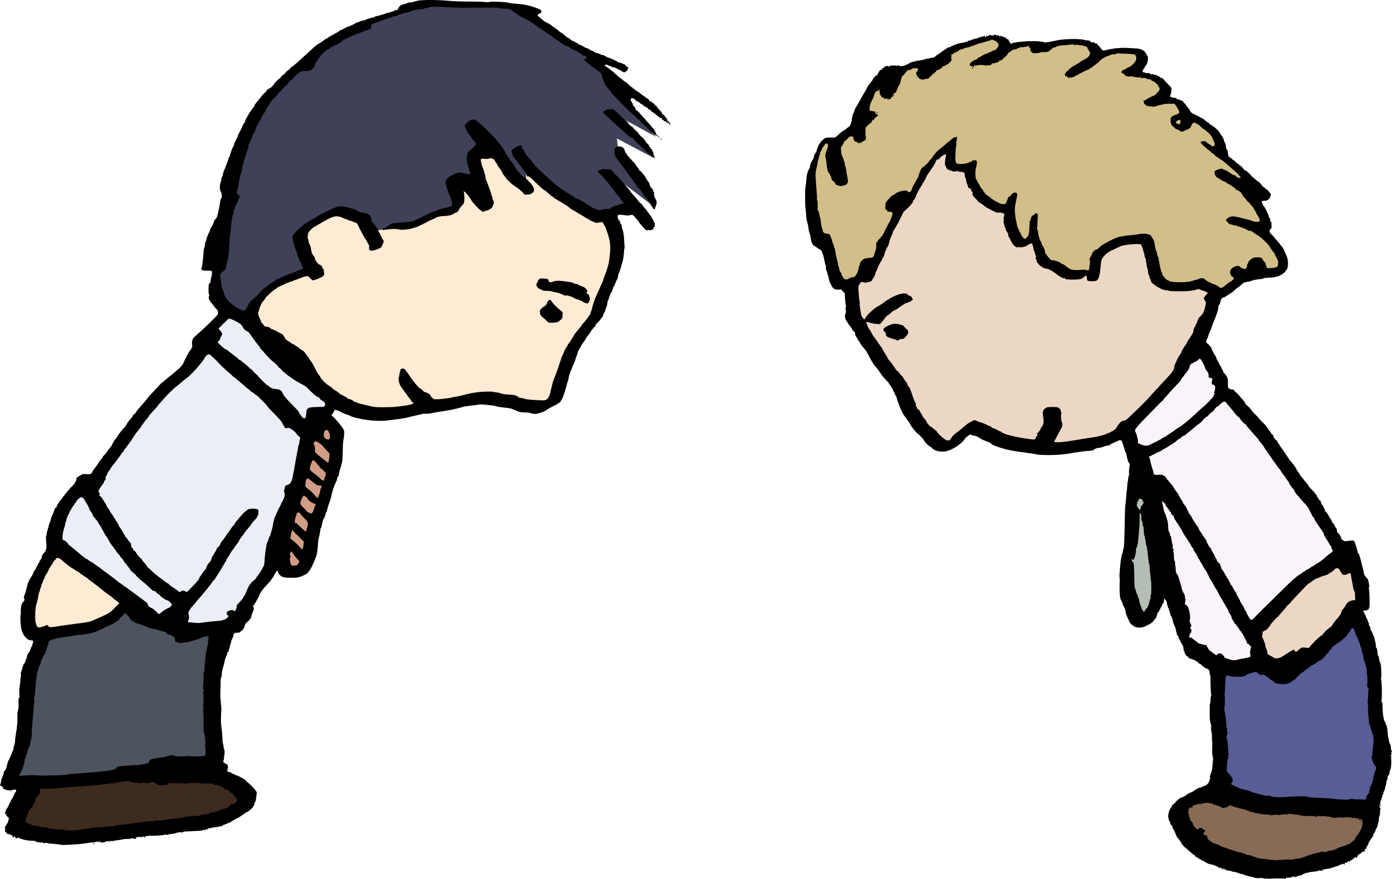
Protocols
Activity 6
UK:
Smile, and say ‘Hello’
Shake right hands (shaking left hands is considered disrespectful in many countries)
Question:
In which cultures do people use the below protocols to greet each other?
Bowing
Rubbing noses
Sticking your tongue out
Notes:
Review the answer to the question asked on slide 14. In addition, learners can explore how greetings may differ in different countries.
Bowing image source: https://www.goodfreephotos.com/albums/vector-images/two-guys-bowing-vector-clipart.png

Slide 18
Protocols
Activity 6
Question: In which cultures do people use the below protocols to greet each other?
Answer:
Bowing: Japan
Rubbing noses: Inuit
Sticking your tongue out: Tibetan
It is important that both parties involved in communication know the rules. This is the same with computer network protocols.
Notes:
Bowing image source: https://www.goodfreephotos.com/albums/vector-images/two-guys-bowing-vector-clipart.png

Slide 19
Climber and belayer protocol
Activity 7
Climbers often attach to a rope for safety via a belay clip.
The length of this rope is controlled by a person called the belayer.
The belayer is responsible for the climber’s safety.
A series of commands exist in order for the climber and belayer to communicate during the climb.
Can you order them correctly so that the climber can ascend safely?
Belay: To fix a rope around an object to secure it
Notes:
Learners are given a series of universal commands between a climber and a belayer, which they should put in the correct order to ensure the safe ascent of the climber. The commands are on the lesson worksheet.

Slide 20
Commands to order
Activity 7
Command | Person | Meaning
Belay On | Belayer | The rope is secured and slack taken up so it is tight.
Climbing | Climber | I wish to climb.
Off Belay | Climber | I wish to be detached from the rope. The climber only says this command when it is safe to do so at their destination.
Belay Off | Belayer | The belay rope has been disconnected.
Climb On | Belayer | I am happy for you to climb.
Slack | Climber | I need some slack rope in order to climb up.
On Belay? | Climber | Is the rope secured?

Slide 21
Answers
Activity 7
Command | Person | Meaning | Order number (1 to 7)
On Belay? | Climber | Is the rope secured? | 1
Belay On | Belayer | The rope is secured and slack taken up so it is tight. | 2
Climbing | Climber | I wish to climb. | 3
Climb On | Belayer | I am happy for you to climb. | 4
Slack | Climber | I need some slack rope in order to climb up. | 5
Off Belay | Climber | I wish to be detached from the rope. The climber only says this command when it is safe to do so at their destination. | 6
Belay Off | Belayer | The belay rope has been disconnected. | 7
Notes:
Climber image source: https://pixabay.com/photos/hiking-mountain-climbing-mountain-1031628/

Slide 22
Computer protocols: email and web address protocols
Activity 8
What rules (protocols) exist for an email address?
An ‘@’ symbol must be used.
The email address must be unique.
What parts of this web address show rules (protocols) being used?
http://www.bbc.co.uk
All website addresses start with ‘http://’ followed by ‘www’.
All website addresses are unique.
They use dots to separate each part of the address.
Notes:
What rules exist for an email address?
Possible answers:
An ‘@’ symbol must be used.
The email address must be unique.
These are examples of computer protocols used in communication across a network. More computer-based protocols will be covered later in this unit.
What parts of this web address show a protocol being used? http://www.bbc.co.uk
Possible answers:
All website addresses start with ‘http://’ followed by ‘www’.
All website addresses are unique.
They use dots to separate each part of the address.
Message image source: https://pixabay.com/vectors/message-private-message-mail-email-369540/

Slide 23
How many devices are connected to the internet?
Plenary
Would you like to revise your answer in the light of the lesson?
Notes:
Ask learners to share their answers to this question. Ask learners if their answer changed over the course of the lesson, and if so, why.
Connections image source: https://pixabay.com/vectors/connection-communication-network-4348764/

Slide 24
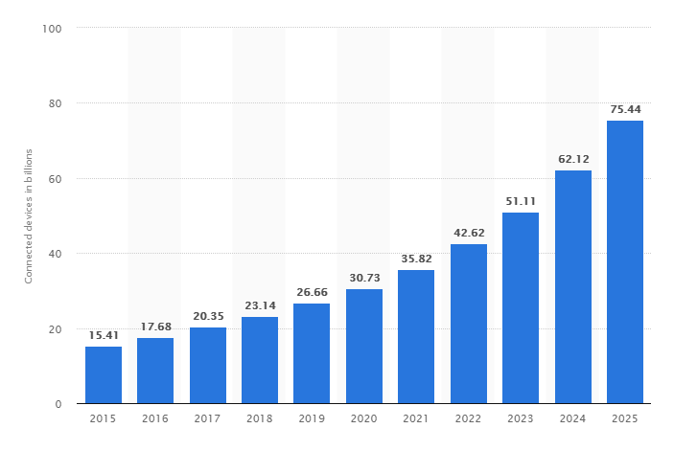
Answer: Over 27 billion
Plenary
Answer:
There are currently just under 8 billion people on the planet. In 2019, the number of connected devices on the internet reached 27 billion! A projected 75 billion will be online by 2025 (statista.com).
Notes:
Ask learners to share their answers to this question. Ask learners if their answer changed over the course of the lesson, and if so, why.
Connections image source: https://pixabay.com/vectors/connection-communication-network-4348764/
Statistics: https://www.statista.com/statistics/471264/iot-number-of-connected-devices-worldwide/

Slide 25
Next lesson
Summary
In this lesson, you…
Defined what a computer network is and explained how data is transmitted between computers across networks.
Defined a protocol and looked at examples of non-networking protocols.
Next lesson, you will…
Look at the hardware necessary for connecting devices to networks.

