Slide 1
Lesson 4: The internet
Year 7 – Internet and Networks
Notes:
Last updated: 08-12-22
Resources are updated regularly — the latest version is available at: ncce.io/tcc.
This resource is licensed under the Open Government Licence, version 3. For more information on this licence, see ncce.io/ogl.

Slide 2
What is the internet?
Starter activity
What is the internet? What can it be used for (give one example)?
In pairs, write your answers on a sticky note.
Notes:
Ask learners what the internet is and what it is used for. Ask learners to work in pairs and put their definitions and examples of use on a sticky note or sheet of paper. Read out a few examples from the class. At this stage, do not give the answer. Learners will be able to review their answers later on in the lesson.
Internet image source: https://pixabay.com/illustrations/network-social-abstract-3139214/

Slide 3
Lesson 4: The internet
Objectives
In this lesson, you will:
Define what the internet is
Explain how data travels between computers across the internet
Describe keywords such as ‘protocols’, ‘packets’, and ‘addressing’

Slide 4
The internet explained
Activity 1
Watch the video:
https://www.youtube.com/watch?v=Dxcc6ycZ73M
Whilst watching, keep thinking about the starter questions.
What is the internet?
What do we use it for?
Notes:
Play this introductory video about the internet (3 minutes, 44 seconds). It explains at a high level how the internet works. Vinton Gray Cerf explains the history of the internet and that no one person is in charge of it. Vinton Gray Cerf is an American internet pioneer and widely known as one of the “fathers of the internet”.
Whilst the video is playing, learners should continue to think about the questions, “What is the internet?” and “What is it used for?”.
Internet image source: https://pixabay.com/illustrations/network-social-abstract-3139214/

Slide 5
The internet explained – Answers
Activity 1
What is the internet?
The internet is a worldwide network of computers.
It is the physical hardware, i.e. the cables, the routers, and other pieces of hardware used to connect devices together.
Any device connected to the internet is part of this network, for example:
Laptops
Games consoles
PCs
Tablets
Mobile phones
Notes:
Give the learners a definition of the internet.

Slide 6
The internet explained – Answers
Activity 1
What do we use it for?
There are many uses of the internet. Below are some of the most common uses:
Storing information (e.g. cloud storage)
Entertainment (e.g. streaming films, videos, and music)
Playing online games
Communication (e.g. email)
Playing online games
Online shopping
Social networking (e.g. Instagram)
Viewing websites
Notes:
Give the learners common examples of what the internet is used for.

Slide 7
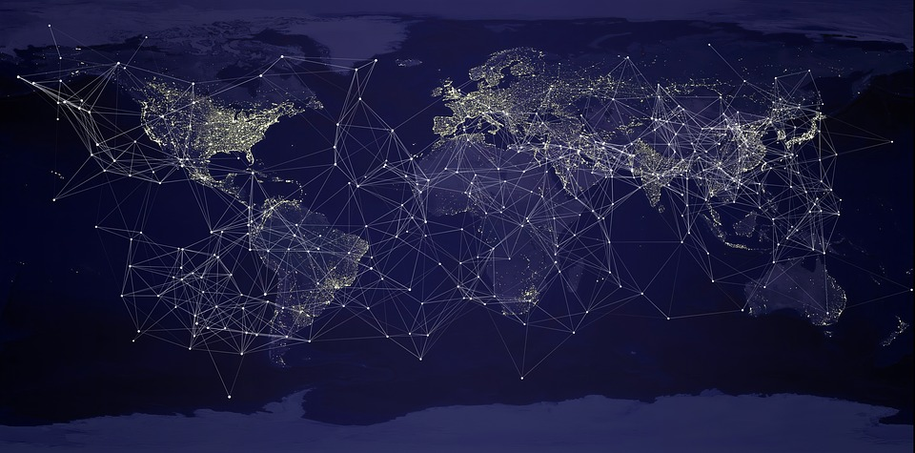
Data transmission across continents
Activity 2
We now know that the internet is a global network of networks.
How are networks in the UK connected to networks in America?
Think, pair, share
Notes:
Learners now know what the internet is, and they understand that it is global. Learners now need to think about how data can transfer from one continent to another. Ask learners to ‘think, pair, share’: “How are networks in the UK connected to networks in America?”.
Image source: https://pixabay.com/illustrations/earth-globalisation-network-3866609/

Slide 8
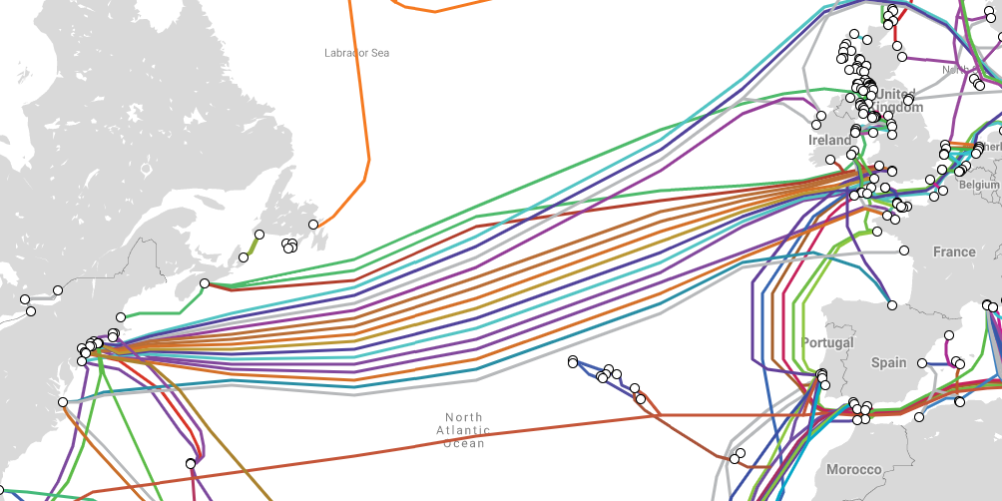
Data transmission across continents
Activity 2
Visit www.submarinecablemap.com
Name 2 countries that are connected by ‘Amitie’. How long is the cable?
Write your answer in the activity worksheet.
Notes:
Some learners may have discussed the use of satellites to connect a network in the UK to a network in America. Satellites are used to connect distant networks in some instances, particularly in remote locations where cables are not present, but it is not the most common way. 99% of internet data passing across continents travels through cables that lie on the seabed. These are faster and cheaper than satellites.
Ask the learners to visit www.submarinecablemap.com. Ask the learners to name two countries that are connected by ‘Amitie’, and how long the cable is. Learners will see the names of cables on the right-hand side of the web page. If they click on ‘Amitie’, it will reveal the answers. Learners should write their answers in the activity worksheet.
Answers: Amitie connects a number of countries together. Valid answers are: UK, France and United States. It is 6,792 km long.

Slide 9
Interesting facts
Activity 2
The first oceanic cable was laid in 1851 to connect telephones
99% of internet data is transmitted through cables under the oceans
Oceanic cables can be damaged by anchors, trawling fishing nets, and even shark bites!
The longest network is 39,000 kilometres
Notes:
Go through the interesting facts related to oceanic internet cables.
Facts taken from: https://www.computerworld.com/article/3412237/10-top-facts-about-google-s-undersea-internet-cable.html
Ocean image source: https://pixabay.com/photos/wave-sea-water-blue-surf-1215449/

Slide 10
A Packet’s Tale
Activity 3
In lesson 1, you learnt that in 2019, there are 27 billion devices connected to the internet.
How does a message from one device find its way to another device?
Watch this video to find out: https://www.youtube.com/watch?v=ewrBalT_eBM
Notes:
In lesson 1, learners found out that there are 27 billion devices connected to the internet. This is more than there are people on the planet. Learners will watch a video called A Packet’s Tale which will explain how messages can be successfully sent from one device to another using packets that travel through cables from sender to receiver and back again to simulate a person viewing a website.

Slide 11
A Packet’s Tale – Summary
Activity 3
Networks send and receive messages in small units of data known as ‘packets’.
A single message may be too large to fit in one packet. It is often split into many packets.
Each packet contains a part of the message, an address of where it came from, and an address of where it is going. These addresses are known as ‘IP addresses’, and they are unique.

Slide 12
IP addresses
Activity 4
An IP address is made up of 4 groups of numbers between 0 and 255, each separated by a full stop.
These are unique for every device on the internet.
Typically, this would be the address of the router that connects to the internet.
Example:
192.168.5.43
Notes:
Explain to the learners what an IP address looks like.

Slide 13
My IP address
Activity 4
Demonstration: What is my IP address?
Notes:
Demonstrate to the learners how to find the IP address of the router that connects your machine to the internet. This will have a unique IP address, as it is part of the internet. Any device outside the school network would need to use this IP address to make contact. To look up the router IP address, you simply need to open Google in a web browser and type into the search bar “what is my ip address”.
Learners could try this at home to see what the IP address of their home router is.

Slide 14
Packets and routers
Activity 5
A router joins networks together across the internet and forwards packets from sender to receiver.
Packets will be sent in the correct order.
There are millions of routers on the internet.
Packets can take different routes on their way to to their destination.
HR
IR 1
IR2
IR3
IR7
IR6
IR5
IR4
HR = Home router
IR = Internet router
HR
Which internet routers will ALL packets pass through? (Hands up)
Notes:
Remind the learners about the role of a router. Explain to them that a router joins networks together across the internet. It is important to emphasise at this stage that there are many different ways of getting from one place to another across the internet, and packets of data making up a single message may take different routes. Use the diagram to help illustrate this. For example, a packet travelling from the home router at the top of the diagram to the home router at the bottom of the diagram may travel through the internet routers 1,2,3,4, or it may travel through internet routers 1,7,3,4.
Packets are sent/passed on to the internet in the correct order, but may travel along different routes until they get to their destination.
Ask the question, “Which internet routers will ALL packets pass through?”
Answer: All packets will pass through internet router 1 and internet router 4. Others internet routers may not all be used, as alternative pathways exist.
Image sources:
House image: https://pixabay.com/vectors/apartment-building-construction-2872754/
House image 2: https://pixabay.com/vectors/home-house-icons-jims-card-1294564/

Slide 15
Packets and routers
Activity 5
Packets can arrive in the wrong order.
If a message were read in the order in which the packets arrived, it may not make sense.
Example: Imagine that a message to be sent from device A to device B across the internet was “hello how are you?”
Notes:
Explain to the learners that whilst packets are sent in the right order, they may arrive in the wrong order, as they may take different routes across the internet before arriving at their destination. Some of these routes are longer or slower than others, so it is quite possible that the packets will be in the wrong order.

Slide 16
Message sent: “hello how are you?”
Activity 5
The packets are split as follows:
Packet 1: “hello”
Packet 2: “how”
Packet 3: “are”
Packet 4: “you?”
Packets are received at their destination as follows:
Packet 1, Packet 3, Packet 4, Packet 2
What would this message be if the packets were read in the order in which they arrived? How might this problem be solved? (Think, pair, share)
Notes:
Answer: hello are you? how
Message icon source: https://pixabay.com/vectors/letters-email-newsletter-write-1132701/

Slide 17
TASK
TASK 1
Open Word
Create a diagram that shows an email going from your IP address in Burton to an IP address in Wall Township, America.
Make sure that you use the correct cable colours and your correct IP address.
An example of what his might look like is on the next slide.
Upload your diagram to TEAMS
Notes:
Answer: hello are you? how
Message icon source: https://pixabay.com/vectors/letters-email-newsletter-write-1132701/

Slide 18
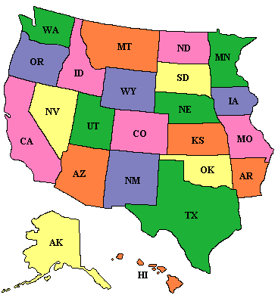
TASK
TASK 1
Cable name:
Apollo
IP address: 192.168.5.43
IP address: 192.143.2.28
Upload your diagram to TEAMS
Notes:
Answer: hello are you? how
Message icon source: https://pixabay.com/vectors/letters-email-newsletter-write-1132701/

