Slide 1
WJEC LEVEL 1/2 VOCATIONAL AWARD ICT (TECHNICAL AWARD)
IT31:
Social engineering
1.3.1 Risks to information held on computers
©SIMPLY TEACH 2023 | www.mysimplyteach.co.uk | info@mysimplyteach.co.uk

Slide 2
WJEC LEVEL 1/2 VOCATIONAL AWARD ICT (TECHNICAL AWARD)
Starter:
What is the biggest threat to a computer network?
The people that use it.
©SIMPLY TEACH 2023 | www.mysimplyteach.co.uk | info@mysimplyteach.co.uk
Notes:
This could be made into a printable worksheet if you prefer.

Slide 3
WJEC LEVEL 1/2 VOCATIONAL AWARD ICT (TECHNICAL AWARD)
Specification point(s):
Social engineering
Lesson objectives:
To know what is meant by social engineering.
To understand how different social engineering techniques work such as: blagging, phishing and shouldering.
To identify ways to prevent becoming a victim of this type of attack.
©SIMPLY TEACH 2023 | www.mysimplyteach.co.uk | info@mysimplyteach.co.uk

Slide 4
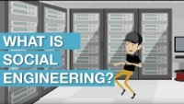
WJEC LEVEL 1/2 VOCATIONAL AWARD ICT (TECHNICAL AWARD)
New information:
What is accidental damage?
Accidental damage refers to unintentional attack on a network and/or computer system. Examples of accidental damage include:
Overwriting a file/folder by mistake.
Leave laptop on a train or another location which means it cannot be recovered.
Natural disasters (e.g. fires/floods etc..)
Unintended disclosure of information because of incorrect user access level settings.
What is malicious damage?
Malicious damage refers to intentional attack on a network and/or computer system. Examples of malicious damage include:
Disgruntled employees who delete data on purpose.
Social engineering.
Discussion
Watch the video and write/come up with a summary on what is meant by social engineering.
©SIMPLY TEACH 2023 | www.mysimplyteach.co.uk | info@mysimplyteach.co.uk
Notes:
This can be made into a printable worksheet.

Slide 5
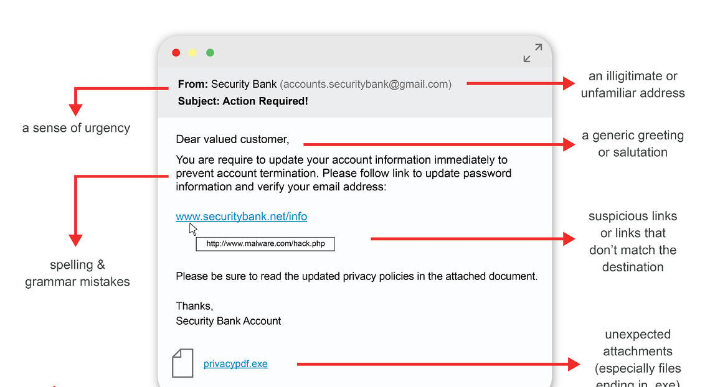
WJEC LEVEL 1/2 VOCATIONAL AWARD ICT (TECHNICAL AWARD)
New information:
Worked example:
What is social engineering?
Social engineering refers to the use of manipulation by an individual or group to trick individuals into disclosing confidential information.
Social engineering techniques:
Blagging - involves the use of deception or false pretences to obtain confidential information or access to restricted areas.
Phishing - a fake email or website that looks legitimate, but is used to steal personal information such as passwords or credit card numbers.
Shouldering - a type of social engineering technique that involves physically standing behind someone or looking over their shoulder in order to gain information.
Baiting – occurs when you are tempted by an offer such as a competition (i.e. win a free holiday)
Discussion
Using the email shown above, identify the indicators that suggest it could be a phishing email.
©SIMPLY TEACH 2023 | www.mysimplyteach.co.uk | info@mysimplyteach.co.uk
Notes:
This can be made into a printable worksheet.

Slide 6
WJEC LEVEL 1/2 VOCATIONAL AWARD ICT (TECHNICAL AWARD)
New information:
Worked example:
What is social engineering?
Social engineering refers to the use of manipulation by an individual or group to trick individuals into disclosing confidential information
Social engineering techniques:
Blagging - a form of social engineering that involves the use of deception or false pretences to obtain confidential information or access to restricted areas.
Phishing - a fake email or website that looks legitimate, but is used to steal personal information such as passwords or credit card numbers.
Shouldering - a type of social engineering technique that involves physically standing behind someone or looking over their shoulder in order to gain information.
Discussion
Using the email shown above, identify the indicators that suggest it could be a phishing email.
©SIMPLY TEACH 2023 | www.mysimplyteach.co.uk | info@mysimplyteach.co.uk

Slide 7
WJEC LEVEL 1/2 VOCATIONAL AWARD ICT (TECHNICAL AWARD)
Main task:
Complete the workbook provided for this lesson. IT31: Social engineering
©SIMPLY TEACH 2023 | www.mysimplyteach.co.uk | info@mysimplyteach.co.uk

