Slide 1
WJEC LEVEL 1/2 VOCATIONAL AWARD ICT (TECHNICAL AWARD)
Unit 1: ICT in Society
Topic: IT11: Smart technology
Name:
Assessment criteria:
Criteria | Emerging | Developing | Secured | Mastered
Smart devices
Wearable technologies
Control systems
Weather forecasting systems
Interim feedback:
Final feedback:
©SIMPLY TEACH 2023 | www.mysimplyteach.co.uk | info@mysimplyteach.co.uk

Slide 2
WJEC LEVEL 1/2 VOCATIONAL AWARD ICT (TECHNICAL AWARD)
Task 1: Wearable technologies
Activity
Using the partially completed mind map below, identify different types of wearable technology.
Smart watch
Wearable technologies
©SIMPLY TEACH 2023 | www.mysimplyteach.co.uk | info@mysimplyteach.co.uk
Notes:
Other answers can be accepted.

Slide 3
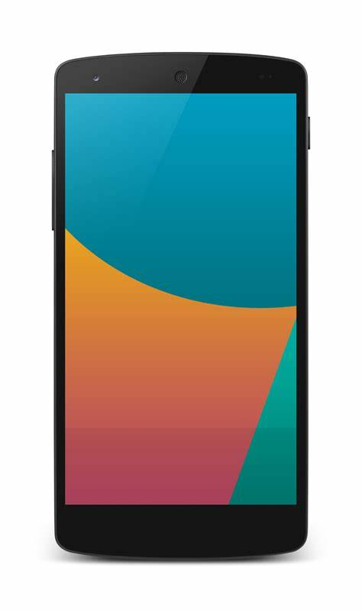
WJEC LEVEL 1/2 VOCATIONAL AWARD ICT (TECHNICAL AWARD)
Task 2: Smartphones
Activity A:
Label around the smartphone to identify all the different features available to a user.
Make calls
Text using SMS
©SIMPLY TEACH 2023 | www.mysimplyteach.co.uk | info@mysimplyteach.co.uk
Notes:
Other answers can be accepted.

Slide 4
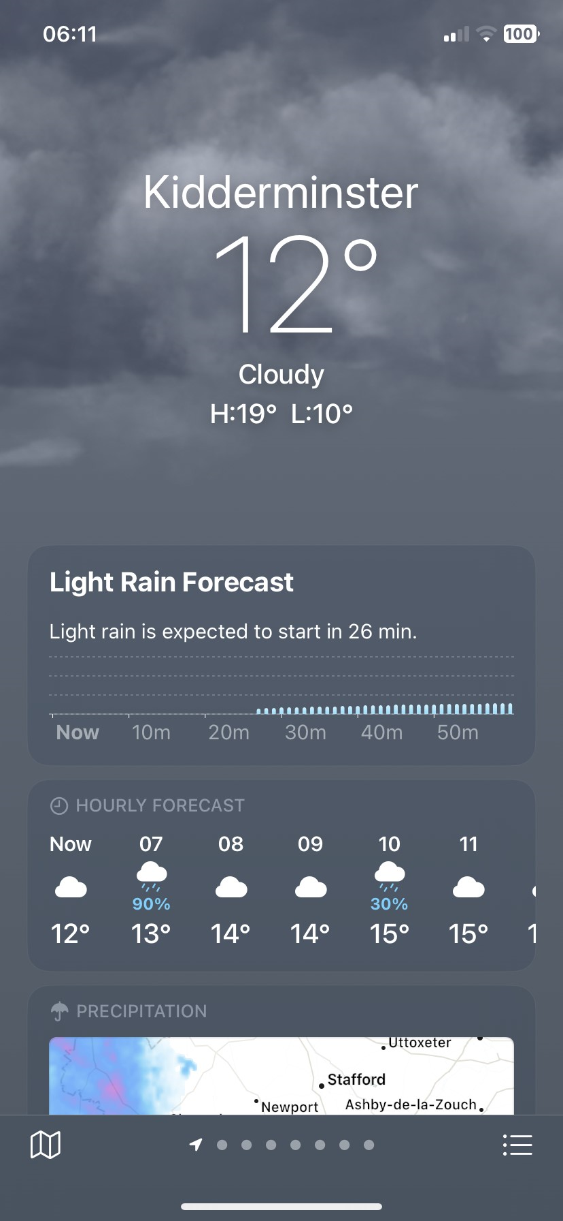
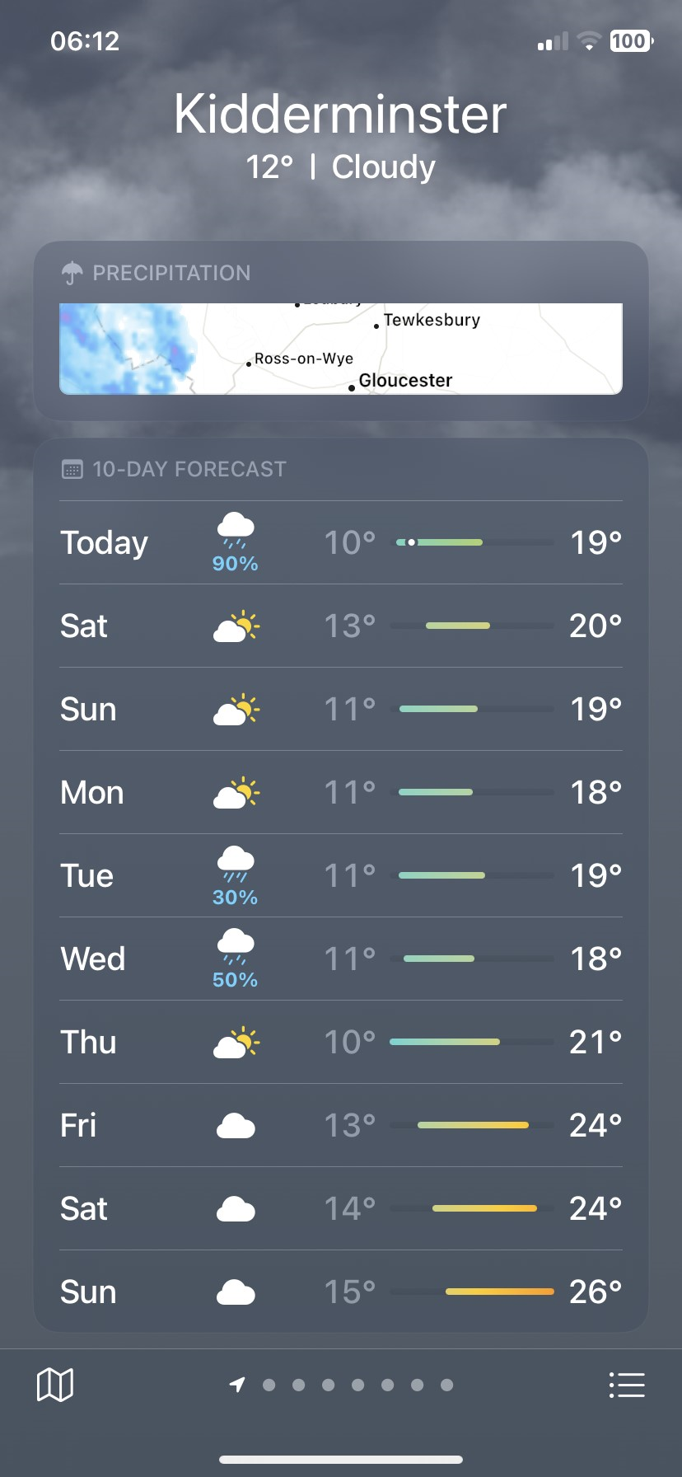
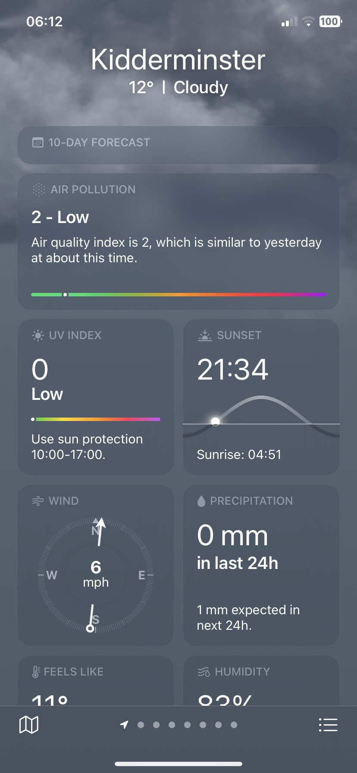
WJEC LEVEL 1/2 VOCATIONAL AWARD ICT (TECHNICAL AWARD)
Task 3: Weather forecasting app
Activity A:
Using the screenshots provided, list as many features you can see on this weather forecasting app.
Temperature
©SIMPLY TEACH 2023 | www.mysimplyteach.co.uk | info@mysimplyteach.co.uk
Notes:
Other answers can be accepted.

Slide 5
WJEC LEVEL 1/2 VOCATIONAL AWARD ICT (TECHNICAL AWARD)
Task 4: Control systems
Activity
Using the partially completed mind map below, identify different types of smart control systems.
Smart meter
Control systems
©SIMPLY TEACH 2023 | www.mysimplyteach.co.uk | info@mysimplyteach.co.uk
Notes:
Other answers can be accepted.

Slide 6
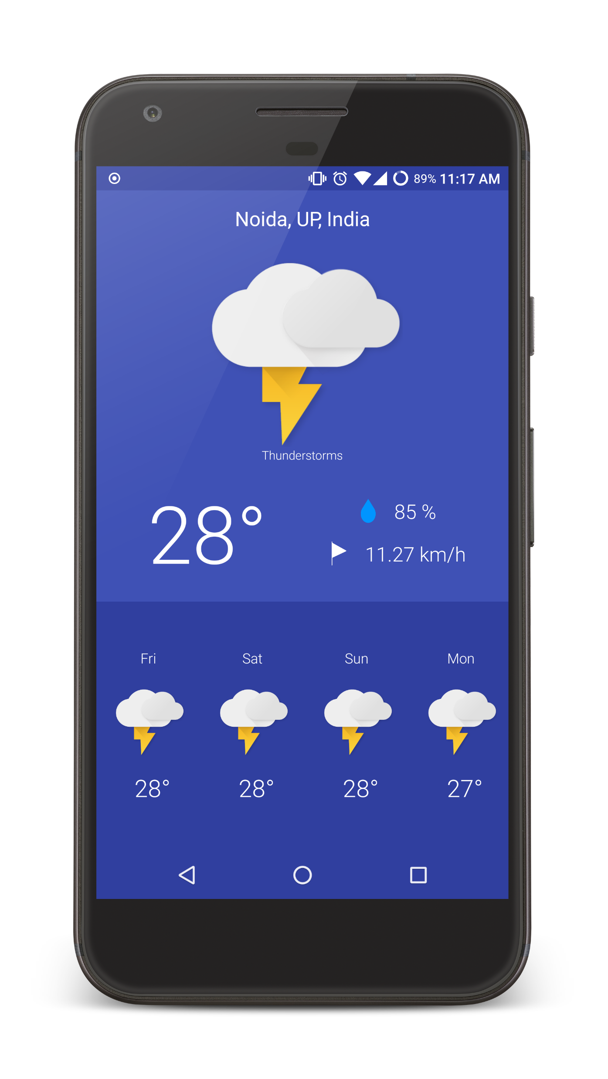
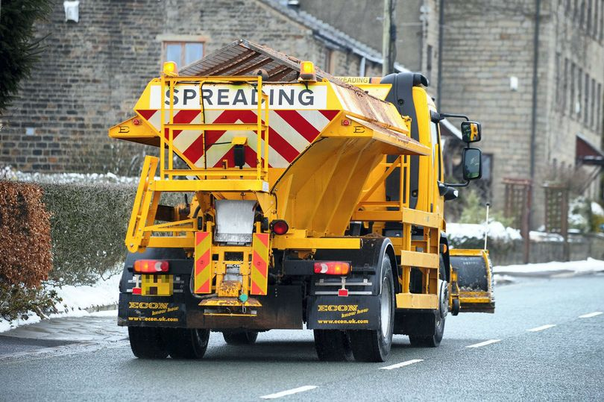
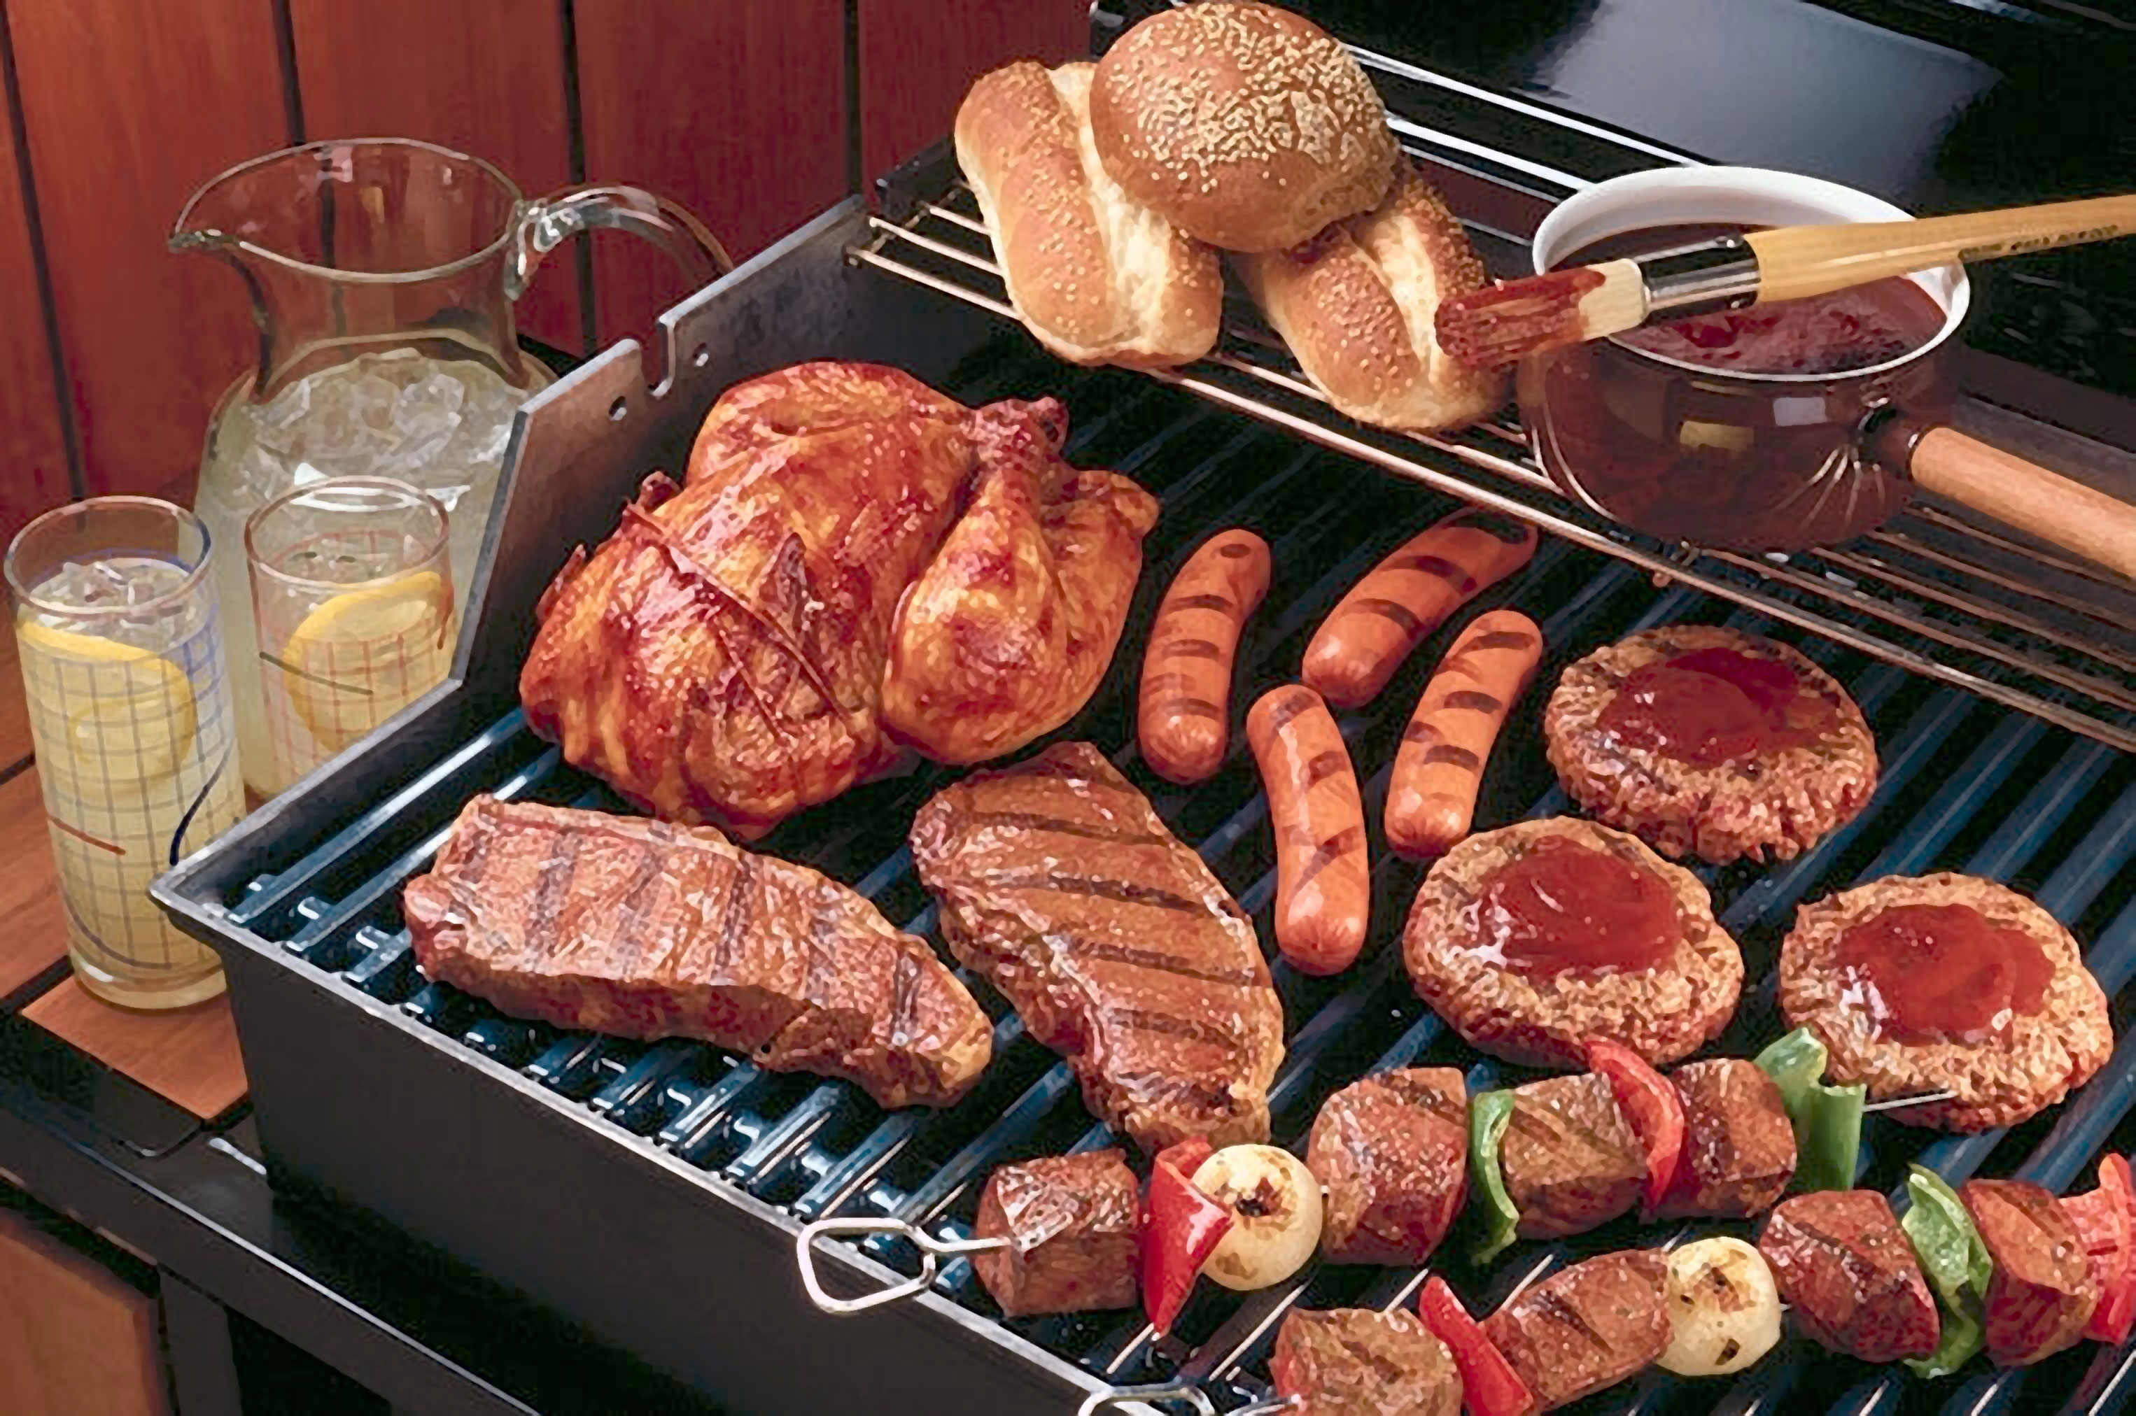
WJEC LEVEL 1/2 VOCATIONAL AWARD ICT (TECHNICAL AWARD)
Task 5: Weather forecasting app
Activity A:
What is meant by a weather forecast?
Activity B:
The use of ICT has enabled users to access extended weather forecasts – for how many days can users check the weather?
Activity C:
Using the picture clues provided (left), list three reasons why users may check the weather on their smartphone.
©SIMPLY TEACH 2023 | www.mysimplyteach.co.uk | info@mysimplyteach.co.uk

Slide 7
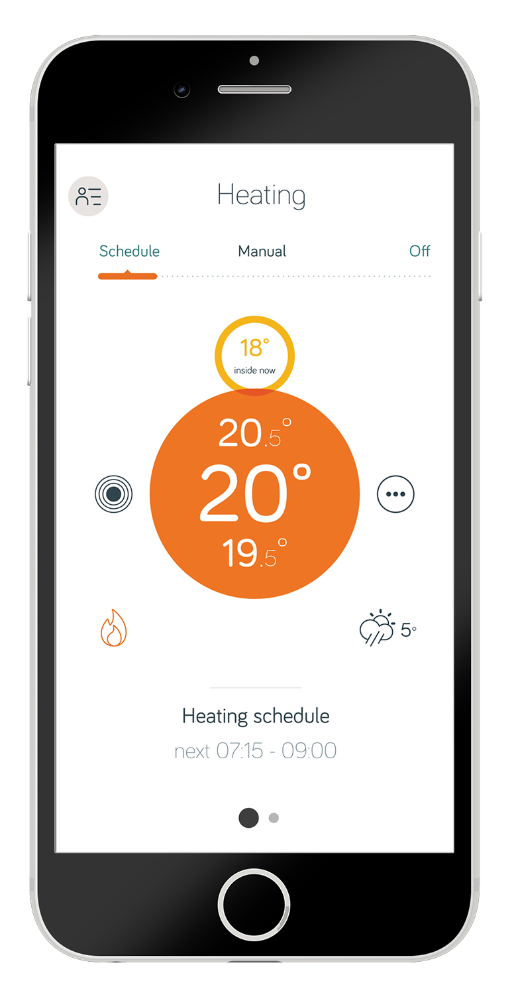
WJEC LEVEL 1/2 VOCATIONAL AWARD ICT (TECHNICAL AWARD)
Task 6: Control systems
Activity A:
Using the boxes provided, identify how each control system can be controlled by an app on your mobile phone.
Thermostat
Lighting
Cooking appliances
Motion activated security cameras.
©SIMPLY TEACH 2023 | www.mysimplyteach.co.uk | info@mysimplyteach.co.uk

Slide 8
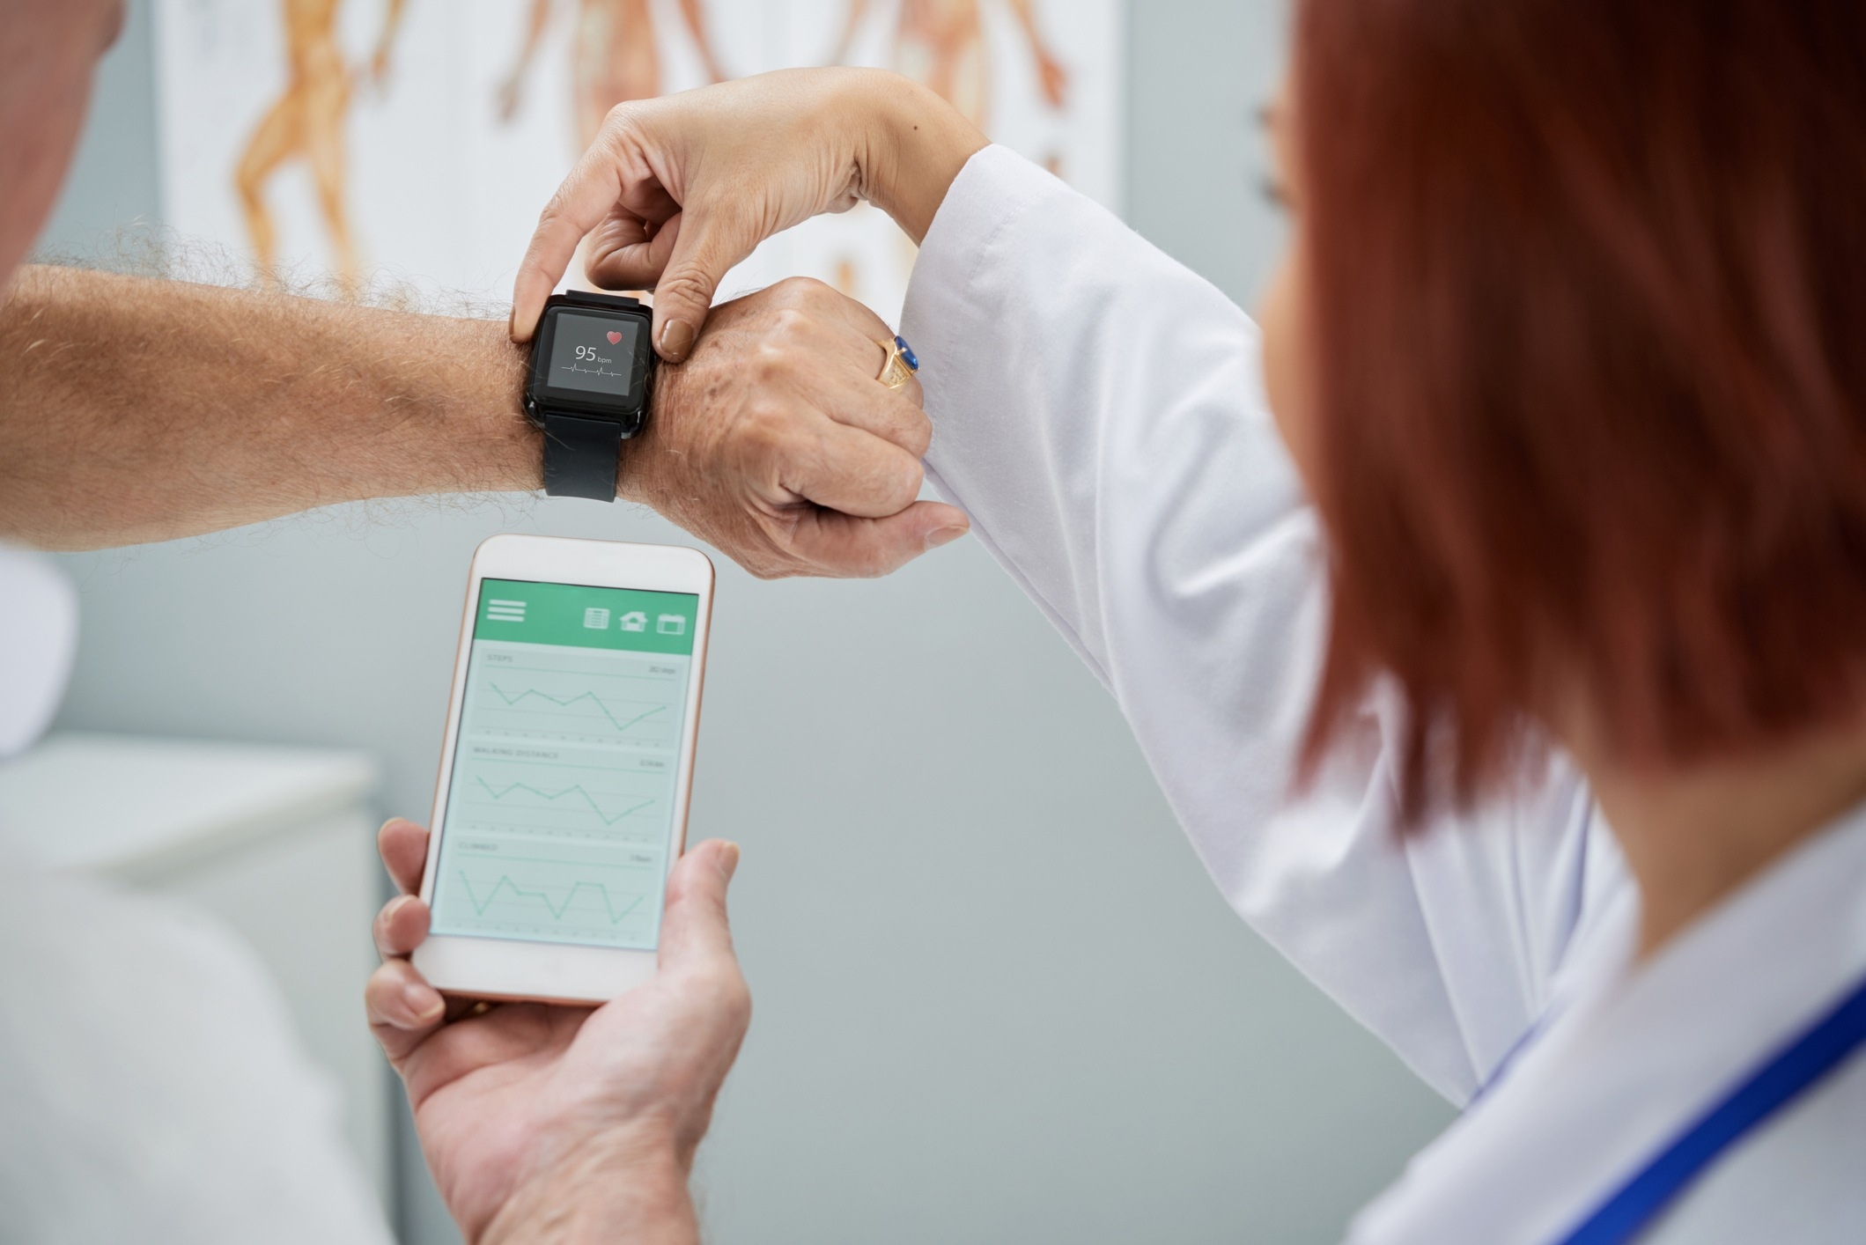
WJEC LEVEL 1/2 VOCATIONAL AWARD ICT (TECHNICAL AWARD)
Task 7: Wearable technologies
Activity A
Identify three benefits to using wearable technology.
Activity B
List three ways wearable technology can be used in the healthcare industry.
​
©SIMPLY TEACH 2023 | www.mysimplyteach.co.uk | info@mysimplyteach.co.uk

Slide 9
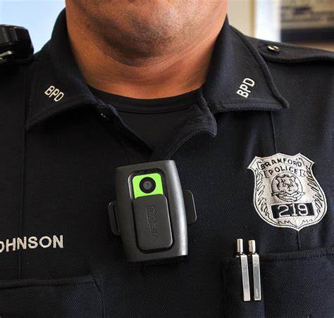
WJEC LEVEL 1/2 VOCATIONAL AWARD ICT (TECHNICAL AWARD)
Task 8: Wearable technologies
Introduction
Police officers have started to wear body cameras while on duty.
Activity
Using the table of keywords below, identify the benefits to the police using wearable body cameras. The first one has been done for you as an example.
Collecting evidence | Body camera footage serves as valuable evidence in criminal investigations with an unbiased sequence of events.
Documentation
Training
Complaints
Safety
©SIMPLY TEACH 2023 | www.mysimplyteach.co.uk | info@mysimplyteach.co.uk

Slide 10
WJEC LEVEL 1/2 VOCATIONAL AWARD ICT (TECHNICAL AWARD)
Task 9: Exam focus
Command word alert!
Identify: Recognise, distinguish and establish what something is
Exam-style question
David has fitted a new parking sensor at the car park of the company he owns. It monitors who enters and exits the car park.
Identify three reasons why this parking sensor might benefit David and his business. (3 marks)
Key points | Response
Guidance Security Traffic Authorisation
©SIMPLY TEACH 2023 | www.mysimplyteach.co.uk | info@mysimplyteach.co.uk

