Slide 1
WJEC LEVEL 1/2 VOCATIONAL AWARD ICT (TECHNICAL AWARD)
IT24:
Networks
1.2.3 How data transfers over different types of network
©SIMPLY TEACH 2023 | www.mysimplyteach.co.uk | info@mysimplyteach.co.uk

Slide 2
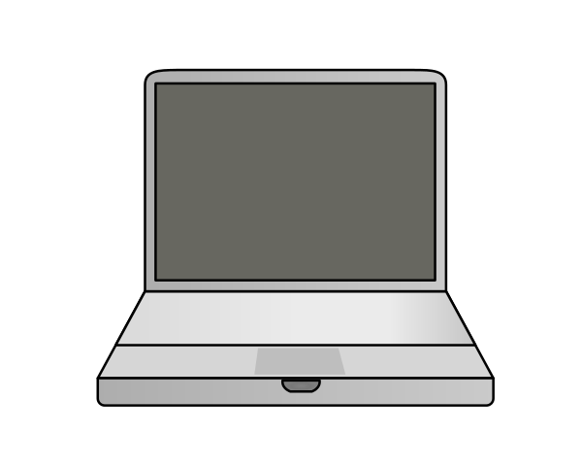
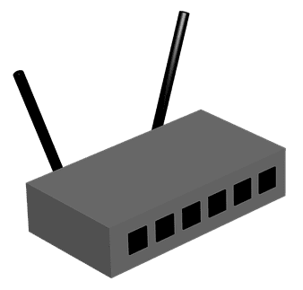
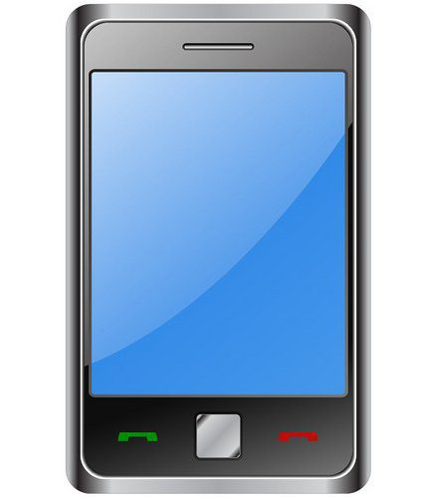
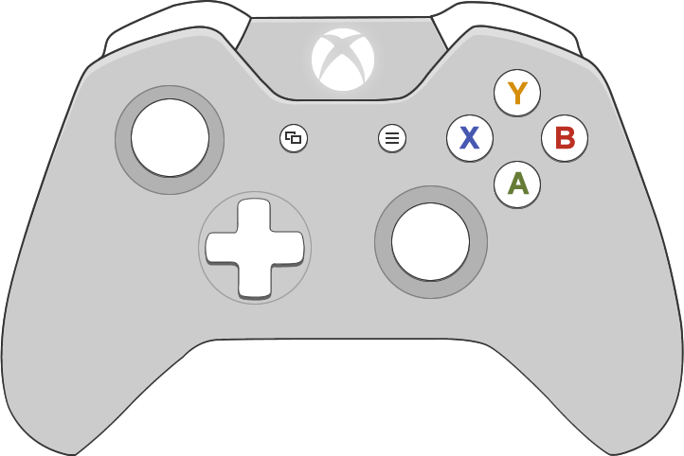
WJEC LEVEL 1/2 VOCATIONAL AWARD ICT (TECHNICAL AWARD)
Starter:
Use the images provided to create what you think a network looks like.
All the images have been labelled.
Laptop
Router
Smartphone
Games console
Smart watch
Laptop
©SIMPLY TEACH 2023 | www.mysimplyteach.co.uk | info@mysimplyteach.co.uk
Notes:
This can be made into a printable starter activity.

Slide 3
WJEC LEVEL 1/2 VOCATIONAL AWARD ICT (TECHNICAL AWARD)
Starter:
Use the images provided to create what you think a network looks like.
All the images have been labelled.
©SIMPLY TEACH 2023 | www.mysimplyteach.co.uk | info@mysimplyteach.co.uk
Notes:
This can be made into a printable starter activity.

Slide 4
WJEC LEVEL 1/2 VOCATIONAL AWARD ICT (TECHNICAL AWARD)
Specification point(s):
The differences between local (LAN) and wide area (WAN) networks
Lesson objectives:
To identify the characteristics associated with a LAN and a WAN.
To identify the characteristics associated with a client-server and a peer-to-peer network.
To identify a range of factors that can have an impact on the performance of a network.
©SIMPLY TEACH 2023 | www.mysimplyteach.co.uk | info@mysimplyteach.co.uk

Slide 5
WJEC LEVEL 1/2 VOCATIONAL AWARD ICT (TECHNICAL AWARD)
New information:
What is a network?
A network is a group of interconnected devices that share an internet connection.
Advantages of using a networked computer.
Users can:
share folders and files.
share peripherals (i.e. printer)
log onto any machine that is connected to the school network.
save files and then open them up on another machine.
retrieve data as it’s backed up on the server.
What is a stand-alone computer?
A stand-alone computer is a device that is not connected to a network.
Discussion
What are the advantages to using a networked computer?
©SIMPLY TEACH 2023 | www.mysimplyteach.co.uk | info@mysimplyteach.co.uk

Slide 6
WJEC LEVEL 1/2 VOCATIONAL AWARD ICT (TECHNICAL AWARD)
New information:
Network types
Networks can be defined by their geographical coverage. Some networks are larger in scale than others. Two examples are LAN and WAN.
LAN
WAN
What does it stand for?
Local Area Network
What does it stand for?
Wide Area Network
How does it work?
It’s a network that covers a small geographical area.
How does it work?
It’s a network that covers a large geographical area.
Discussion
What type of network would be used in the following situations:
Home network
School network
Nationwide bank
Internet
Infrastructure
It uses network hardware and cables owned by the individual/organisation
Infrastructure
It uses additional transmission media owned by other companies such as telephone lines.
Who uses a LAN?
Schools, homes and any business that works in a small building or site.
Who uses a WAN?
It can be a collection of different LAN’s. The best example is the Internet.
©SIMPLY TEACH 2023 | www.mysimplyteach.co.uk | info@mysimplyteach.co.uk

Slide 7
WJEC LEVEL 1/2 VOCATIONAL AWARD ICT (TECHNICAL AWARD)
New information:
Network models
Different types of networks will also use different models that determine who responsible for the resources used over a network. Two common examples are: client-server and peer-to-peer network.
Client-server
Peer-to-peer
Where are files stored?
In a centralised location such as the server.
Where are the file stored?
It’s decentralised. Stored on the individuals computer.
Backing up data
All data is backed up in a centralised location. (i.e. a server)
Backing up data
Peer-to-peer may need to perform their own backups.
Discussion
How would each model operate differently when storing, backing up, installing and updating data?
What is the purpose of a file server and a web server?
Updates/Installation
Upgrades can be done centrally and not on individual computers.
Updates/Installation
Upgrades would need to be performed on each computer.
Hardware
File servers to store/retrieve files.
Web servers to access the world wide web.
Hardware
Router to connect to the network and access the internet,
©SIMPLY TEACH 2023 | www.mysimplyteach.co.uk | info@mysimplyteach.co.uk

Slide 8
WJEC LEVEL 1/2 VOCATIONAL AWARD ICT (TECHNICAL AWARD)
New information:
Discussion
With the person next to you or on your own, write down a list of reasons why the performance of a network may be affected.
Factors that affect network performance
Number of users using the network. It uses more bandwidth.
Distance from the router.
Interference from physical objects.
Choice of transmission cable (e.g. fibre optic)
Streaming videos in HD.
The use of a VPN (Virtual Private Network)
Wi-Fi frequency may need to be changed.
©SIMPLY TEACH 2023 | www.mysimplyteach.co.uk | info@mysimplyteach.co.uk

Slide 9
WJEC LEVEL 1/2 VOCATIONAL AWARD ICT (TECHNICAL AWARD)
Main task:
Complete the workbook provided for this lesson. IT24: Networks
©SIMPLY TEACH 2023 | www.mysimplyteach.co.uk | info@mysimplyteach.co.uk

